Slide 1


Welcome to the Online Session
My name is Sally Levengood-we will start right at 6:00.
If you want to test your microphone you can push the talk button to the left and try to talk. Be sure to push it again when you are done. Only one person can talk at a time.
You can also try the audio wizard-
The little microphone at the top…

Slide 2
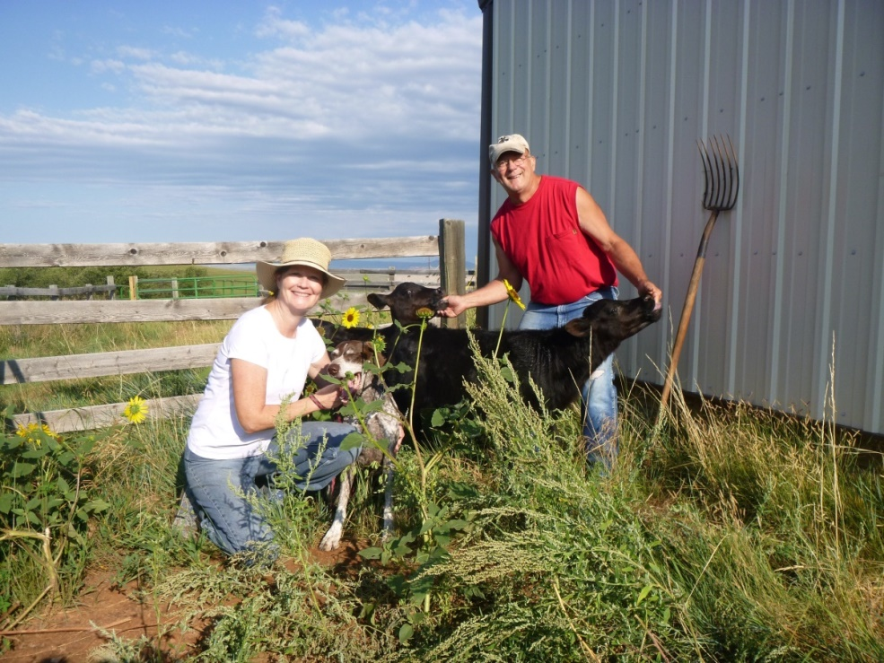
Getting to know you!
I am an RN, BSN with many years experience in nursing homes and with teaching nursing assistants. I lived in Fairbanks 30+ years and now I live in South Dakota. I am looking forward to working with you!

Slide 3
Who are YOU?
YOU MUST PUT THE MIC DOWN before anyone else can talk.
Practice using the microphone.
Tell us your NAME
Where you LIVE
WHY you are taking the class
What are you excited to learn
Do you have family? Do you work? What is your favorite food?
Did you take the ACCUPLACER? OR ENG 111?

Slide 4
Blackboard Collaborate
-the online sessions
Online is mandatory = 5% of your grade
You need a working microphone AND speakers to get full credit for attendance. Be on time!
You can type a message in the chat room if you cannot speak.
Raise or lower your hand, type, yell-whatever makes me stop

Slide 5
A little more Online Business
Use the Leave the Room signal if you go-participation determines your grade
You may be asked to vote or answer with a raised hand-smiley face works too
Please find a quiet room and ask not to be disturbed during class…BE ON TIME
I cannot help you with tech issues DURING class-make a date to work with me before class.
You will need your book every time

Slide 6
Blackboard Tour
BLACKBOARD-Who is getting email announcements? Only your UA email is used.
Calendar or Schedule Updates
Each chapter has tools and help-power points
EVERY chapter has an assignment-no late assignments are accepted.
Quiz comes up in the Module/New Module opens at noon on the quiz date

Slide 7
Getting Started-Being Successful
First assignments are due by midnight on Jan 20th.
Read the chapter, do the workbook first
Start your work early-some chapters are VERY long. NO late assignments are accepted, assignments must be complete by midnight.
Assignments are 15% of your grade.-Graded on completion not correct answers.
After the assignment is graded, you can see what you missed-follow the instructions on checking your grades under Assignments and Grades

Slide 8
Grades, Syllabus, Schedule
60% is quiz grades, 15% assignments, 10% skills lab, 10% clinicals, and 5% online sessions
Syllabus has GREAT information on dress code, vaccinations required, policies…READ IT
Schedule is subject to change-it appears in a file as well as on your calendar.
GET STARTED on shot records and TB tests!

Slide 9

What does it mean to participate?
What was new to you?
What would it feel like to be the patient?
How will it be different when you actually provide care than it is in the book?
Answer Questions – have your book handy!
Getting Help:
Your campus IT department or UAF IT help-450-8300
Email or call an instructor
Check with another student

Slide 10

Chapter 1
Key terms and abbreviations
Where do C.N.A.’s work?
“Skilled” care page 3
Who makes up the Health Team?
CNA—LPN—RN—BSN—ANP
Stantdards: Licensure,
Certification,
Accreditation

Slide 11

Chapter 3
NURSE PRACTICE ACT-STATE regulation that protects the public and regulates nursing practice (recertify in every state)
OBRA-Federal Law – sets the minimum training for nursing assistant, requires a registry by the state, oversees resident care
Your tasks are determined by 1) your state regulations, 2) your job description, 3)your education and training, 4) supervision

Slide 12
Chapter 2 Resident Rights
OBRA provided legislation protecting resident rights.
What is the difference between a hospital and a nursing home? Patients vs Residents
Information, Refuse treatment, Privacy
Ombudsman

Slide 13
NEXT online Session 2/2/16
First Assignments Due 1/20/16
WATCH your UA Emails
Sally Levengood slevengo@alaska.edu
605-642-2329
Cathy Winfree cmwinfree@alaska.edu
907-455-2876

Slide 14
This work is licensed under a Creative Commons Attribution 4.0 International License.
This workforce product was funded by a grant awarded by the U.S. Department of Labor’s Employment and Training Administration. The product was created by the grantee and does not necessarily reflect the official position of the U.S. Department of Labor. The U.S. Department of Labor makes no guarantees, warranties, or assurances of any kind, express or implied, with respect to such information, including any information on linked sites and including, but not limited to, accuracy of the information or its completeness, timeliness, usefulness, adequacy, continued availability, or ownership. UAF HEART is an equal opportunity employer/program and auxiliary aids and services are available upon request to individuals with disabilities. This project received $2.5 million (27% of its total cost) from a grant awarded under the TAACCCT grants, as implemented by the U.S. Department of Labor’s Employment and Training Administration.

