Slide 1
PTRT 2432
Artificial Lift
Green Book Chapter 1
Planning an Artificial Lift Program

Slide 2
Objectives
Explain principle of artificial lift
List the factors to be considered in designing a program
Explain the relationship between reservoir engineers and operating personnel in assessing and predicting reservoir performance
Explain how inflow capability is evaluated (PI and IPR methods)
Explain how outflow is related to getting the desired rate of production
Realize the importance of minimizing downtime and lost production in obtaining economic gain from a well

Slide 3
Principle of Artificial Lift
Over time reservoir pressures decline
Artificial lift is a means of furnishing the power necessary to bring oil or gas to the surface in the absence of sufficient reservoir pressure
80% of wells in the US are on some type of artificial lift. Of those:
  10% use gas lift
  85% use sucker rod pumping
  5% all other methods

Slide 4
Design Considerations
Reservoir characteristics
  Porosity
  Permeability
  Presence of sand
  Fluid saturation
  Formation pressure and temperature
Reservoir drive
  Water drive
  Solution-gas drive
  Gas cap
  Combination
Properties of the oil, water and gas
  Density
  Viscosity
  Paraffin content
  Shrinkage
  Scaling tendancies
  corrosiveness

Slide 5
Design Considerations
Inflow and Outflow characteristics
  PI
  Gas-to-liquid ratio
  Water cut
  Physical dimensions – diameter and depth
Well completion data
  Reservoir depth and thickness
  Type of completion
  Completion interval
  Casing and tubing size
  Hole deviation
Available power
  High-pressure gas-lift gas
  Fuel gas
  electricity

Slide 6
Reservoir Performance
Drive mechanism determines how the productivity and character of the fluids can be expected to change during the life of the well
Expected recoverability of fluids
  Solution-gas drive = 5 – 30%
  Gas-cap drive = 20 – 40 %
  Water drive = 35 – 80%
Engineers provide predictions to the operating personnel based on available data AND update periodically based upon production data and periodic well tests
Both need to work together for maximum recovery
  Operator can’t make “blind” changes
  Engineer can’t predict without field data

Slide 7
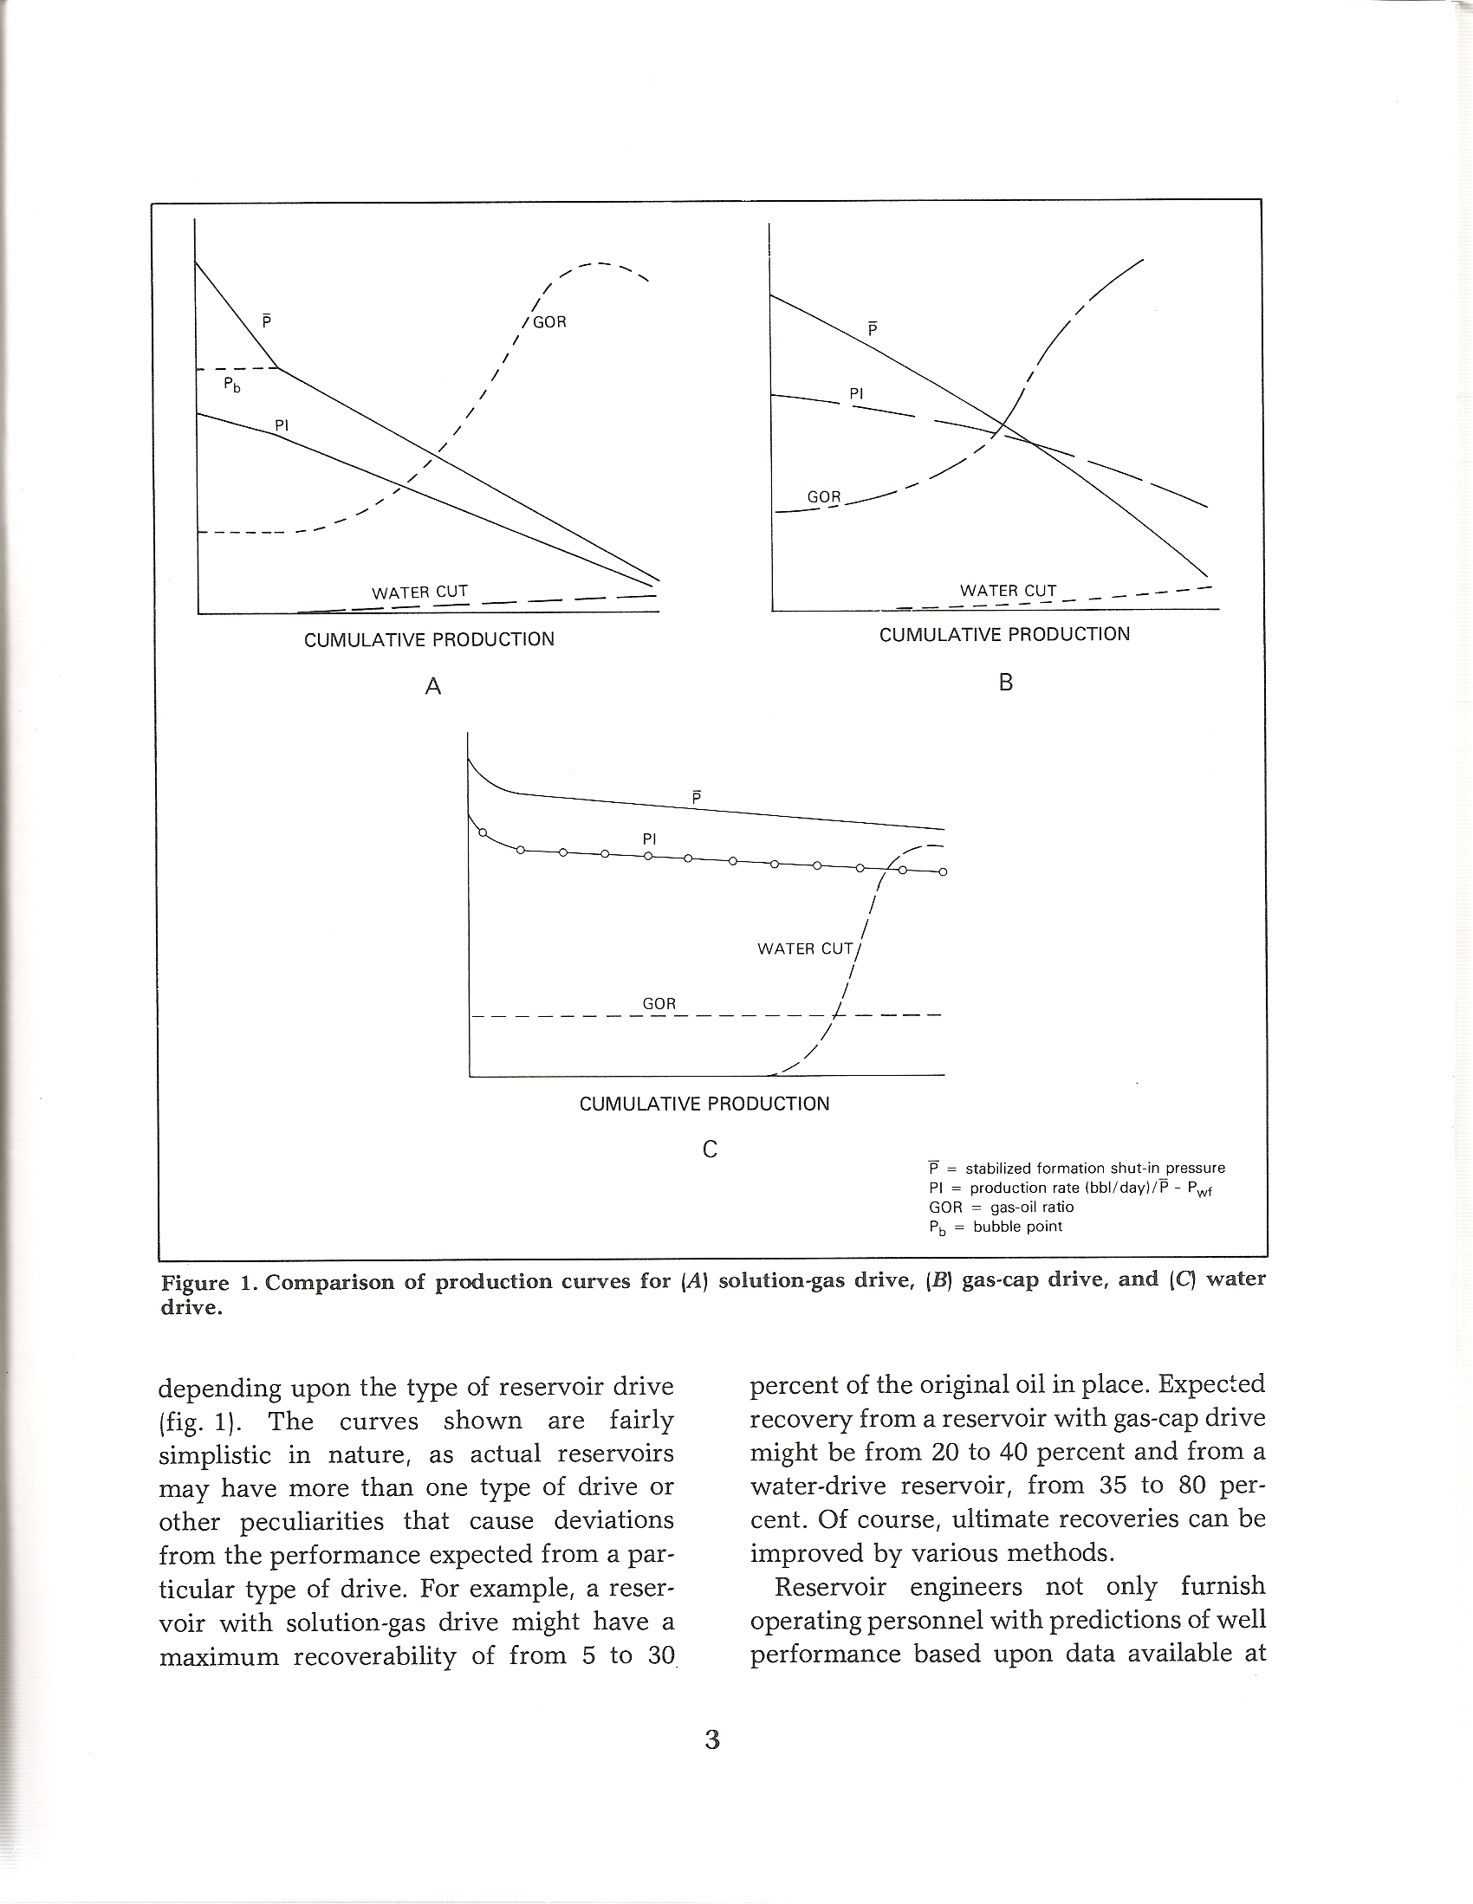
Reservoir Drive Mechanisms
Solution-gas drive
Gas cap drive
Water drive
Solution-gas drive
Gas cap drive

Slide 8
Well Inflow Characteristics
One of the most important
  Nothing can be produced is nothing can flow into the wellbore
  Reservoir and fluid characteristics are key
Assuming no complications or restrictions then single-phase flow (liquid only)
  Proportional to difference between shut in pressure (P) and the well bore pressure (P_{wf}) (drawdown)

Slide 9
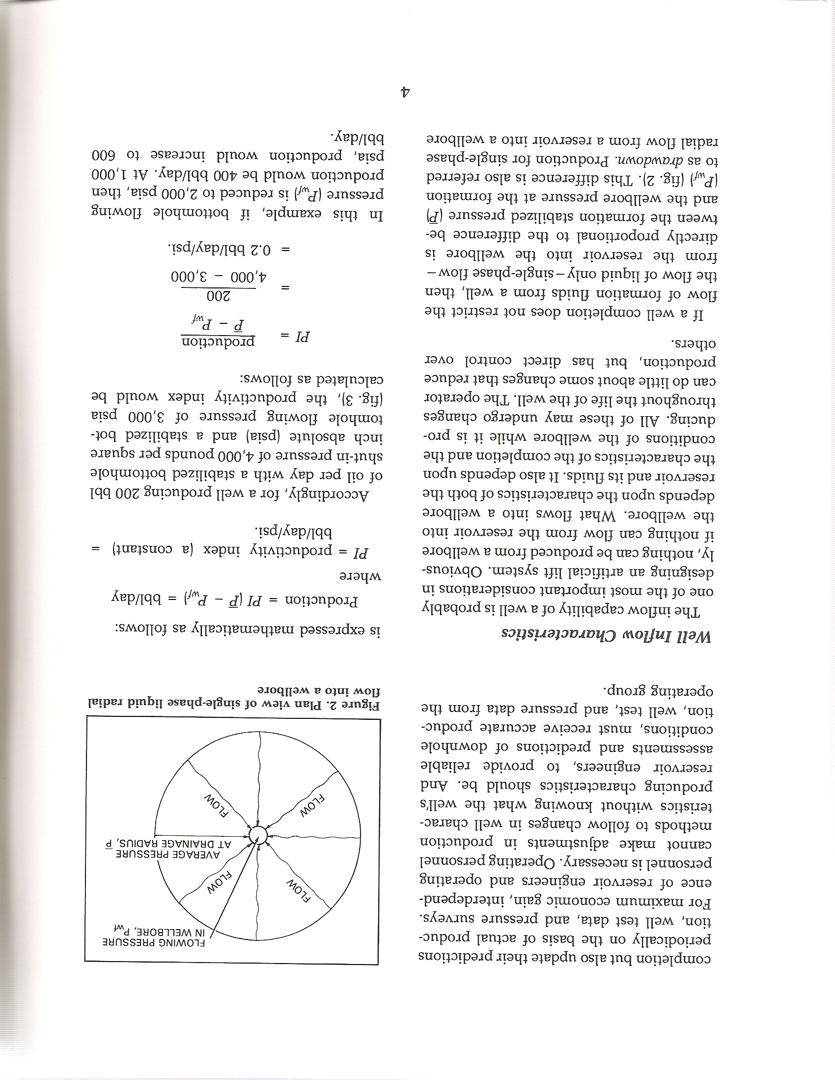
For well producing 200 bbl/day and
BHP = 4000 psia
P_{wf} = 3000 psia
This PI good for the life of the well

Slide 10
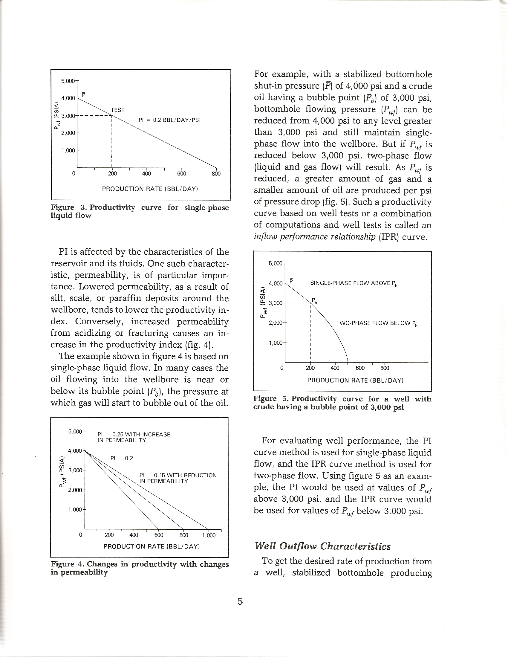
Effect of permeability

Slide 11
Effect of two-phase flow
PI = 0.2 as before
Called IPR (Inflow Performance Relationship)

Slide 12
Well Outflow Characteristics
To achieve desired rate of production
  Flowing BHP (P_{wf}) must be reduced to the level require by the inflow characteristics
  P_{wf} is limited by the outflow characteristics of the well
Outflow refers to the flow system between the bottom of the well and the stock tanks
In the simplest system (rarely true)
  Single phase liquid throughout
  Depends on
    hydrostatic pressure
    Friction losses
    Backpressure from separator

Slide 13
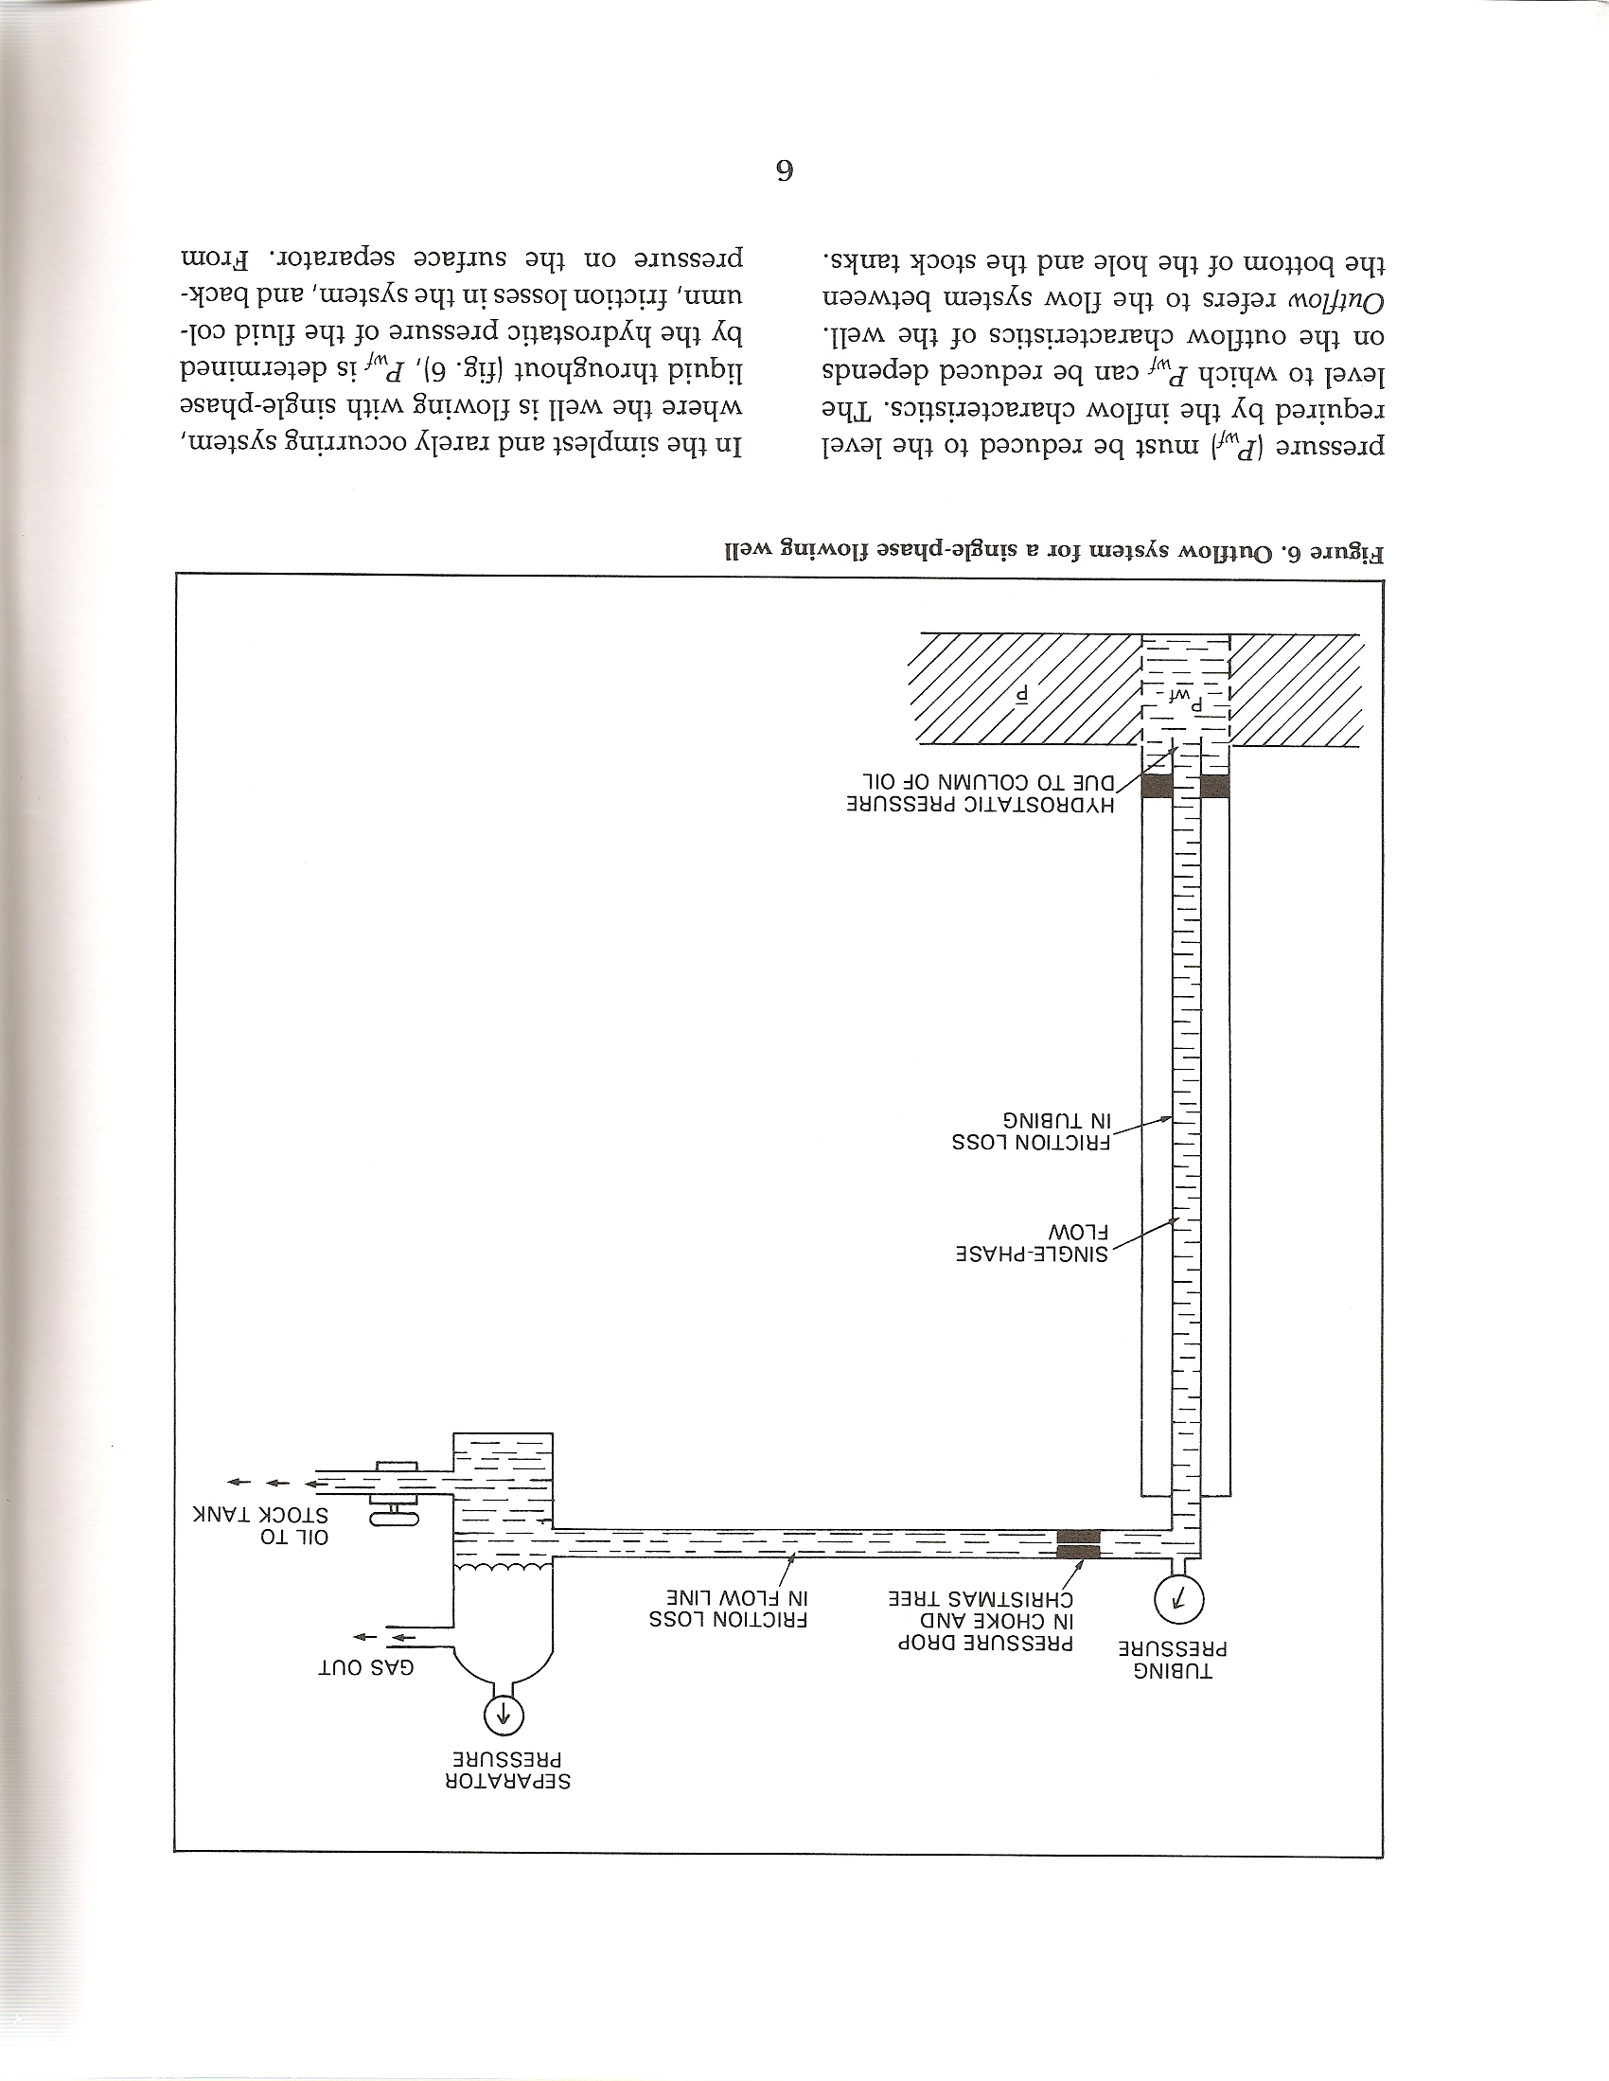
Simplest System

Slide 14
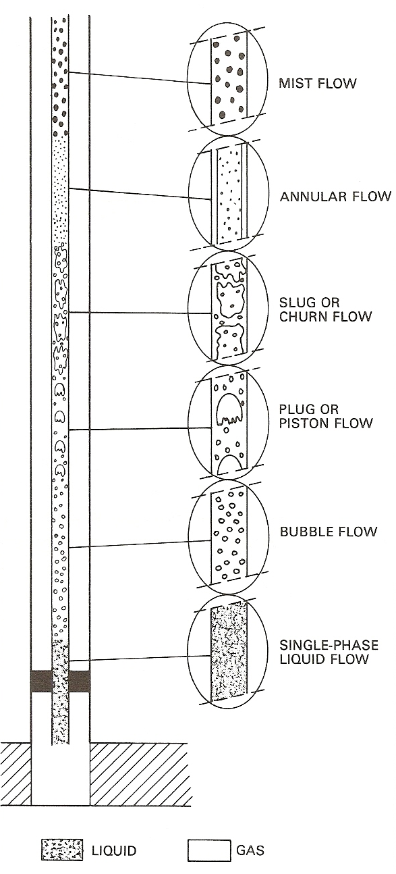
Typical flow up the well

Slide 15
Typical flow
Use IPR and PI to match the characteristics of the outflow system
  Producing capacity increases with drawdown BUT
  Capacity of pumping unit decreases with depth
The point where the two curves intersect is the optimum depth to set the pumping unit

Slide 16
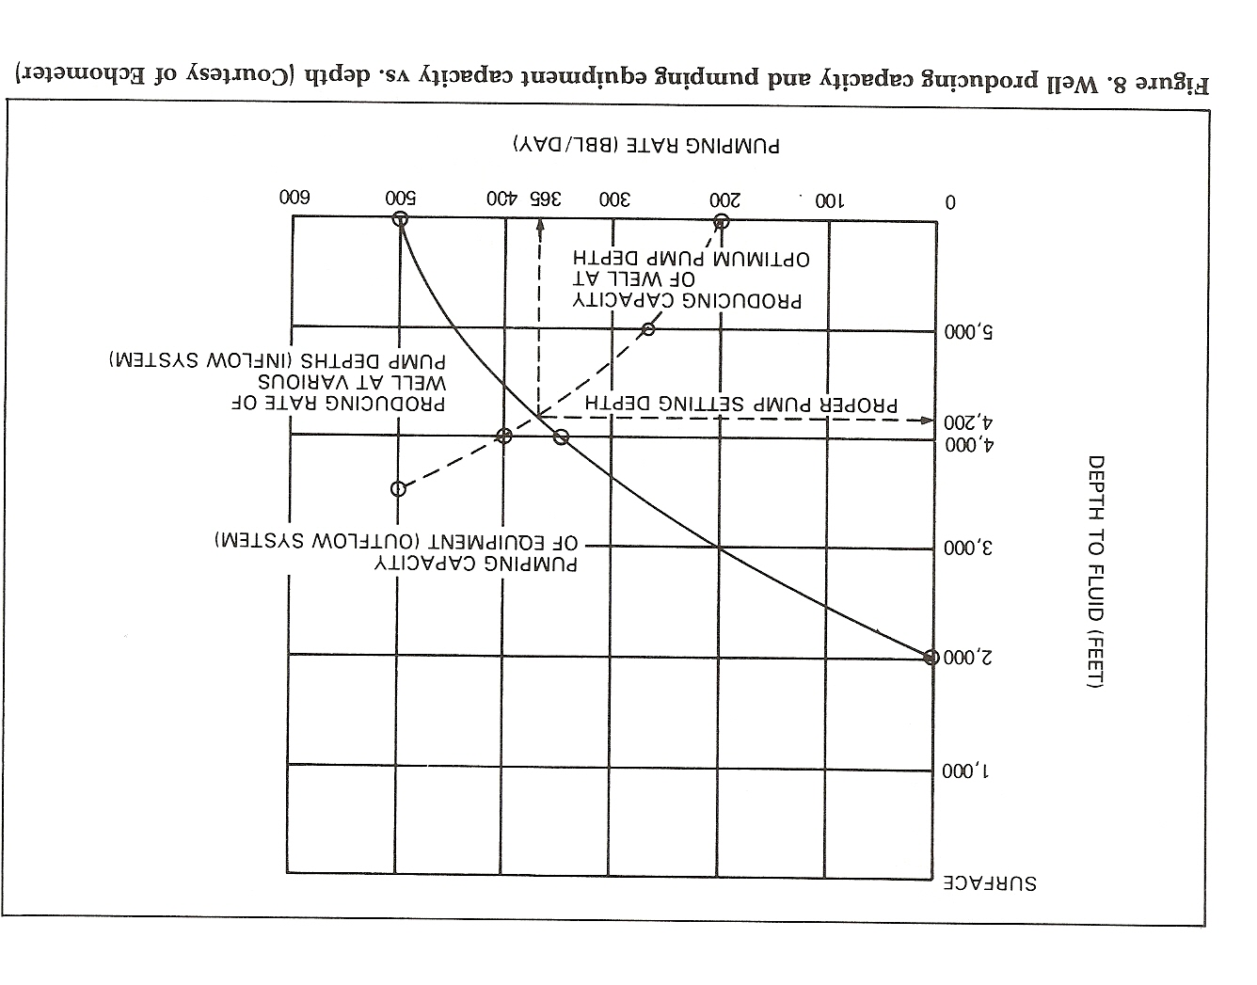
Optimum Depth Estimate

