Slide 1

Reproductive System
CNA 2 OSBN Curriculum
http://www.medcomrn.com/dev/flash/flvplayer/movie.php?movie=http://ss1.medcomrn.com/flv/78720r_sec01_300k.flv&title=&detectflash=false&detectflash=false
Notes:
Caution that the topics and verbage may embarrass stds

Slide 2
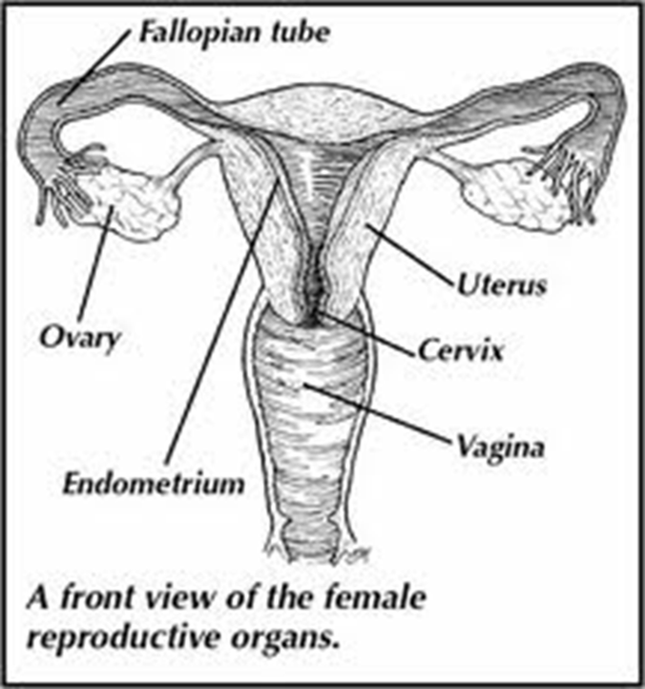
Female Reproductive System
Sexual Function
Supporting Fetus
Vagina
Cervix
Ovaries
Fallopian Tubes
Uterus
Breasts
Menstrual Cycle
Menopause
http://www.medcomrn.com/dev/flash/flvplayer/movie.php?movie=http://ss1.medcomrn.com/flv/78720r_sec03_300k.flv&title=&detectflash=false&detectflash=false
Notes:
Female Reproductive System
􀂃 Involved in sexual function
􀂃 Responsible for nourishing and supporting a fetus as it develops
• Ovaries
􀂃 Stores eggs (ova, ovum) usually one matures each month and is released (ovulation)
􀂃 Produces hormones estrogen and progesterone-necessary for growth, development and function
• Fallopian tubes
􀂃 Carry eggs to uterus
􀂃 Fertilization takes place as egg moves through tube
• Uterus
􀂃 Hollow, pear-shaped, muscular organ
􀂃 If egg fertilized, the embryo implants in the lining where it grows into a baby
􀂃 Enlarges for growth of fetus or rids self of partial lining each month (menses)
• Cervix
􀂃 Narrow canal where uterus and vagina meet
• Vagina
􀂃 Pathway that connects the uterus with the outside of the body
􀂃 Intercourse and birth canal
• Breasts
􀂃 Glandular, ductal tissue, fibrous and fatty tissue
􀂃 Secrete milk after childbirth
• Perineum-inner and outer labia, introitus (opening to vagina), urethra and rectum
• Menstrual cycle-approx every 28 days
􀂃 Release of one ovum
􀂃 Uterus lining builds up to accept lining
􀂃 Ovum fertilized or menstruation starts
􀂃 Discharge usually 4 to 7 days (menstruation)
• Menopause-usually age 45 to 55. Discontinuation of menses, hormonal shift

Slide 3
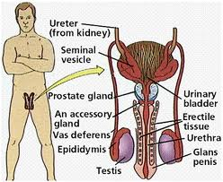
Male Reproductive System
Penis
Scrotum
Vas Deferens
Seminal Vesicles
Prostate Gland
http://www.medcomrn.com/dev/flash/flvplayer/movie.php?movie=http://ss1.medcomrn.com/flv/78720r_sec02_300k.flv&title=&detectflash=false&detectflash=false
Notes:
• Penis
􀂃 Organ contains 3 columns of spongy material-enlarges with sexual excitement
• Scrotum
􀂃 With 2 testes (testicles)
􀂃 Glands produces sperm and testosterone
• Vas deferens
􀂃 Sperm duct from Epididymis to urethra
• Seminal Vesicles
• Prostate gland and bulbo-urethral area
􀂃 Provide water vitamins and nutrients that mix with the sperm
• *Illness, injury and aging can affect sexuality

Slide 4
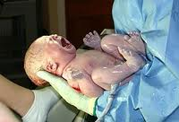
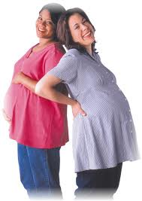
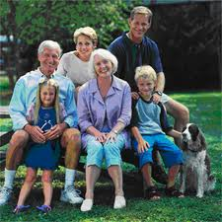
Care of: Peripartum Woman, Newborn & Family:
Notes:
peripartum /peri·par·tum/ (-pahr´tum) occurring during the last month of gestation or the first few months after delivery, with reference to the mother.

Slide 5
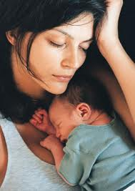
Postpartum Care
Body Returns
Uterus Returns
Physical & Emotional
  Lochia
  Episiotomy
  Breast Feeding
    Nipple Care
  Emotional Changes
  Mood Swings
  Lifestyle Changes
  Post Partum Depression
http://www.medcomrn.com/dev/flash/flvplayer/movie.php?movie=http://ss1.medcomrn.com/flv/78798hr_sec06_300k.flv&title=&detectflash=false
Notes:
Postpartum
• Mother’s body returns to normal state
• Uterus returns to pre-pregnancy size
• Mother adjusts physically and emotionally to childbirth
􀂃 Vaginal discharge (Lochia)
􀂃 Consists of blood and other substances from the uterus
􀂃 Begins as bright red, then pinkish brown
􀂃 Episiotomy
􀂃 Incision into perineum during childbirth to increase size of vagina to allow for birth
􀂃 Cesarean Birth
􀂃 Incision in abdomen and uterus to remove baby
􀂃 If vaginal delivery is not possible related to problems with mother or baby
􀂃 Breasts
􀂃 Breast feeding, supportive bra needed
􀂃 Breast/nipple care
􀂃 Emotional changes
􀂃 Normal to have mood swings related to life style changes, hormones, fatigue, etc.
􀂃 Post partum depression
􀂾 Lasts longer than 6 weeks
􀂾 Mother may need counseling and/or medication

Slide 6
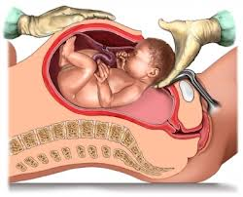
C-Section Care
Dressing
Swelling
Redness
C&DB
Check Sensation
Respirations
Itching
http://www.medcomrn.com/dev/flash/flvplayer/movie.php?movie=http://ss1.medcomrn.com/flv/78798hr_sec05_300k.flv&title=&detectflash=false

Slide 7
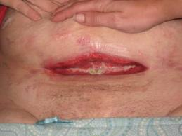
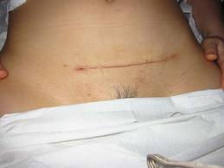
Observation & Reporting
Elevated Temp
Abd/Perineal Pain
Foul Smelling Discharge
Episiotomy/C-Section Incision
  Bleeding/Drainage/Swelling
Breast Swelling
Red Lochia when Pinkish
Pain/Burning w/Urination
Leg Pain/Tenderness/Swelling
Sadness/Feeling of Depression
Notes:
􀂃 Elevated temperature
􀂃 Abdominal or perineal pain
􀂃 Foul smelling discharge
􀂃 Bleeding, drainage, redness or swelling from episiotomy or C-section incision
􀂃 Saturating a peri-pad within 1 hour of application
􀂃 Red lochia after it has been pinkish brown
􀂃 Burning or pain with urination
􀂃 Leg pain, tenderness or swelling
􀂃 Sadness or feelings of depression
􀂃 Breast pain, tenderness or swelling

Slide 8
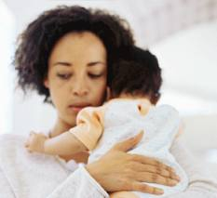

CNA 2 Actions
Avoid Infection
Monitor for Hemorrhage
Activity
  Assist w/1st up after Delivery
  BR after Spinal Anesthesia
Breast Care
Emotional Care
Surgical Care
  Post-op Guidelines
  Sitz Bath as Directed by Nurse
Notes:
Avoid infection
􀂃 Good handwashing
􀂃 Clean peri-pads, wipe front to back, assist with peri cleaning
􀂃 Encourage fluids
􀂃 Keeping bladder empty
Monitor for hemorrhage
􀂃 Report number of peri-pads used and level of saturation. Observe for large amount
of bleeding (more than one peri-pad soaked per hour)
Activity
􀂃 Assist to bathroom with first ambulation after delivery
􀂃 Bed rest may be required after spinal anesthesia
Breast Care
􀂃 Assist with putting on bra for support
􀂃 Report pain
􀂃 Hand infant to mother for breast feeding every 2-3 hours
􀂃 Support mother and infant’s position with pillows
Emotional care
􀂃 Encourage family visits; allow to watch with infant care
Surgical care
􀂃 General post-op care guidelines
􀂃 Increased awareness of possibility of blood clots
􀂃 Sitz bath as directed by nurse

Slide 9
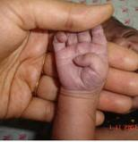
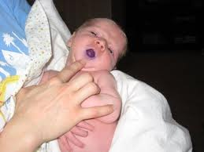
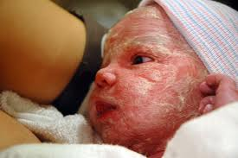
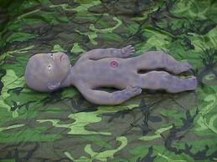
Care of the Newborn
Birth-28 days old
VS:
  97-99/120-160/30-60
Cyanosis
  Peripheral OK
  Central no
Urine
Stools
Skin: Vernix
Notes:
• Birth to 28 days of age
Normal Vital Signs
􀂃 BP Systolic 60-80, diastolic 40-50-not usually measured
􀂃 Temp-usually Axillary 97-99 degrees
􀂃 Apical Pulse at rest 120-160 (infant is quiet and not crying)
􀂃 Respiratory Rate-30 to 60 often irregular
• Cyanosis
􀂃 Peripheral is normal for several hours after birth
􀂃 Central is not normal (chest “blotchiness” with cyanosis)
• Urine
􀂃 Note first void
􀂃 Should void 2 to 25 times/day
• Stools
􀂃 Changes from meconium (green/black thick stool) to green/brown to yellow/brown to golden yellow
􀂃 First stool should pass within the first 24 hours
• Skin
􀂃 Thin, may have white cheesy “vernix” on skin
􀂃 Gloves worn until after first bath

Slide 10
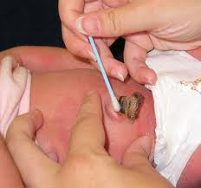
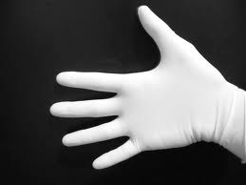
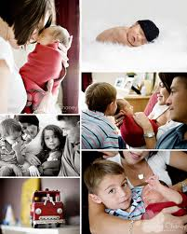
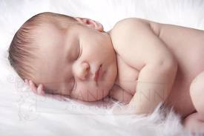
Care of the Newborn
Umbilical Cord
Hearing Screen
Safety
  Abduction
  Support Head
  No Bottle Propping
Infection Control
  METICULOUS Handwashing
Family
  Encourage Visitation
Notes:
• Umbilical Cord
􀂃 Cord care per facility policy
􀂃 Usually keep diaper away from cord
􀂃 Usually detaches in 10-14 days
• Hearing
􀂃 Hearing screen is done before discharge (review Newborn Hearing Test)
• Safety
􀂃 Position on back or side to sleep, to prevent suffocation
􀂃 Transport in crib only, to prevent infant abduction
􀂃 Support head when moving infant
􀂃 Handle infant with gentle, smooth movements
􀂃 Do not heat formula in microwave oven
􀂃 Do not prop bottles when feeding
• Infection control
􀂃 Meticulous hand hygiene, before and after each contact
􀂃 Keep peri area and cord area as clean and dry as possible
• Family
􀂃 Encourage visitation
􀂃 Encourage hand washing before touching infant
􀂃 Report any symptoms of illness of visitors
􀂃 Report any negative behavior toward infant or mother

Slide 11
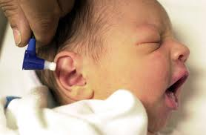
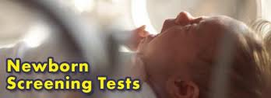
Screening
http://www.medcomrn.com/dev/flash/flvplayer/movie.php?movie=http://ss1.medcomrn.com/flv/78811b_sec10_300k.flv&title=&detectflash=false

Slide 12
Otoacoustic Emissions (OAE)
This screening uses a tiny microphone placed in the baby’s ear to emit very soft sounds (most babies are even asleep when this test is performed). A computer can then record how the inner ear responds to these soft sounds.
Automated Auditory Brainstem Test (AABR)
With this test your baby will have small headphones placed over his or her ears and sensors placed on the head. Brain activity that shows response to light sounds coming from the headphones will then be recorded.

Slide 13
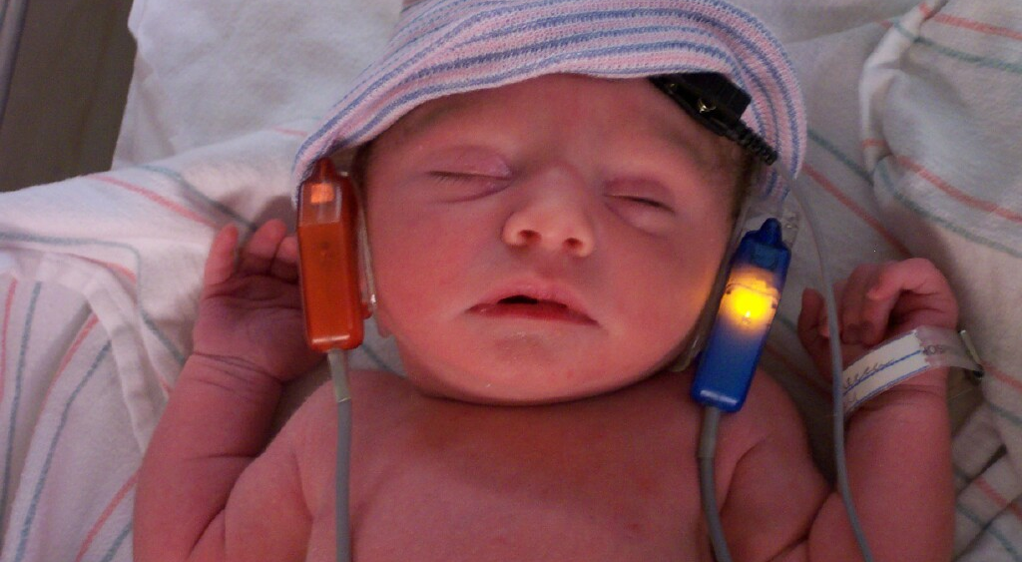
Image Courtesy of celebritydiagnosis.com
http://www.youtube.com/watch?v=QvrBogzziXA

Slide 14
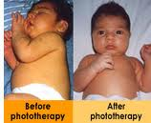
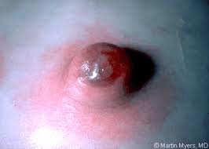
Observation & Reporting
Jaundice
Redness/Rashes
Cord Stump/Circumcision
  Redness/Drainage
Elevated Temp
Limp Body
Jitteriness
Lack of Ext. Movement
Poor Feeding/Vomiting
No BM 1st 24 Hrs
Visitors who are ill should
wear mask
Notes:
􀂃 Jaundice (yellow skin and/or white of the eyes)
􀂃 Redness or rashes
􀂃 Redness or drainage around the cord stump or circumcision
􀂃 Elevated temperature
􀂃 Limp body and/or slow to respond
􀂃 Jitteriness
􀂃 Lack of movement of any extremity
􀂃 Poor feeding or vomiting
􀂃 No BM or urine for 24 hours

Slide 15

CNA 2 Actions
Refer to Previous
“Care of the Newborn”
Report Abnormals to Nurse STAT

Slide 16

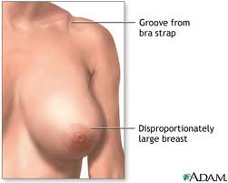
Mammoplasty
Surgical Procedure
Augmentation
  Breast Enlargement
  Personal Decision
  Incision:
    Under Breast/Axilla/Edge of Areola
  Outpatient
Reduction
  Relieve Physical Discomfort
Notes:
• Surgical procedure to reshape the breast
• Augmentation
􀂃 Enlarge breast size by placing an implant
􀂃 Usually done because patient is self-conscious about small breasts
􀂃 Incision can be under breast, in axilla or edge of areola and a pocket is made and various materials inserted to enlarge breast
􀂃 Often done as an outpatient
• Reduction
􀂃 Relieve physical discomfort related to large breast size
􀂃 Usually bilateral to reduce symptoms of tenderness, pain (especially shoulder pain) and fatigue
􀂃 Several procedures available
􀂃 Nipple may be transplanted to new area

Slide 17
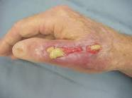
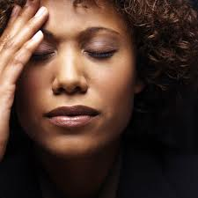
Observation & Reporting
Fever
Odor
Drainage
  Increased
  Change in Color
Increased Pain
Notes:
􀂃 Fever
􀂃 Odor
􀂃 Increased drainage
􀂃 Increased pain

Slide 18
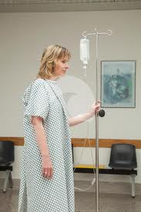
CNA 2 Actions
Report Abnormal S&S to Nurse
General Post-op Care
Emotional Support
Non-Operative Side
Encourage Ambulation
Notes:
􀂃 General postoperative care
􀂃 Emotional support
􀂃 Avoid pressure on suture lines by positioning patient on the non-operative side
􀂃 Encourage patient to ambulate
􀂃 Report abnormal s/s to nurse

Slide 19
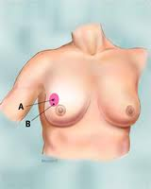
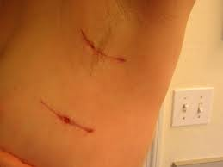
Lumpectomy
Removal of the Tumor
May/May not include Lymph Nodes
Goal:
  Remove Cancer
  Conserve Breast
Notes:
Lumpectomy
• Removal of tumor conserving much of breast tissue.
• May or may not include the removal of lymph nodes
• Goal is to remove the cancer while conserving the breast

Slide 20
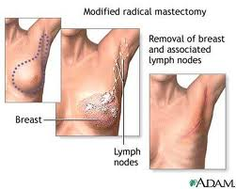
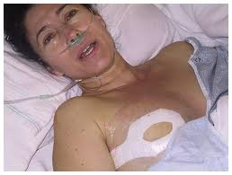
Mastectomy
Removal All or Part of a Breast
Female or Male
Types
  Simple
  Modified Radical
  Radical
Notes:
• Removal or partial removal of a breast
• May be female or male
• Types:
Simple Mastectomy
􀂃 Removal of breast tissue plus the nipple
Modified Radical Mastectomy
􀂃 Removal of entire breast and multiple lymph nodes
Radical Mastectomy
􀂃 Removal of the entire breast, chest wall muscle, lymph nodes and some additional tissue

Slide 21
Observation & Reporting
Dressing CDI
Pain
Fever
Edema
  Operative Site
  Hand/Arm
Numbness/Tingling
Emotional Changes
Notes:
􀂃 Dressing intact, observe for drainage
􀂃 Pain
􀂃 Fever
􀂃 Increased swelling (edema) in operative site or arm/hand
􀂃 Numbness and/or tingling of arm
􀂃 Emotional changes (depression)

Slide 22
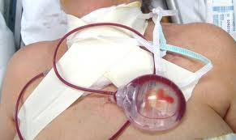
CNA 2 Actions
Report Abnormals to Nurse
NO BP Affect Arm
General Post-op Care
JP Drains
Assist w/ADLs prn
Non-Operative Positioning
Notes:
􀂃 General postoperative care
􀂃 Emotional support
􀂃 Ensure JP drains are secure and patent
􀂃 No Blood Pressure in affected arm
􀂃 Assist with ADLs as needed, do not pull on affected arm
􀂃 Avoid pressure by positioning patient on non-operative side
􀂃 Report abnormal signs or symptoms to nurse

Slide 23
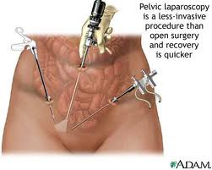
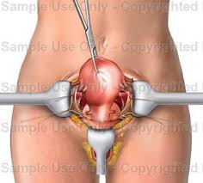
Hysterectomy
Surgical Removal of Uterus & Cervix
Laproscopicaly vs Abdominal
Notes:
• Surgical removal of the uterus and cervix
• May also remove ovaries and fallopian tubes
• May be laproscopicaly or through abdominal incision
• Can relieve pain and bleeding or cancerous growth
• Types
􀂃 Laparoscopic
􀂃 Small incisions in the abdomen
􀂃 Instruments inserted to release uterus and remove through vagina
􀂃 Total Abdominal Hysterectomy (TAH)
􀂃 Removal of uterus through abdominal wall

Slide 24
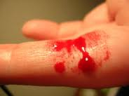
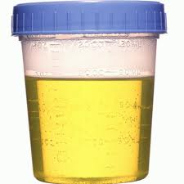
Observation & Reporting
Dressing CDI
Vaginal Bleeding
  Increased
    > 1 peri-pad soaked/Hr.
  Watch for Clots
Abnormal VS
Decreased UOP
  <60 mls/2hrs
  <120/mls/4hrs
Notes:
􀂃 Dressing intact/observe for drainage
􀂃 Increased vaginal bleeding/observe for blood clots
􀂃 Observe for large amount of bleeding (more than one peri-pad soaked per hour)
􀂃 Abnormal vital signs, decreased urine output (Foley) <60 ml in 2 hours or < 120 ml in 4 hours

Slide 25
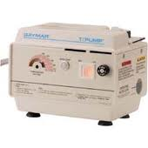
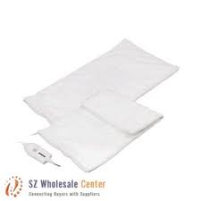
CNA 2 Actions
Report Abnormals to Nurse
Heat to Low Back as Ordered
Encourage Fluids
Monitor VS
General Post-op Care
Notes:
􀂃 Prior to surgical interventions, sitz bath as ordered
􀂃 Heat application to lower back if ordered
􀂃 Encourage fluids and frequent voiding to prevent bladder infections
􀂃 Discourage “straining” with BMs if possible
􀂃 Monitor vital signs closely (signs and symptoms of infection)
􀂃 General post-operative care
􀂃 Report abnormal signs and symptoms to nurse

Slide 26
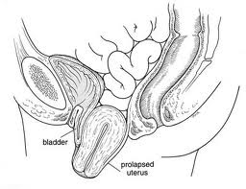
Uterine Prolapse
Notes:
• The uterus and the bladder are held in their normal positions just above the inside end of the vagina by a "hammock" made up of supportive muscles and
ligaments.
• Wear and tear on these supportive structures in the pelvis can allow the bottom of the uterus, the rear of the bladder or both to sag through the muscle
and ligament layers.
• When this occurs, the uterus or bladder can create a bulge into the vagina. The uterus protrudes downward and herniated through pelvic floor causing
protrusion of uterus.
• In severe cases the cervix can protrude outside the body
• Symptoms include feelings of pressure and possible urinary incontinence or retention
• Incontinence is usually increased with activities such as coughing, lifting or walking

Slide 27
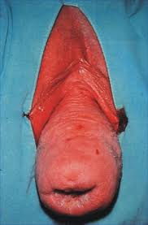
Observation & Reporting
Pain
  Vagina/Pelvis
  Lower Abd/Back
  Groin
Heaviness/Pressure
Urinary
  Incontinence
  Retention
Bloody Discharge
Visual Appearance of Prolapse
Notes:
􀂃 Pain in the vagina, pelvis, lower abdomen, groin, or lower back
􀂃 Heaviness or pressure in the vaginal area
􀂃 Urinary incontinence or retention of urine
􀂃 Bloody discharge
􀂃 Visual appearance of prolapse

Slide 28

CNA 2 Actions
Report Abnormals to Nurse
Heat as Ordered
Encourage Fluids
Discourage “Straining”
Monitor VS
General Post-Op Care
Notes:
􀂃 Prior to surgical interventions, sitz bath as ordered
􀂃 Heat application to lower back if ordered
􀂃 Encourage fluids and frequent voiding to prevent bladder infections
􀂃 Discourage “straining” with BMs if possible
􀂃 Monitor vital signs closely (signs and symptoms of infection)
􀂃 General post-operative care
􀂃 Report abnormal signs and symptoms to nurse

Slide 29

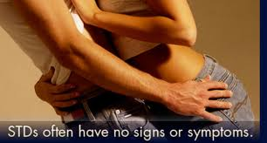
Sexually Transmitted Infections/Diseases
STI’s/STD’s
Spread
  Body Fluids
    Semen/Vaginal fluid/Blood
    Affected Skin
Sx’s not Confined to
Genital Area
Prevention
  Abstinence
  Condoms
Notes:
Sexually Transmitted Infections (STI’s); or Sexually Transmitted Diseases (STD’s)
• Diseases that can be transmitted sexually
• Some STDs spread through body fluids such as semen, vaginal fluid, or blood. Signs and symptoms may occur in other parts of the body, not only in
genital area.
• Others spread through contact with affected skin
• Prevention includes abstinence and use of condoms

Slide 30

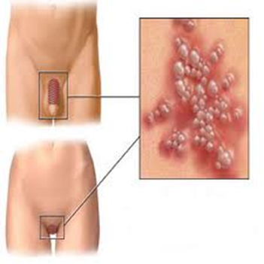
Common STI’s/STD’s
Chlamydia
HIV/AIDS
Gonorrhea
Syphilis
Genital Herpes
Genital Warts
Notes:
• Types of common STDs:
􀂃 Chlamydia
􀂃 Gonorrhea
􀂃 AIDS
􀂃 Syphilis
􀂃 Genital herpes (painful, blister-like sores)
􀂃 Genital warts

Slide 31
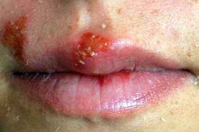
Observation & Reporting
Painful, Fluid filled Sores
Itching/Burning/tingling
Fever
Abd. Pain
Burning on Urination
Vaginal/Urethral Discharge
Warts On:
  Penis/Anus/Vagina/Cervix/Labia/Genitalia
Notes:
􀂃 Painful, fluid filled sores on or near the genitalia
􀂃 Itching, burning and/or tingling in the genital area
􀂃 Fever; abdominal pain
􀂃 Warts on penis, anus, vagina, cervix, labia or genitalia
􀂃 Burning upon urination
􀂃 Vaginal and/or urethral discharge

Slide 32
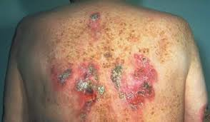
CNA 2 Actions
Report Abnormals to Nurse
Standard Precautions
Emotional Support
Gonorrhea
Notes:
􀂃 Report abnormal signs or symptoms to nurse
􀂃 Use standard precautions when caring for patient
􀂃 Emotional support

