Slide 1
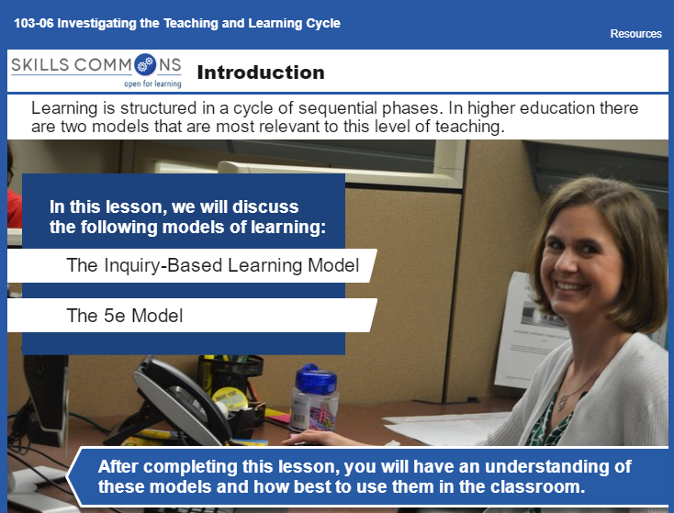
Module 8: Investigating the Teaching and Learning Cycle
Think about the Learning Cycle you foster in your classroom.
Which strategy presented in this assessment do you resonate with the most?
Both strategies begin with asking questions…
Do you ask the right questions? Explain.
Do you allow students to answer? Explain.
"ED 215 Methods of Lesson Planning and Instruction" by Donna Hanks, Western Dakota Technical College is licensed under CC BY 4.0 / A derivative from the original work.

