Slide 1
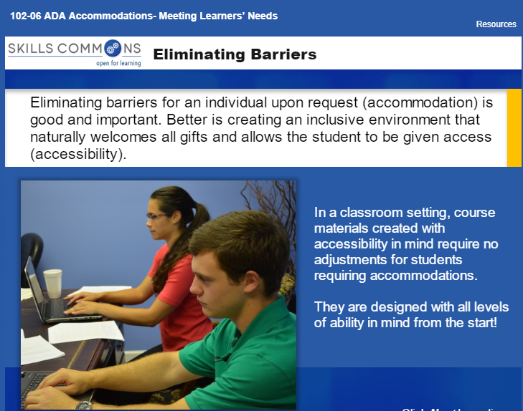
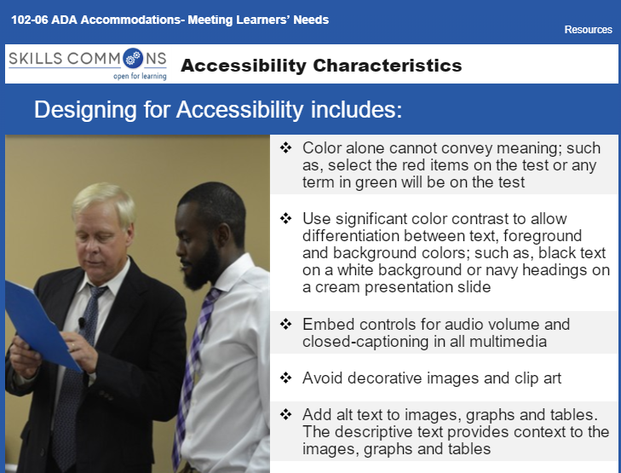
Module 5:
ADA Accommodations-Meeting Learners’ Needs

Slide 2
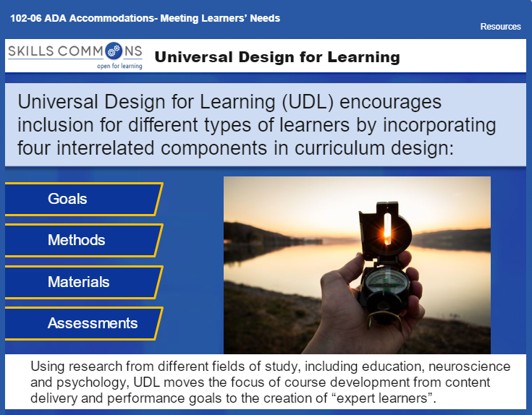
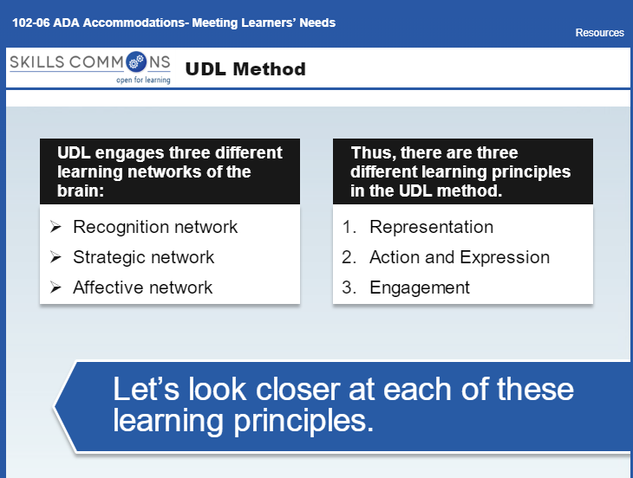
Module 5:
ADA Accommodations-Meeting Learners’ Needs

Slide 3
Module 5:
ADA Accommodations-Meeting Learners’ Needs
In effort to eliminate barriers and provide an all-inclusive experience for your students, identify UDL strategies you can incorporate to your class that would help eliminate barriers for your students.
  Go to Handouts in MyWDT/Module 5 and download Universal Design for Learning Guidelines for reference.
Create a conversation answering the following questions:
  What strategies did you identify?
  How will incorporating these strategies benefit your students?
  When do you plan on incorporating these strategies?
"ED 215 Methods of Lesson Planning and Instruction" by Donna Hanks, Western Dakota Technical College is licensed under CC BY 4.0 / A derivative from the original work.

