Slide 1





BASICS OF MANUFACTURED CONSTRUCTION
    PRESENTED BY TRAMCON, UNIVERSITY OF FLORIDA
MODULE 2: The Quality Program and Process for Manufactured Construction

Slide 2

Contents
Module 2 – The Quality Program and Process for Manufactured Construction
2.1 Introduction
2.2 Concepts and Definitions
2.3 History
2.4 Quality Standards
2.5 Quality Control Program for Manufactured Construction
2.6 Quality Control Process for Manufactured Construction
2.7 Defects and Possible Product Recalls
2.8 Accuracy and Precision in Manufactured Construction
2.9 Guidelines for Investigation and Reporting of Quality System Issues (QSI)
MODULE 2: The Quality Program and Process for Manufactured Construction

Slide 3
Introduction
This module includes:
Explaining the various concepts and definitions used in the quality process in manufacturing.
Discussing the history of quality in manufacturing and how it has evolved to the present day.
Discussing the various types of standards and processes used in quality control management.
Addressing how these concepts are applied in the manufactured construction sector, specifically to manufactured and modular homes.
MODULE 2.1 Introduction
Notes:
A high standard of quality is very important for all manufactured products, including the products of manufactured construction. These include manufactured and modular homes, metal buildings, and building components such as structural insulated panels and trusses. In this module, we will address the topic of quality as it applies to manufacturing in general, and specifically how it is applied in manufactured construction. We will begin by explaining the various concepts and definitions used in the quality process in manufacturing. We will then discuss the history of quality in manufacturing and how it has evolved to the present day. The next step will be for us to discuss the various types of standards and processes used in quality control management. Finally we will address how these concepts are applied in the manufactured construction sector, specifically to manufactured and modular homes. It is important to remember that quality has a cost. A high standard of quality will result in fewer mistakes and recalls, result in lower costs, and have a positive impact on the bottom line of the organization. A low or poor standard of quality will likely cause negative impacts on both the company’s bottom line and reputation.

Slide 4
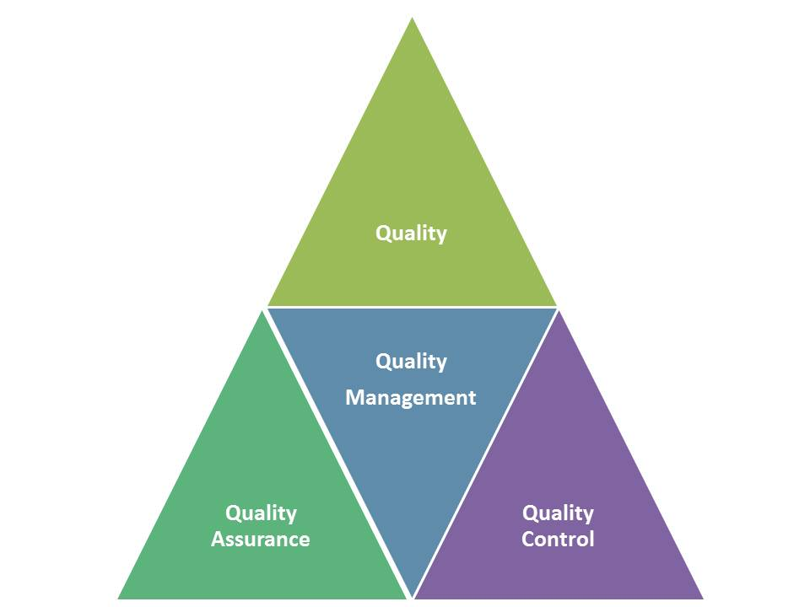
Introduction
Quality in manufactured construction is built on a program that assures quality, checks it, and builds it into the management systems.
MODULE 2.1 Introduction
Notes:
Quality in manufactured construction is built on a program that assures quality, checks it, and builds it into the management systems.

Slide 5
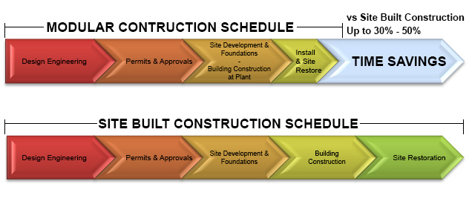
Introduction
The time savings resulting in manufactured compared to site built construction is in part a result of the quality built into the process.
MODULE 2.1 Introduction

Slide 6
Quality
The international standard, ISO 8402-1986, defines quality as “...the total of features and characteristics of a product required for its ability to satisfy stated or implied needs.”
Failure to meet quality requirements will have impacts on both the financial condition and reputation of a company.
In the recent airbag recall involving the Takata Corporation, 34 million vehicles in the U.S. and 7 million more worldwide were potentially affected by defective airbags.
MODULE 2.2 Concepts and definitions
Notes:
Quality in manufacturing can be defined as a measure of the state of being free from defects, deficiencies, and significant variations. It is gained and maintained by strict and consistent commitment to standards designed to achieve a uniformity of product in order to satisfy specific customer or user requirements. The international standard, ISO 8402-1986, defines quality as “...the total of features and characteristics of a product required for its ability to satisfy stated or implied needs.” Failure to meet quality requirements will have impacts on both the financial condition and reputation of a company. For example, in the automobile industry, a defect in manufacturing an automobile often results in the recall of millions of cars and the loss of customer faith in the business, further resulting in a decline in car sales and sales revenue. In the recent airbag recall involving the Takata Corporation, 34 million vehicles in the U.S. and 7 million more worldwide were potentially affected by defective airbags. The problem involved defective inflator and propellant devices that could deploy improperly in the event of a crash, shooting metal fragments into the vehicle’s occupants. The problem of potential defects also exists in manufactured construction. A defect found in the manufacturing process can trigger a recall of manufactured buildings or building components, resulting in significant costs and the loss of production. In the case of manufactured buildings, it means crews may have to be sent to each site where the building was installed to make costly repairs.

Slide 7
Quality management
Quality management has four main components: quality planning, quality control, quality assurance, and quality improvement.
Quality management is focused both on the product being manufactured and the process by which it is manufactured.
Quality management employs quality assurance and control of both processes and products to achieve consistent quality.
MODULE 2.2 Concepts and definitions
Notes:
Quality management is an approach that an organization uses to ensure its product or service is consistent. It has four main components: quality planning, quality control, quality assurance, and quality improvement. Quality management is focused both on the product being manufactured and the process by which it is manufactured. Quality management employs quality assurance and control of both processes and products to achieve consistent quality.

Slide 8
Quality Management System (QMS)
A quality management system (QMS) is a collection of processes needed to implement quality management.
Elements of a QMS:
1. Quality policy
2. Quality objectives
3. Quality manual
4. Organizational structure and responsibilities
5. Data management
6. Processes, including purchasing
7. Product quality leading to customer satisfaction
8. Continuous improvement including corrective and preventive action
9. Quality instruments
MODULE 2.2 Concepts and definitions
Notes:
A quality management system (QMS) is a collection of processes needed to implement quality management. It is comprised of the organizational structure, policies, procedures, processes, and resources needed for this purpose. When it was originally developed in the late 19th century, QMS focused on predicting the outcomes of an industrial production line using statistics and sampling techniques. More recently, in the 20th century, labor input, which dominates the cost of production, was used to detect problems and take corrective action. In the 21st century, QMS is converging with sustainability and transparency initiatives so that both the manufacturer and customer have high levels of satisfaction with the product. A very important international standard series known as ISO 9000 is probably the most widely implemented QMS system in both the U.S. and worldwide. QMS is characterized by its ability to reduce quality problems by combining systematic thinking, transparency, documentation, and diagnostic tools.
Elements of a QMS include:
1. Quality policy
2. Quality objectives
3. Quality manual
4. Organizational structure and responsibilities
5. Data management
6. Processes, including purchasing
7. Product quality leading to customer satisfaction
8. Continuous improvement including corrective and preventive action
9. Quality instruments

Slide 9
Quality Assurance
Quality assurance (QA) is the systematic measurement, comparison with a standard, monitoring of processes, and an associated feedback loop designed to prevent errors.
QA has two main principles:
1. Fit for the purpose
The product should be designed to be suitable for its end use.
The mistakes should be limited
2. Right first time.
MODULE 2.2 Concepts and definitions
Notes:
Quality assurance (QA) is another terminology commonly used in the quality management process. QA is the systematic measurement, comparison with a standard, monitoring of processes, and an associated feedback loop designed to prevent errors. It is a method for preventing mistakes or defects in manufactured products and avoiding problems when delivering the product to the customer. It involves planning and training ahead of time before the manufacturing begins to assure a high standard of quality and then constantly adjusts the manufacturing process as needed to maintain high product quality. ISO 9000 defines QA as the part of quality management focused on providing confidence that quality requirements will be fulfilled. As a means of preventing errors, QA has two main principles: 1. Fit for the purpose and 2. Right first time. The first principle, fit for the purpose, means that the product should be designed to be suitable for its end use. Right first time, the second principle, simply means the mistakes should be limited. QA includes a wide range of activities including managing the quality of material inputs, assemblies, products, components, production services, and production and inspection processes. For a product to have high quality, all the components used in its manufacture must have high quality and the processes used to manufacture it must also meet high standards of quality.

Slide 10
Quality control
Quality control (QC) is a process of reviewing all the factors involved in the production process, with a focus on meeting quality requirements. Quality control emphasizes three aspects:
Quality Assurance happens before the product is manufactured.
Quality Control occurs during the manufacturing process.
MODULE 2.2 Concepts and definitions
Notes:
Quality control (QC) is a process of reviewing all the factors involved in the production process, with a focus on meeting quality requirements. Quality-control emphasizes three aspects:
1. Process elements such as controls, job management, defined and well managed processes, performance criteria, and records.
2. Competence, such as knowledge, skills, experience, and qualifications
3. Non-process elements such as personnel, integrity, organizational culture, motivation, team spirit, and quality relationships.
If any of these three elements are deficient the quality of the product will likely be at risk. Controls include inspections where every product is examined both during the production process and prior to shipment to the customer. Quality-control requires product testing to uncover and report defects to management so that they can make the decision to either allow the product to be shipped or reworked and repaired.

Slide 11
Quality control
Quality control emphasizes three aspects:
1. Process elements
2. Competence
3. Non-process elements
controls, job management, defined and well managed processes, performance criteria, and records.
knowledge, skills, experience, and qualifications
personnel, integrity, organizational culture, motivation, team spirit, and quality relationships.
MODULE 2.2 Concepts and definitions
Notes:
Quality control (QC) is a process of reviewing all the factors involved in the production process, with a focus on meeting quality requirements. Quality-control emphasizes three aspects:
1. Process elements such as controls, job management, defined and well managed processes, performance criteria, and records.
2. Competence, such as knowledge, skills, experience, and qualifications
3. Non-process elements such as personnel, integrity, organizational culture, motivation, team spirit, and quality relationships.
If any of these three elements are deficient the quality of the product will likely be at risk. Controls include inspections where every product is examined both during the production process and prior to shipment to the customer. Quality-control requires product testing to uncover and report defects to management so that they can make the decision to either allow the product to be shipped or reworked and repaired.

Slide 12
The origins of quality and quality control
In Denmark, around 3500 BC, tools used in the production of Viking boats had been rejected at the time of building the boats.
According to the Code of Hammurabi, the builder whose house later collapsed and killed the owner was subject to the death penalty.
In ancient Greece construction work was subject to quality control and tools to control the quality of joints in construction were being utilized.
The hallmark symbol, one of the first symbols of a quality control process indicated a product was created by a master craftsman.
MODULE 2.3 History
Notes:
The origins of quality and quality control
Quality control dates back many years, in fact, probably thousands of years. There is evidence in Denmark, for example, that around 3500 BC, tools used in the production of Viking boats had been rejected at the time of building the boats. The probable reason was that the Swedish flint used in the tools was unacceptable for their intended purpose. For quality control the ability to measure dimensions and weights if very important to ensure products are being manufactured to the correct tolerances. The first measurement of length occurred in Egypt in about 3000 BC and was called the Royal Egyptian Cubit. It was defined as equal to the length of the forearm from the bent elbow to the tip of the extended middle finger plus the width of the palm of the hand of the Pharaoh or king ruling at that time. The master copy of this standard length was carved into granite and workers transferred this measure by using wooden or granite copies. The transfer standards were very important and had to be recalibrated about once a month or whenever there was a full moon and if the workers did not bring their cubits back into compliance they could be punished by death. These length measures and other measuring equipment were used to set up the precise angles to establish the orientation of Egyptian pyramids around 2500 BC. In the ancient world quality was very important and in ancient Mesopotamia, for example, according to the Code of Hammurabi, the builder whose house later collapsed and killed the owner was subject to the death penalty. Is clear that in the ancient world quality control was especially important. There is also evidence of quality control in China in the 16th to the 11th century BC in the handicraft industries which included metallurgy, bamboo, woodworking, and textile industries. In ancient Greece construction work was subject to quality control and tools to control the quality of joints in construction were being utilized. Specifications were used to clearly describe the exact requirements of the construction. Similar examples could be found in India around the 4th century BC and in medieval Europe. Master craftsmen emerged in Europe to produce a wide variety of goods to include armor and swords. Apprentices underwent extensive training which was long and demanding and they had to demonstrate they could produce high-quality products before they could join the field and be considered craftsmen. The process of transferring knowledge from master to apprentice was called “instructional capital." The hallmark symbol, one of the first symbols of a quality control process indicated a product was created by a master craftsman. It was used for the first time by the Goldsmiths Guild in London on products containing precious metals and is still used today.

Slide 13


The origins of quality and quality control
The first measurement of length occurred in Egypt in about 3000 BC and was called the Royal Egyptian Cubit.
Standard measures and special tools were used to build the Great Pyramids of Egypt in 2000-3000 BC.
MODULE 2.3 History
Notes:
The origins of quality and quality control
Quality control dates back many years, in fact, probably thousands of years. There is evidence in Denmark, for example, that around 3500 BC, tools used in the production of Viking boats had been rejected at the time of building the boats. The probable reason was that the Swedish flint used in the tools was unacceptable for their intended purpose. For quality control the ability to measure dimensions and weights if very important to ensure products are being manufactured to the correct tolerances. The first measurement of length occurred in Egypt in about 3000 BC and was called the Royal Egyptian Cubit. It was defined as equal to the length of the forearm from the bent elbow to the tip of the extended middle finger plus the width of the palm of the hand of the Pharaoh or king ruling at that time. The master copy of this standard length was carved into granite and workers transferred this measure by using wooden or granite copies. The transfer standards were very important and had to be recalibrated about once a month or whenever there was a full moon and if the workers did not bring their cubits back into compliance they could be punished by death. These length measures and other measuring equipment were used to set up the precise angles to establish the orientation of Egyptian pyramids around 2500 BC. In the ancient world quality was very important and in ancient Mesopotamia, for example, according to the Code of Hammurabi, the builder whose house later collapsed and killed the owner was subject to the death penalty. Is clear that in the ancient world quality control was especially important. There is also evidence of quality control in China in the 16th to the 11th century BC in the handicraft industries which included metallurgy, bamboo, woodworking, and textile industries. In ancient Greece construction work was subject to quality control and tools to control the quality of joints in construction were being utilized. Specifications were used to clearly describe the exact requirements of the construction. Similar examples could be found in India around the 4th century BC and in medieval Europe. Master craftsmen emerged in Europe to produce a wide variety of goods to include armor and swords. Apprentices underwent extensive training which was long and demanding and they had to demonstrate they could produce high-quality products before they could join the field and be considered craftsmen. The process of transferring knowledge from master to apprentice was called “instructional capital." The hallmark symbol, one of the first symbols of a quality control process indicated a product was created by a master craftsman. It was used for the first time by the Goldsmiths Guild in London on products containing precious metals and is still used today.

Slide 14
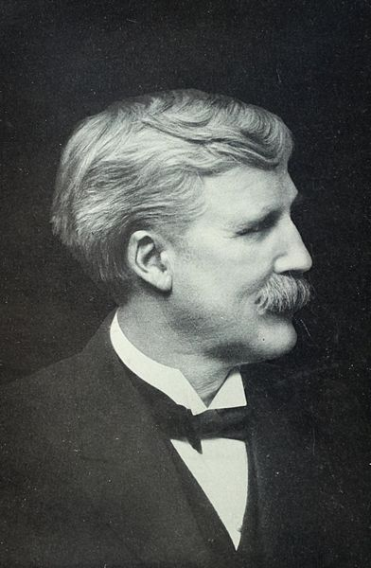
Quality and the Industrial Revolution
Frederick Taylor was one of the first to turn the management of quality and quality control into a science (In the late 19th century).
His approach was threefold:
1. Find the best practice wherever it exists.
2. Disassemble the best practice into its constituent activities
3. Remove the activities that did not add value
MODULE 2.3 History
Notes:
Quality and the Industrial Revolution
It was the Industrial Revolution which started in the early 18th century when modern quality control emerged. It was during the Industrial Revolution that the factory system was developed, replacing the previous system of craftsmen producing goods with more division of labor and specialist trades. In the late 19th century Frederick Taylor developed the concept of the division of labor. He examined the time and motion of work in the factory and designs the work to maximize the productivity of the workforce. His approach was threefold
1. Find the best practice wherever it exists.
2. Disassemble the best practice into its constituent activities.
3. Remove the activities that did not add value
At the end of the 19th century the first groups were organized to produce standards for goods and their production. The American Society of mechanical engineers (ASME) was one of the first of these bodies and was founded in 1880 because there were over 50,000 fatalities per year being caused by failures in steam pressure systems. ASME develops standards that clearly described requirements for building safe steam pressure vessels. A wide range of other similar organizations were founded to help resolve other problems emerging in the new technological age of the time. These included the American Institute of Electrical Engineers (AIEE), the American Society of Civil Engineers (ASCE), and the American Society for Testing Materials (ASTM).

Slide 15
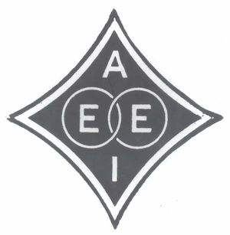
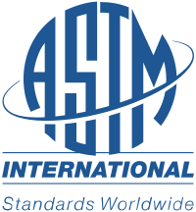


Quality and the Industrial Revolution
At the end of the 19th century the first groups were organized to produce standards for goods and their production.
The American Society of Civil Engineers (ASCE)
The American Society for Testing Materials (ASTM)
The American Institute of Electrical Engineers (AIEE)
The American Society of mechanical engineers (ASME) - 1988
MODULE 2.3 History
Notes:
Quality and the Industrial Revolution
It was the Industrial Revolution which started in the early 18th century when modern quality control emerged. It was during the Industrial Revolution that the factory system was developed, replacing the previous system of craftsmen producing goods with more division of labor and specialist trades. In the late 19th century Frederick Taylor developed the concept of the division of labor. He examined the time and motion of work in the factory and designs the work to maximize the productivity of the workforce. His approach was threefold
1. Find the best practice wherever it exists.
2. Disassemble the best practice into its constituent activities.
3. Remove the activities that did not add value
At the end of the 19th century the first groups were organized to produce standards for goods and their production. The American Society of mechanical engineers (ASME) was one of the first of these bodies and was founded in 1880 because there were over 50,000 fatalities per year being caused by failures in steam pressure systems. ASME develops standards that clearly described requirements for building safe steam pressure vessels. A wide range of other similar organizations were founded to help resolve other problems emerging in the new technological age of the time. These included the American Institute of Electrical Engineers (AIEE), the American Society of Civil Engineers (ASCE), and the American Society for Testing Materials (ASTM).

Slide 16




The Role of Japan
Joseph M. Juran and W. Edwards Deming, concentrated on improving all organizational processes by the people who use them.
By the 1970s, the US automobile industry and its supporting manufacturers were being badly outdone by Japanese manufacturers.
Chrysler Corporation adopted the quality control systems developed by the Japanese and the company redesigned its entire product line.
The result was that Chrysler products improved enormously and it became a profitable company once again.
General Motors and Ford, underwent similar transformations
MODULE 2.3 History
Notes:
The Role of Japan in Improving American Quality Standards
The birth of modern quality control in the U.S. came as a direct response to events in Japan after World War II. Just after the end of the war, two Americans, Joseph M. Juran and W. Edwards Deming, visited Japan. Rather than focusing simply on inspection which was the norm in the U.S., they concentrated on improving all organizational processes by the people who use them. Deming’s statistical quality control methods were taken to heart by Japanese manufacturers to help them reduce costs, improve productivity and market share, and develop manufacturing systems around his principles. When Deming returned to the US in the late 1940s, his ideas were largely ignored and his work was not actually discovered in the US until the 1980s. By the 1970s, the US automobile industry and its supporting manufacturers were being badly outdone by Japanese manufacturers who emphasized approaches to quality management that were highly successful and resulted in the manufacturing of products of the highest quality. Chrysler Corporation, which was saved by a US government bailout of $2 billion in 1980, almost failed due to the poor quality of its products and the competition from Japanese automakers whose cars were highly reliable, safe, well-engineered, and affordable. Chrysler managed to pull itself out of the enormous hole it had created because it rapidly adopted the quality control systems developed by the Japanese and the company redesigned its entire product line. The result was that Chrysler products improved enormously and it became a profitable company once again. The other major US automobile manufacturers, General Motors and Ford, underwent similar transformations caused by the remarkable success of high-quality standards borrowed from the Japanese.

Slide 17


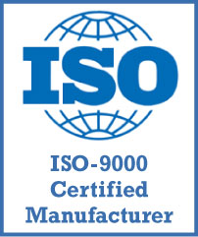
Quality Standards
The best known and most frequently used standards for guiding and controlling quality are the International Standards Organization (ISO) 9000 family of standards.
ISO 9000:2005 - covers the basic concepts and language
ISO 9001:2008 - sets out the requirements of a quality management system
ISO 9004:2009 - focuses on how to make a quality management system more efficient and effective
ISO 19011:2011 - sets out guidance on internal and external audits of quality management systems.
MODULE 2.4 Quality Standards
Notes:
2.4 Quality Standards
Quality is something every company strives for and which is often very difficult to achieve. Manufacturers need to ensure their products are consistently of high quality. Using standards for quality and quality control can help them manufacturers develop and make high quality products, comply with regulations and other standards, avoid product failures and recalls, and help them enter new markets. The best known and most frequently used standards for guiding and controlling quality are the International Standards Organization (ISO) 9000 family of standards. ISO 9000 is a series of standards, developed and published by ISO for the purpose of defining, establishing, and maintaining an effective quality assurance system for manufacturing and service industries. The ISO 9000 family addresses various aspects of quality management and contains some of ISO’s best known standards. The standards provide guidance and tools for companies and organizations who want to ensure that their products and services consistently meet customer’s requirements, and to ensure that quality is consistently improved. Standards in the ISO 9000 family include:
ISO 9000:2005 - covers the basic concepts and language
ISO 9001:2008 - sets out the requirements of a quality management system
ISO 9004:2009 - focuses on how to make a quality management system more efficient and effective
ISO 19011:2011 - sets out guidance on internal and external audits of quality management systems.
Figure 2.7 ISO 9001 is the standard used by a manufacturer to demonstrate its ability to consistently provide a product that meets customer requirements, and aims to enhance customer satisfaction and it includes a process for continual improvement of the system used for this purpose.

Slide 18
ISO 9000 - 8 principles
A Customer Focus
Involvement of people
Good Leadership
Process approach to quality management
Management system approach
Continual Improvement
Factual approach to decision making
Supplier relationships
MODULE 2.4 Quality Standards
Notes:
ISO 9000 is guided by 8 principles:
1. A Customer Focus
The customer is the primary focus of a business. In the case of manufactured construction, the customer is the person purchasing the factory built home or building component. By understanding and responding to the needs of customers, the company can correctly target key demographics and therefore increase revenue by delivering the products and services that the customer is looking for. With knowledge of customer needs, resources can be allocated appropriately and efficiently. Most importantly, a business’s dedication will be recognized by the customer, creating customer loyalty. And customer loyalty is return business. In manufactured construction the customer is the home buyer.
2. Good Leadership
A team of good leaders will establish unity and direction quickly in a business environment. Their goal is to motivate everyone working on the project, and successful leaders will minimize miscommunication within and between departments. Their role is intimately intertwined with the next ISO 9000 principle. Due to the high pace of manufactured construction, leadership and the ability to develop effective teams are of utmost importance.
3. Involvement of people
The inclusion of everyone on a business team is critical to its success. Substantial will lead to a personal investment in a project and in turn create motivated, committed workers. These people will tend towards innovation and creativity, and utilize their full abilities to complete a project. If people have a vested interest in performance, they will be eager to participate in the continual improvement that ISO 900 facilitates.
4. Process approach to quality management
The best results are achieved when activities and resources are managed together. This process approach to quality management can lower costs through the effective use of resources, personnel, and time. If a process is controlled as a whole, management can focus on goals that are important to the big picture, and prioritize objectives to maximize effectiveness.
5. Management system approach
Combining management groups may seem like a dangerous clash of titans, but if done correctly can result in an efficient and effective management system. If leaders are dedicated to the goals of an organization, they will aid each other to achieve improved productivity. Some results include integration and alignment of key processes. Additionally, interested parties will recognize the consistency, effectiveness, and efficiency that come with a management system. Both suppliers and customers will gain confidence in a business’s abilities.
6. Continual Improvement
The importance of this principle is paramount, and should a permanent objective of every organization. Through increased performance, a company can increase profits and gain an advantage over competitors. If a whole business is dedicated to continual improvement, improvement activities will be aligned, leading to faster and more efficient development. Ready for improvement and change, businesses will have the flexibility to react quickly to new opportunities.
7. Factual approach to decision making
Effective decisions are based on the analysis and interpretation of information and data. By making informed decisions, an organization will be more likely to make the right decision. As companies make this a habit, they will be able to demonstrate the effectiveness of past decisions. This will put confidence in current and future decisions.
8. Supplier relationships
It is important to establish a mutually beneficial supplier relationship; such a relationship creates value for both parties. A supplier that recognizes a mutually beneficial relationship will be quick to react when a business needs to respond to customer needs or market changes. Through close contact and interaction with a supplier, both organizations will be able to optimize resources and costs.

Slide 19
Quality Control program for Manufactured Construction
HUD homes are subject to a very specific Federal regulation process. Modular homes are subject to the state building code in which the home will be installed.
There is also an additional level of inspection audited by the state or third party, depending on whether is a modular home or a HUD home.
As part of the production process, once production of the unit beings, a Traveler is produced.
The Traveler is a document that outlines the quality control inspections that must be accomplished at each of the stations in the manufacturing process.
MODULE 2.5 Quality Control Program for Manufactured Construction
Notes:
Quality Control Program for Manufactured Construction
Each manufactured or modular home plant is required to have a quality control program. Once the manufactured or modular home is designed, the drawings are sent to a third party agency for review. Manufactured homes are commonly referred to as HUD homes. For HUD homes, ultimately registered with the U.S. Department of Housing and Urban Development (HUD). HUD homes are subject to a very specific Federal regulation process whereas modular homes are subject to the state building code in which the home will be installed. Plants building both HUD and manufactured homes will have two sets of inspectors, federal for HUD homes and state for modular homes.
Each company’s quality control program is slightly different. However, when a customer specifies the type of home they require, the quality process starts when the plans for the home are generated. The plans are submitted for review and approval and subject to the quality process. As part of the production process, once production of the unit beings, a Traveler is produced, and as its name implies, it travels along with the unit as it is being manufactured. The Traveler is a document that outlines the quality control inspections that must be accomplished at each of the stations in the manufacturing process. For example, at Station 1 there will be a list of items to be completed and checked by the responsible person. If nonconformance with quality standards is found in the process, it must be addressed, resolved, and appropriately noted on the quality control paperwork.
After all the required steps in the quality assurance and production process are completed at a station, a unit closeout occurs and the unit is moved to the next station in the production process. For example, at the Flooring Station, the underfloor electrical work has to be finished and inspected before the decking is installed. This inspection is performed by the in-house inspection staff. In a factory, a Quality Control Manager is responsible for checking compliance with quality control procedures. In a typical factory, the Quality Control Manager also audits the performance of the monitoring process. The party who is responsible for quality is the supervisor of the employees performing the tasks at a given station.
There is also an additional level of inspection audited by the state or third party, depending on whether is a modular home or a HUD home. This additional monitoring is performed by independent inspectors who audit the home assembly during production. These inspectors are required to assess just one stage of the construction process. During this inspection, any problems that are identified as repetitive may result in an increase in the frequency of inspection. A problem that is found to be repetitive could result in every home being inspected for the defect at a direct cost to the manufacturer.

Slide 20
Quality Control program for Manufactured Construction
After all the required steps in the quality assurance and production process are completed at a station, a unit closeout occurs and the unit is moved to the next station in the production process.
In a factory, a Quality Control Manager is responsible for checking compliance with quality control procedures.
The party who is responsible for quality is the supervisor of the employees performing the tasks at a given station.
MODULE 2.5 Quality Control Program for Manufactured Construction
Notes:
Quality Control Program for Manufactured Construction
Each manufactured or modular home plant is required to have a quality control program. Once the manufactured or modular home is designed, the drawings are sent to a third party agency for review. Manufactured homes are commonly referred to as HUD homes. For HUD homes, ultimately registered with the U.S. Department of Housing and Urban Development (HUD). HUD homes are subject to a very specific Federal regulation process whereas modular homes are subject to the state building code in which the home will be installed. Plants building both HUD and manufactured homes will have two sets of inspectors, federal for HUD homes and state for modular homes.
Each company’s quality control program is slightly different. However, when a customer specifies the type of home they require, the quality process starts when the plans for the home are generated. The plans are submitted for review and approval and subject to the quality process. As part of the production process, once production of the unit beings, a Traveler is produced, and as its name implies, it travels along with the unit as it is being manufactured. The Traveler is a document that outlines the quality control inspections that must be accomplished at each of the stations in the manufacturing process. For example, at Station 1 there will be a list of items to be completed and checked by the responsible person. If nonconformance with quality standards is found in the process, it must be addressed, resolved, and appropriately noted on the quality control paperwork.
After all the required steps in the quality assurance and production process are completed at a station, a unit closeout occurs and the unit is moved to the next station in the production process. For example, at the Flooring Station, the underfloor electrical work has to be finished and inspected before the decking is installed. This inspection is performed by the in-house inspection staff. In a factory, a Quality Control Manager is responsible for checking compliance with quality control procedures. In a typical factory, the Quality Control Manager also audits the performance of the monitoring process. The party who is responsible for quality is the supervisor of the employees performing the tasks at a given station.
There is also an additional level of inspection audited by the state or third party, depending on whether is a modular home or a HUD home. This additional monitoring is performed by independent inspectors who audit the home assembly during production. These inspectors are required to assess just one stage of the construction process. During this inspection, any problems that are identified as repetitive may result in an increase in the frequency of inspection. A problem that is found to be repetitive could result in every home being inspected for the defect at a direct cost to the manufacturer.

Slide 21
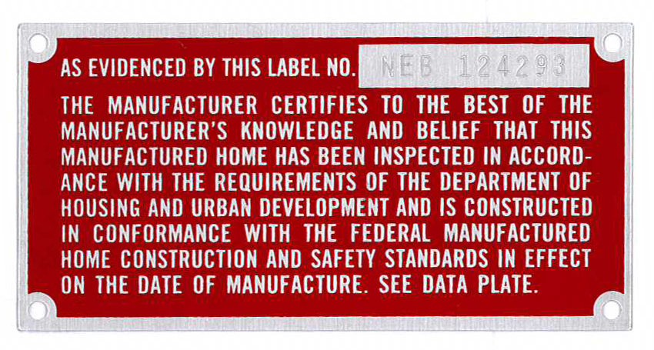
Quality Control program for Manufactured Construction
Manufactured HUD homes are identified by a HUD code label that is affixed to the outside of the home.
MODULE 2.5 Quality Control Program for Manufactured Construction
Notes:
Manufactured HUD homes are identified by a HUD code label that is affixed to the outside of the home. It is a light metal and is usually a reddish color and will always have the term ”Housing and Urban Development” with in the text. The code label attests that the home has been manufactured using an effective quality control program.

Slide 22
IPIAs and DAPIAs
There are 15 HUD approved state and private third party agencies that inspect a manufactured home at various stages of production. They are referred to as Inspection Primary Inspection Agencies (IPIAs).
An additional type of third party agencies also approves the manufacturer's designs to ensure the plans are consistent with HUD Standards. This party is referred to as the Design Approval Primary Inspection Agencies (DAPIAs).
MODULE 2.5 Quality Control Program for Manufactured Construction
Notes:
IPIAs and DAPIAs
There are 15 HUD approved state and private third party agencies that inspect a manufactured home at various stages of production. They are referred to as Inspection Primary Inspection Agencies (IPIAs). An additional type of third party agencies also approves the manufacturer's designs to ensure the plans are consistent with HUD Standards. This party is referred to as the Design Approval Primary Inspection Agencies (DAPIAs). Manufacturers contract directly with a state or local third party agency and pay for the design review and home inspection services.
After reviewing the plans for a home, DAPIA either approves the drawings and specifications, or disapproves them and provides the reasoning behind the disapproval. Depending on the location of the future home, items such as wind zone specifications, window sizes, header sizes, floor joists, wood grading, load bearing walls, and other important features are checked.
To locate an IPIA or DAPIA, it is necessary to determine where in the state government the agency is located. For example, the third party IPIA agency that controls inspections in Florida is located in the Department of Highway Safety and Motor Vehicles:
FLORIDA TYPE: IPIA
Chuck Smith
Program Manager
Bureau of MH/RV Construction
Division of Motor Vehicles
2900 Apalachee Parkway, Room A129
Tallahassee, FL 32399-0640
PH: (850) 617-2808
FAX: (850) 617-5191

Slide 23
On-site inspection
When the factory built home is assembled and installed on-site, inspections are performed by the building department of the local municipality.
Any deviations found by the building department inspectors are flagged and must be corrected by the team installing the home on its foundation.
MODULE 2.5 Quality Control Program for Manufactured Construction
Notes:
On-site inspection
When the factory built home is assembled and installed on-site, inspections are performed by the building department of the local municipality. Their inspectors apply the same techniques and use the same standards and process to inspect the factory built home as is used to inspect homes built on-site. The local municipality would examine the plans and specifications and inspect the work being performed to ensure it follow these construction documents. Any deviations found by the building department inspectors are flagged and must be corrected by the team installing the home on its foundation.

Slide 24
Quality Control
Quality control is a process of ensuring compliance with the plans, specifications and the applicable building codes.
The goal is for the problems to be resolved so that they can be avoided in the future. This is referred to as the Quality Assurance Procedure. There is normally contained in a Quality Assurance Manual that contains the information on a standard procedure.
MODULE 2.6 Quality Control Process in Manufactured Construction
Notes:
Quality Control
Quality control in the production environment means making sure products are manufactured in accordance with the plans and specifications. Some defects are likely to occur on the production line. The main task of the quality control system is to locate these defects and ensure they are corrected as early in the production process as possible.
Quality control is a process of ensuring compliance with the plans, specifications and the applicable building codes. The method for achieving the quality control varies between factories. Typically, the Quality Control Department monitors the performance level implemented at each section in the factory. Usually, the Quality Control Department is not directly responsible for the quality output, but is responsible to address the defects and issues and bring them to the attention of plant personnel. The goal is for the problems to be resolved so that they can be avoided in the future. This is referred to as the Quality Assurance Procedure. There is normally contained in a Quality Assurance Manual that contains the information on a standard procedure. In addition to the in-plant manufacturer quality control inspections, there are also state inspections and the federally regulated quality inspection.
The state regulated quality control agency is a third party agency that supervises the inspection during the unit’s construction in the plant at least one time. That means each home is inspected at least one time by the state or third party (IPIA). If there is a pattern of nonconformance, the number of inspection may increases. If it is determined that a house with a nonconformance has left the factory and is in the possession of the customer, there may be an additional investigation required on the home site. The sequence of inspections may continue back to the plant and through the production system until it is found and eliminated. The inspection may have to be carried out for twenty or more homes if the problem has not been eliminated. Repetitive problems can be extremely expensive and have to be avoided.

Slide 25
Plant Policy
The purpose of the Plant Policy is to establish points of inspection, inspection procedures, and responsibilities for inspection and corrective action, defect control, and record keeping.
MODULE 2.6 Quality Control Process in Manufactured Construction
Notes:
Plant Policy
In order to assure that company quality standards are met, inspection of every product begins immediately at the Station 1 and the inspection process is continuous from until the unit clears the final station, typically final finishing and labeling. This is referred to at the Plant Policy. The purpose of the Plant Policy is to establish points of inspection, inspection procedures, and responsibilities for inspection and corrective action, defect control, and record keeping.

Slide 26
Procedures for a Receiving Inspection
Receiving Inspection is the process of inspecting all shipments of raw materials and components used in the manufacturing process.
Rejection of any products or materials will be marked on the Bill of Lading and a copy maintained in the invoice file.
MODULE 2.6 Quality Control Process in Manufactured Construction
Notes:
Procedures for a Receiving Inspection
Receiving Inspection is the process of inspecting all shipments of raw materials and components used in the manufacturing process. Critical are inspected and tested to assure adherence to specifications and the purchase order issued by the factory to the supplier. All items will receive dimensional, quality and general appearance inspection and checks for proper approval stamps, such as IAPMO, UL, Grade Stamp, AGA, and others. Records denoting acceptance or rejection of incoming items will be maintained. Bill(s) of Lading are also in this inspection process. They are a detailed list of all the materials and their quantities in a shipment to the plant. Rejection of any products or materials will be marked on the Bill of Lading and a copy maintained in the invoice file. Rejected material shall be returned to the supplier or restricted from use until the product or material conforms to requirements. Shipments are moved into storage or the plant after the Receiving Inspection as soon as possible after acceptance. Rejected materials are identified and/or red taped and held in a separate area pending disposition action.

Slide 27
General Inspections
The purpose of an assembly system is to assure that the proper components, produced per the latest approved engineering drawings and specifications, are properly installed in their correct positions as detailed and identified on the drawings.
Responsibility for the performance of the critical inspections is delegated by the Quality Control Manager to qualified persons of accountability.
MODULE 2.6 Quality Control Process in Manufactured Construction
Notes:
General Inspections
Assembly inspection is primarily visual and dimensional. The purpose of an assembly system is to assure that the proper components, produced per the latest approved engineering drawings and specifications, are properly installed in their correct positions as detailed and identified on the drawings. Prefabricated components and appliances are installed according to the manufacturer’s installation instructions and specifications, or as shown in approved methods of installation.
Responsibility for the performance of the critical inspections is delegated by the Quality Control Manager to qualified persons of accountability. The designated quality control representatives work under the authority of the Quality Control Manager.

Slide 28
Inspection Checklists
The Traveler checklist indicates the items to be inspected at each inspection point.
All reports will identify each unit by its serial number and model and will include the date the unit entered the first stage of production.
The Quality Manager is in-charge of the inspection forms at all times.
MODULE 2.6 Quality Control Process in Manufactured Construction
Notes:
Inspection Checklists
The Traveler checklist indicates the items to be inspected at each inspection point. There is a QC checklist for each unit fabricated. All reports will identify each unit by its serial number and model and will include the date the unit entered the first stage of production. The unit will have the serial number affixed at the Station 1 of production. All reports accompany each unit in a readily accessible location throughout the assembly line and under limited circumstances they be removed from the unit until the unit has been completed, inspected and the Decal/Insignia is affixed. All inspection forms remain with the home until all inspections are completed and the home is labeled. Completed inspection forms will be filed with the unit file, located in the Service department. All reports will be made available to the regulatory agency and will be kept on file for a minimum of five (5) years. The Quality Manager is in-charge of the inspection forms at all times.

Slide 29
Inspection Procedures
A designated quality control representative
Inspect the items listed in the QC checklist
Any defects found will be noted
Scheduling corrective action
Sign the QC checklist off as corrected
Final Inspection is performed by the Quality Manager or his representative prior to affixing a label on the unit, and the QC Checklists are then signed and filed.
MODULE 2.6 Quality Control Process in Manufactured Construction
Notes:
Inspection Procedures
A designated quality control representative will inspect the items listed in each department on the QC checklist. Any defects found will be noted, and responsible production personnel will be notified for scheduling corrective action. When the work has been satisfactorily corrected, the designated quality control representative will inspect and sign the QC checklist off as corrected. All inspections will be performed before construction is covered.
The Quality Manager or his representative will perform inspections on the production line at designated inspection areas at least once while unit is in the designated inspection area to verify adherence to the approved plans and specifications.
The QC Checklists are signed off at the major assembly stations when elements of work have been completed. If an item inspected is in compliance, the QC representative indicates this by initialing the Accept or “ACC” column on the shop traveler to the left of the line item. If any deviations are found, the QC representative initials the Traveler in the reject or “REJ” column and notes the deviation in the “Description of Deviation” column. The QC representative then coordinates corrective action. After the correction of a deviation, the production representative will initial the far right Corrected or “COR” column and a QC representative will re-inspect the line item. If corrective action is in compliance, the QC representative will initial the far right “ACC” column next to the line item.
Final Inspection is performed by the Quality Manager or his representative prior to affixing a label on the unit, and the QC Checklists are then signed and filed.
A Red Tag is issued in the event that a non-conformance is determined after the unit has been labeled. The Red Tag is issued by the Quality Manager and the transportation coordinator will be notified in order to prevent shipping the unit. The Quality Manager notes the serial number, the model number, the date and initials the tag and provides a description of the non-conformance. This tag will be attached to the front of the defective unit. After corrective action has been implemented by production personnel, the individual doing the work will date and initial at the “CORRECTED BY” line. QC will then re-inspect and, if in compliance, will initial and date red tag at “ACCEPTED BY” line. The red tag may then be removed and kept in the permanent home file.

Slide 30
Defect Control
The deviation will be noted on the Traveler by designated QC personnel and the corrective action will be scheduled and noted.
The Quality Control Manager is responsible for evaluating the defects to determine if it is a random occurrence, or if it is related to a trend in defective material or workmanship.
MODULE 2.6 Quality Control Process in Manufactured Construction
Notes:
Defect Control
The foremen are initially responsible for identifying defects. It is their responsibility to notify the responsible production personnel of the defects so that corrective action can be scheduled and/or taken before the unit moves to the next area. If the defect is to be fixed in a designated area, the area in which the correction will be made will be indicated on the Traveler on the “Description of Deviation” line. The deviation will be noted on the Traveler by designated QC personnel and the corrective action will be scheduled and noted. The Quality Control Manager is responsible for evaluating the defects to determine if it is a random occurrence, or if it is related to a trend in defective material or workmanship.

Slide 31
Quality Control Defect Control
When defects are discovered by Quality Control Personnel, they note them on the QC Checklist, and notify the proper Production Personnel for scheduling corrective action.
The Quality Manager will be responsible to make sure that any non-compliance is successfully corrected prior to affixing a Decal/Insignia on any unit manufactured by this plant.
MODULE 2.6 Quality Control Process in Manufactured Construction
Notes:
Quality Control Defect Control
When defects are discovered by Quality Control Personnel, they note them on the QC Checklist, and notify the proper Production Personnel for scheduling corrective action. The Quality Manager will be responsible for evaluating the defects. If any other defects or noncompliance are present, the Quality Control Manager allows the Production Personnel to schedule repair or correction of the defects or non-compliance at any stage of the production process, provided they will not be permanently concealed and inspection of the repair can be accomplished. The Quality Manager will be responsible to make sure that any non-compliance is successfully corrected prior to affixing a Decal/Insignia on any unit manufactured by this plant.

Slide 32
Layers of Inspection
In-house station personnel
In-house station supervisor
In-house quality control department
Third Party state inspectors
Federal inspectors (For HUD homes)
The local municipality inspectors
MODULE 2.6 Quality Control Process in Manufactured Construction
Notes:
Layers of Inspection
Quality is the compliance with the drawings, specifications, and building codes. In the production industry, quality is measured by number of noncompliance with the plans, specifications and applicable codes.
The following is the sequence of quality control in a plant:
- In-house station personnel
- In-house station supervisor
- In-house quality control department
- Third Party state inspectors
- For HUD homes, Federal inspectors technically check of audit the Third Party state inspectors who are monitoring the in-house quality control personnel. If they find a concern they return to conduct additional audits.
- The local municipality inspects the quality of the installation of the house on site
As is clear, in the Manufactured Construction industry there is a multi-level process for measuring of the quality of the produced houses.
All production defects carry consequences. Early identification of a problem indicates the quality control process is functioning properly. It is normal for people to make mistakes, and nobody expects that the outcome is always perfect. It is important to identify the problem at the earliest stage of production possible. For example, if an individual makes and error in measuring a member, it is best if a plant worker finds the problem at the station where the problem occurred. The second level for identifying the mistake is the supervisor on the floor. The third level is the quality control team in the plant. These three levels of quality control constitute the in-house process is over and then it is the Third Party inspection agency that may find the defect. Clearly it is undesirable for the problem to escalate to this level because the cost increases at each successive level. So the goal in the plant is that the problem is resolved at the lowest possible level.

Slide 33
Design Review
Most states have a design approval and inspection system for modular housing similar to that used for manufactured housing.
Includes requirements for quality control procedures and manuals, design review of all units produced, and in-plant inspections by state approved third-party agencies and/or the state itself.
MODULE 2.6 Quality Control Process in Manufactured Construction
Notes:
Design Review
Most states have a design approval and inspection system for modular housing similar to that used for manufactured housing, including requirements for quality control procedures and manuals, design review of all units produced, and in-plant inspections by state approved third-party agencies and/or the state itself. In such cases, a preemptive state code based on one of the model codes is most often used. Nevertheless, a major impediment faced by manufacturers who ship to multiple states is the potential need for separate procedural and design reviews and in-plant inspections of the same designs by representatives of the destination state in order to satisfy each state.

Slide 34
Defects and Possible Product Recalls
Noncompliance
Defect
Serious defect
Imminent safety hazard
Problems that are identified in the production process fall into one of four categories:
MODULE 2.7 Defects and Possible Product Recalls
Notes:
Defects and Possible Product Recalls
Problems that are identified in the production process fall into one of four categories noncompliance, defect, serious defect and imminent safety hazard.
(1) Noncompliance: A failure of the manufactured home to comply with a Federal manufactured home construction or safety standard that does not constitute a defect, serious defect, or imminent safety hazard.
(2) Defect: A failure to comply with an applicable Federal manufactured home safety and construction standard that renders the manufactured home or any part or component thereof not fit for the ordinary use for what was intended, but does not result in an unreasonable risk of injury or death to occupants of the affected manufactured home.
(3) Serious defect: Any failure to comply with an applicable Federal manufactured home construction and safety standard that renders the manufactured home or any part thereof not fit for the ordinary use for which it was intended and which results in an unreasonable risk of injury or death to the occupants of the affected manufactured home.
(4) Imminent safety hazard: A hazard that presents an imminent and unreasonable risk of death or severe personal injury that may or may not be related to failure to comply with an applicable Federal manufactured home construction or safety standard.
The requirements of both the state and federal construction programs apply to buildings that are going to be located within the United States and its territories. Buildings that are for export outside the US are exempt from these requirements. However, may be subject to the requirements of the final destination.

Slide 35
Accuracy and precision
The plans provide the exact dimensions required for each component that will make up a completed home.
In general, a tolerance of 1/8” is normal for manufactured construction, that is, placing and cutting of components must be within 1/8” of the specified size or location.
One attribute of deviations is that they are additive.
MODULE 2.8 Accuracy and precision in manufactured construction
Notes:
Accuracy and precision in manufactured construction
In the factory environment, some components are built at offline stations and then moved into the production process. Workers at the offline stations may not be familiar with how their product connects with other elements in the building. As a result it is especially important for the workers at the offline stations to be comply with the drawings and specifications because a high level of precision is needed for the various pieces to fit together as designed.
The plans provide the exact dimensions required for each component that will make up a completed home. If a worker places or sets a wall just ½” off from where it should be located, the adjacent wall sitting next to it will be affected. In general, a tolerance of 1/8” is normal for manufactured construction, that is, placing and cutting of components must be within 1/8” of the specified size or location. However, deviations greater than 1/8” can be problematic and are therefore unacceptable. One attribute of deviations is that they are additive. For example, when an interior wall is installed with a deviation of 1/8” and the walls adjacent to the placement have a 1/8” deviation, the result is a total ¼” variation, which would be unacceptable. Precision in the manufactured construction industry is extremely important.

Slide 36
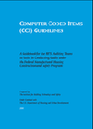
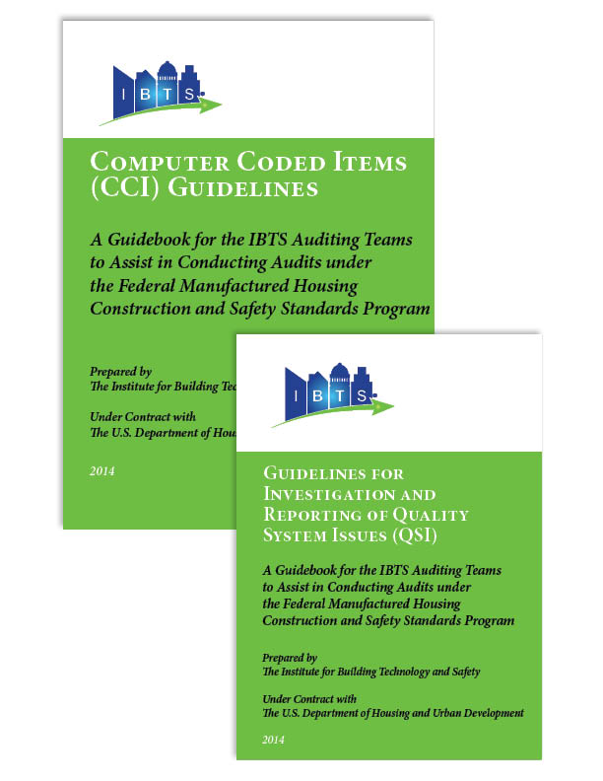
Guidelines for Investigation and Reporting of QSIs
An important set of guidelines for assuring the quality of HUD homes is the Guidelines for Investigation and Reporting of Quality System Issues (QSI) issued by the Institute for Building Technology and Safety.
HUD requires manufacturers to have a Quality System (QS) that is approved by the DAPIA agency and accepted by the IPIA agency.
MODULE 2.9 Guidelines for Investigation and Reporting of Quality System Issues
Notes:
Guidelines for Investigation and Reporting of Quality System Issues (QSI)
An important set of guidelines for assuring the quality of HUD homes is the Guidelines for Investigation and Reporting of Quality System Issues (QSI) issued by the Institute for Building Technology and Safety. These guidelines lay out the quality control process and the requirements for in-plant inspections and auditing of the quality control system. HUD requires manufacturers to have a Quality System (QS) that is approved by the DAPIA agency and accepted by the IPIA agency. The QS commits the manufacturer to conduct adequate inspections and tests the record with the standards. The Quality System includes the Quality Assurance Program in the Quality Control means as reflected in the approved Quality Assurance Manual.

Slide 37
Quality Assurance Manuals and IPIA Roles
Federal Manufactured Home Procedural and Enforcement Regulations require that a manufacturer submits information about its Quality Assurance Manual so that the DAPIA agency in order can review and approve the manufacturer’s Quality Assurance Manual.
The manufacturer’s DAPIA-Approved Quality Assurance manual outlines the programs, methods, procedures, personal responsibilities, training, checklists, forms, test equipment, documentation methods be used to assure compliance with the processes call for the manufactures Faulty Assurance Manual and the conformance of houses built.
MODULE 2.9 Guidelines for Investigation and Reporting of Quality System Issues
Notes:
Quality Assurance Manuals and IPIA Roles
Federal Manufactured Home Procedural and Enforcement Regulations require that a manufacturer submits information about its Quality Assurance Manual so that the DAPIA agency in order can review and approve the manufacturer’s Quality Assurance Manual. As a minimum the manual will include:
1. The manufacturer’s quality assurance program
2. An organizational chart showing accountability, by position, of the manufacturer's quality control personnel
3. A description of production line tests and test equipment for compliance with the Standards
4. A station by station description of the manufacturing process
5. A list of quality control inspections required by the manufacture of each station
6. Identification by title of each person will be held accountable for each quality control inspection
The manufacturer’s DAPIA-Approved Quality Assurance manual outlines the programs, methods, procedures, personal responsibilities, training, checklists, forms, test equipment, documentation methods be used to assure compliance with the processes call for the manufactures Faulty Assurance Manual and the conformance of houses built. The IPIA agency completes initial plant certification or updates its certification of a manufacturing facility. The purpose is to make sure that the quality processes and outlined in the manufacturers Quality Assurance Manual haven't adequately implemented to ensure conforming houses are being built. When the plant certification is completed the agency makes its report to HUD and supplies the manufacturing plant with labels there are a fixed to the manufactured home indicating that it has followed the Quality Assurance program as outlined in the Quality Assurance Manual.
As problems are found on the production line the IPIA agency representatives are required to determine the source of the problem the cause the failure to conform. By doing this the agency and the manufacturer are able to determine how well the Quality Assurance Manual is being followed.

Slide 38
Quality Assurance Manuals and IPIA Roles
As a minimum the manual will include:
  The manufacturer’s quality assurance program
  An organizational chart showing accountability, by position, of the manufacturer's quality control personnel
  A description of production line tests and test equipment for compliance with the Standards
  A station by station description of the manufacturing process
  A list of quality control inspections required by the manufacture of each station
  Identification by title of each person will be held accountable for each quality control inspection
MODULE 2.9 Guidelines for Investigation and Reporting of Quality System Issues

Slide 39

The Role of the IBTS
The Institute for Building Technology and Safety (IBTS) produces Guidelines for Investigation and Reporting of Quality System Issues (QSI).
The IBTS Audit teams evaluate the performance of the IPIA agency and how well it is ensuring the manufacturer’s compliance with the Quality Assurance Manual and the conformance of the homes being built.
MODULE 2.9 Guidelines for Investigation and Reporting of Quality System Issues
Notes:
The Role of the Institute for Building Technology and Safety (IBTS)
The Institute for Building Technology and Safety (IBTS) is responsible for conducting evaluations of how well the IPIA agency is monitoring the manufacturer’s Quality Assurance system. IBTS produces t Guidelines for Investigation and Reporting of Quality System Issues (QSI). The IBTS Audit teams evaluate the performance of the IPIA agency and how well it is ensuring the manufacturer’s compliance with the Quality Assurance Manual and the conformance of the homes being built. IBTS ensures that the IPIA representatives are evaluating the key Quality Control Elements in the plant. These elements include:
Use of approved checklists
Thoroughness of inspections
Quality Assurance accountability
Production line testing
Work process and description correspond to the Quality Assurance Manual
Compatibility of the work process and approved checklist
Quality Assurance Operations
Training Current
Design approvals
Designs used by plant personnel
Availability of all applicable designs
Receipt and storage of materials
Installation of materials
The bottom-line question that the IBTS audit team tries to answer when evaluating the performance of the IPIA agency is: Has the IPIA representative determined that the quality control system can ensure that conforming homes are produced on a continued basis?

Slide 40
The Role of the IBTS
Quality Control Elements:
Use of approved checklists
Thoroughness of inspections
Quality Assurance accountability
Production line testing
Work process and description correspond to the Quality Assurance Manual
Compatibility of the work process and approved checklist
Quality Assurance Operations
Training Current
Design approvals
Designs used by plant personnel
Availability of all applicable designs
Receipt and storage of materials
Installation of materials
MODULE 2.9 Guidelines for Investigation and Reporting of Quality System Issues

