Slide 1
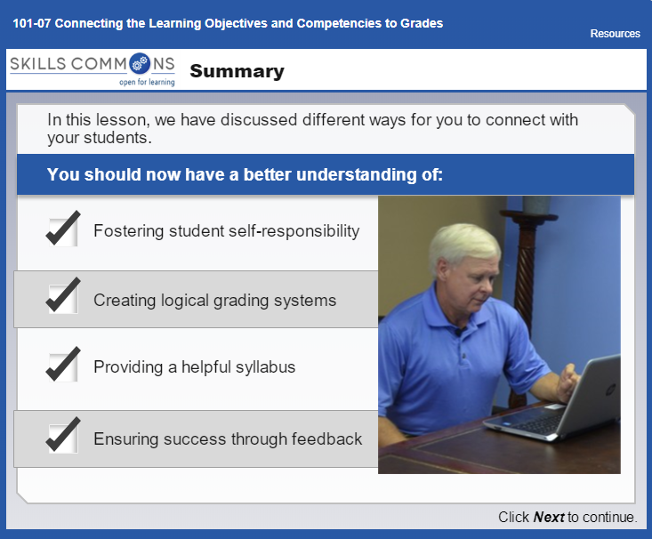
ED211 Module 3: Connecting Learning Objectives to Competencies and Grades
The four topics discussed in Module 3 are listed on the right.
Select the one topic you struggle with the most or have the least experience with.
Post a question about this topic to the class. The goal here is to create a conversation that will help generate ideas to assist you with your students.
Refer to personal experiences and concepts covered in the assessment to prepare your questions and responses.
Respond to at least one other post within the thread.
ED 211 Methods of Lesson Planning and Instruction" by Donna Hanks, Western Dakota Technical College is licensed under CC BY 4.0 / A derivative from the original work

