Slide 1
Chapter 45
Urinary Elimination
NUR 192

Slide 2
Scientific Knowledge Base:
Organs of Urinary Elimination
Kidneys Remove waste from the blood to form urine | Ureters Transport urine from the kidneys to the bladder
Bladder Reservoir for urine until the urge to urinate develops | Urethra Urine travels from the bladder and exits through the urethral meatus

Slide 3
Acts of Urination
Brain structure influences bladder function.
  Cerebral cortex, thalamus, hypothalamus, brain stem
  Urination (Micturition): Normal voiding involves the contraction of the bladder and coordination/relaxation of the urethral sphincter.
    Bladder holds as much as 600 mL of urine
    Desire to Urinate:
      Adult: 150-200mL
      Child: 50-100 mL
    Reflux Incontinence

Slide 4
Multiple Factors Influence Urination
Disease Process
Disease conditions are classified as prerenal (decreased blood flow to and through the kidney), renal (disease conditions of the renal tissue), or postrenal (obstruction in the lower urinary tract that prevents urine flow from the kidneys).
Specific diseases include: diabetes mellitus, multiple sclerosis, BPH, Alzheimer's disease, Parkinson’s disease, and degenerative joint disease.

Slide 5
Diseases That Cause Irreversible Damage
ESRD
  Irreversible damage to the kidney tissue
Uremic syndrome
  Increase in nitrogenous wastes in the blood, fluid and electrolyte abnormalities, nausea, vomiting, headache, coma, and convulsions.
  If progresses, may require renal replacement therapies.

Slide 6
Dialysis
Dialysis can be peritoneal or renal. Peritoneal is an indirect method of cleaning the blood of waste products using osmosis and diffusion with the peritoneum functioning as a semipermeable membrane.
Hemodialysis uses a machine equipped with a semipermeable filtering membrane that removes accumulated waste products and excess fluids from the blood. The processes of diffusion, osmosis, and ultrafiltration cleanse the client’s blood. The blood returns through a vascular access device (Gore-Tex graft, AV fistula, or hemodialysis catheter.
Organ transplantation is the replacement of the client’s diseased kidneys with a healthy one from a living or cadaver donor.

Slide 7
Terms
Nocturia is the urge to void that awakens one at night.
Polyuria is an excessive output of urine.
Oliguria is a decreased urinary output in spite of adequate fluid intake.
Anuria is when the kidneys produce no urine.
Dysuria -burning during urination as urine passes through inflamed tissues.
Cystitis - an irritated bladder. Can lead to the bladder and urethral mucosa causing hematuria.
Pyelonephritis is an infection that has spread to the kidneys. S/S are flank pain, tenderness, fever, and chills.

Slide 8
Alterations in Urinary Elimination
Urinary retention An accumulation of urine due to the inability of the bladder to empty | Urinary tract infections (UTIs) Can Result from catheterization or procedure Other: residual urine, poor perineal hygiene
Urinary incontinence Involuntary leakage of urine | Urinary diversions Diversion of urine to external source

Slide 9
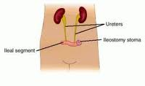
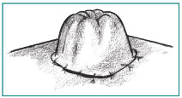
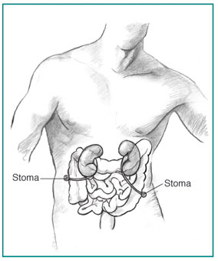
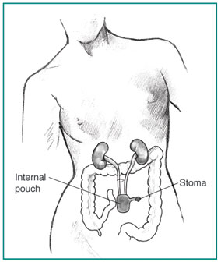
continent pouch
Nephrostomy

Slide 10
Nursing Knowledge Base
Infection control and hygiene
Growth and development
Muscle tone
Psychosocial considerations
Cultural considerations

Slide 11
Nursing Process and Alterations in Urinary Function
Assessment
  Nursing history
    Patterns of urination
      Frequency, times of day, normal volume, recent changes
    Symptoms of urinary alterations
      Urgency, void when sneezing or coughing
    Factors affecting urination
      Age, environment, medications, psychological factors, muscle tone, fluid balance, current surgical/diagnostic procedures, presence of disease conditions.

Slide 12
Physical Assessment
Skin and Mucosal Membranes Assess hydration | Kidneys Flank pain may occur with infection or inflammation
Bladder Distended bladder rises above symphysis pubis | Urethral Meatus Observe for discharge, inflammation, and lesions

Slide 13
Assessment of Urine
Daily Weights & Intake and output
Color
  Pale-straw to amber color
Clarity
  Transparent unless pathology is present
Odor
  Ammonia in nature

Slide 14
Weights and Intake & Output
Daily Weights & Intake and output
  Weights
  I&O:
    Indications:
    Intake Includes:
      Oral: ANY & all liquids by mouth: gelatin, ice cream, soup, juice, water;
Other: Any type of feeding received thru a tube; IV fluids
(continuous, intermitant-piggybacks-, flushes), blood &
blood components, liquid medications, water to flush NG
tubes (before/after meds)
    Output Includes:
      urine, diarrhea, vomitus, gastric suction, drainage from postsurgical wounds or other tubes

Slide 15
Weights and Intake & Output
Output Collection & Measurement:
  Ambulatory Client:
    Save urine in a calibrated Container
      Puritan hat, graduated cylinder: Fig 41-8 pg 983
      Measure & record amount after each void
  Bed-bound
    Bed pan, urinal
    Measure & record amount after each void
  Foley Catheter/Tube/suction
    Foley: empty urine into a graduated container or
      Urimeter: attached to foley & drainage bag (holds 100-200 ml) and then empty into drainage bag. Used for precise measurement
    Drainage/Suction: empty container
  Documentation
  I&O calculated by shift & over 24 hours
  REPORT: end of shift I&Os; ANY hourly output < 30 mL over 2 hours; high volumes: 2000-2500 ml daily.

Slide 16
Diagnostic test & Examinations
Collection:
  Test determines method
  Each specimen:
    Must be labeled including: client’s name, date & time of collection.
    Transported to lab timely
    Collection:
    TABLE 45-2.
      Random,
      Mid-stream (clean): Skill 45-1
      Sterile – if client has Foley
        Obtain thru sampling port. Clamp tubing below port & allow collection in tube, use antimicrobial swab and withdraw 3-5 mL with syringe. Place urine in sterile container
      Timed – 2,-12, or 24 hour collections
        Time begins after client urinates & ends with a final voiding at the end of the time period

Slide 17
Diagnostic test & Examinations
Testing:
  Urinalysis:
    First voided
    pH: (4.6-8.0)
    Protein (none or up to 8mg/100mL)
    Glucose: none
    Ketones: none
    Blood: none
  Specific gravity: 1.0053-1.03
  Culture
  Diagnostic: Noninvasive examination, Invasive examination
    Signed consent for procedure, assess for allergies (shellfish (iodine), pre-test instructions (NPO, clear liquids, bowel cleansing)

Slide 18
Implementation
Catheterization
Catheter insertion
Catheter care
Alternative to urethral catheterization

Slide 19
Procedure for Catheterization
Supplies:
Catheterization Kit
Bath Blanket
Additional light - penlight
Sterile gloves
Tape
Sharpie

Slide 20
Implementation of skill
1. provide privacy
2. Raise bed to a comfortable height
3. Drape patient with blanket
4. Remove wrapper of packet and use as a trash bag.
5. Apply clean gloves locate land mark –change gloves and wash hands.
6. Open sterile kit
7. Place drape under buttock – Shinny side down
8. Apply sterile gloves

Slide 21
Cont.
9. Open Betadine – be sure not allergic – pour over cotton balls.
10. Squirt lubricate on tray
11.Test balloon on catheter, and aspriate fluid back.
12. Spread lubricate on catheter and place back in box
13. Separate trays and move top one forward.

Slide 22
Cont.
Pick up cotton balls with forceps and clean client. Top to bottom starting on side away from you first, other side, then down middle. Different cotton ball each time.
Pick up catheter and insert 2-3 inches for female and 6-8 inches for male or until you see urine.
Hold catheter in place and blow up balloon to secure, then tape in place.

Slide 23
Cont
Removal of foley:
1. obtain order
2. Gather supplies
3. Empty collection bag and remove
4. Place towel under hip
5. Withdraw solution with 10 cc syringe
6. Squirt solution into trash and do a second time making sure balloon collapsed.
Clean patient and remove dirty items to dirty utility room.

Slide 24
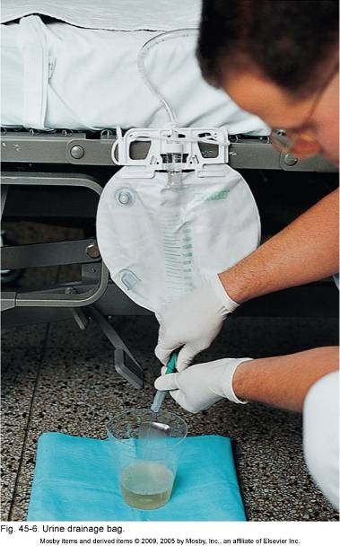

Slide 25
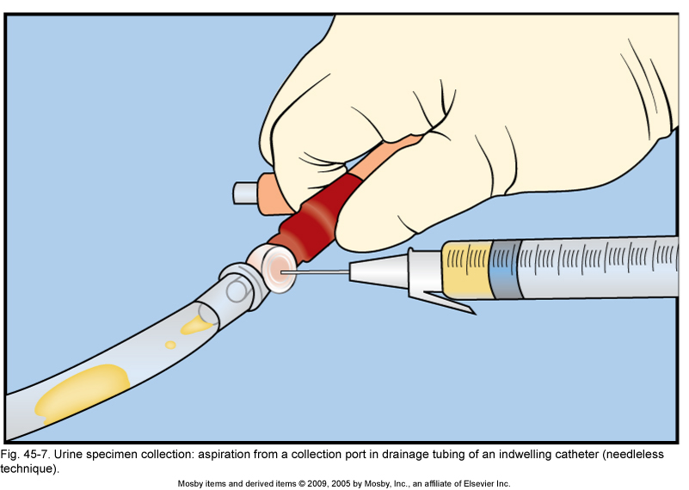

Slide 26
Evaluation
Determine if client has met outcomes and goals.
Evaluate how the client reports improvement that are made.
Help the client redefine goals if needed.
Revise nursing interventions as indicated.

Slide 27
Lets look at J.T’s 24 hour intake
J. T.’s primary IV is running at 34 ml/hr while NPO. The nurse runs Vancomycin 250 mg IV q 8 hr [volume is 100 ml per dose]. Then the nurse administers ampicillin (395 mg IV q 6 hr) it is given in 10 ml syringes . Since microtubing was used for the medications, total flush is negligible (approximately 3 ml). What is John’s total intake for 24 hours?
Calculate using the critical information:

Slide 28
This work is licensed under a Creative Commons Attribution 4.0 International License.
Except where otherwise noted, this content by Southern Regional Technical College is licensed under the Creative Commons Attribution 4.0 International License. To view a copy of this license, click https://creativecommons.org/licenses/by/4.0/
Healthcare Careers Work!(HCW) is sponsored by a $2.3 million grant from the U.S. Department of Labor, Employment & Training Administration. TAACCCT Grant #TC- 26488-14-60-A-13. Southern Regional Technical College is an equal opportunity employer and will make adaptive equipment available to persons with disabilities upon request.
This workforce product was funded by a grant awarded by the U.S. Department of Labor’s Employment and Training Administration. The product was created by the grantee and does not necessarily reflect the official position of the U.S. Department of Labor. The U.S. Department of Labor makes no guarantees, warranties, or assurances of any kind, express or implied, with respect to such information, including any information on linked sites and including, but not limited to, accuracy of the information or its completeness, timeliness, usefulness, adequacy, continued availability, or ownership.

