Slide 1
Chapter 25
Patient Education

Slide 2
Standards for Client Education
The Joint Commission sets standards for client and family education.
Successful accomplishment of standards requires collaboration among health care professionals.
All state Nurse Practice Acts recognize that patient teaching falls within the scope of nursing practice.

Slide 3
Purpose of Client Education
To help individuals, families, or communities achieve optimal levels of health
Patient education includes:
  Maintenance and promotion of health and illness prevention
  Restoration of health
  Coping with impaired functioning

Slide 4
Teaching and Learning
Teaching
  An interactive process that promotes learning
Learning
  The purposeful acquisition of knowledge, skills, behaviors, and attitudes

Slide 5
Role of the Nurse in
Teaching and Learning
Teach information that the patient and the family need to make informed decisions regarding their care.
Determine what patients need to know.
Identify when patients are ready to learn.

Slide 6
TJC’s Speak Up Tips
Speak up if you have questions or concerns.
Pay attention to the care you get.
Educate yourself about your illness.
Ask a trusted family member or friend to be your advocate.
Know which medicines you take and why.
Use a health care organization that has been carefully evaluated.
Participate in all decisions about your treatment.

Slide 7
Teaching as Communication
Closely parallels the communication process.
Depends in part on effective interpersonal communication.
The learning objective describes what the learner will be able to accomplish after instruction is given.

Slide 8
Domains of Learning
Cognitive | Includes all intellectual behaviors and requires thinking
Affective | Deals with expression of feelings and acceptance of attitudes, opinions, or values
Psychomotor | Involves acquiring skills that require integration of mental and muscular activity
Copyright line.

Slide 9
Quick Quiz!
1. A patient newly diagnosed with diabetes needs to learn how to use a glucometer. Use of a glucometer constitutes
A. Affective learning.
B. Cognitive learning.
C. Motivational learning.
D. Psychomotor learning.
25 - 9

Slide 10
Domains of Learning
Different teaching methods are appropriate for each domain of learning.
Cognitive: discussion (one-on-one or group), lecture, question-and-answer session, role play, discovery, independent project, field experience
Affective: role play, discussion (one-on-one or group)
Psychomotor: demonstration, practice, return demonstration, independent projects, games

Slide 11
Basic Learning Principles
Motivation to learn: addresses the client’s desire or willingness to learn
Ability to learn: depends on physical and cognitive abilities, developmental level, physical wellness, thought processes
Learning environment: allows a person to attend to instruction

Slide 12
Ability to Learn
Adult learning
  Self-directed
  Patient-centered
Physical capability
  Level of personal development
  Physical health
  Fatigue

Slide 13
Learning Environment
Well lit | Good ventilation
Appropriate furniture | Comfortable temperature
Quiet | Private

Slide 14
Integrating the Nursing and Teaching Process
A relationship exists.
The nursing and teaching process are not the same.
The nursing process requires assessment of all data.
The teaching process focuses on the client’s learning needs and ability to learn.
When education becomes part of the care plan, the teaching process begins.

Slide 15
Nursing Process: Assessment
See through the patient’s eyes.
  Teaching is patient-centered.
Assess the patient’s learning needs.
Ask questions to identify motivation to learn.
Determine the patient’s physical and cognitive ability to learn.
Provide an appropriate teaching environment.
Assess the readiness and ability of a family caregiver or other learning resource.
Assess health literacy/learning disabilities.

Slide 16
Nursing Process: Assessment (
Health literacy: the cognitive and social skills that determine the motivation and ability of individuals to gain access to, understand, and use information in ways that promote and maintain good health.
Health literacy includes patients’ reading and mathematics skills, comprehension, and decision-making and functioning skills with regard to health care.

Slide 17
Nursing Process: Nursing Diagnosis
Nursing diagnoses for patient education
  Deficient knowledge (affective, cognitive, psychomotor)
  Ineffective health maintenance
  Impaired home maintenance
  Ineffective family therapeutic regimen management
  Ineffective self-health management
  Noncompliance (with medications)

Slide 18
Nursing Process: Planning
Determine goals and expected outcomes that guide the choice of teaching strategies and approaches with a patient:
  Set priorities.
  Select timing to teach.
  Organize the teaching materials.
  Use teamwork and collaboration.

Slide 19
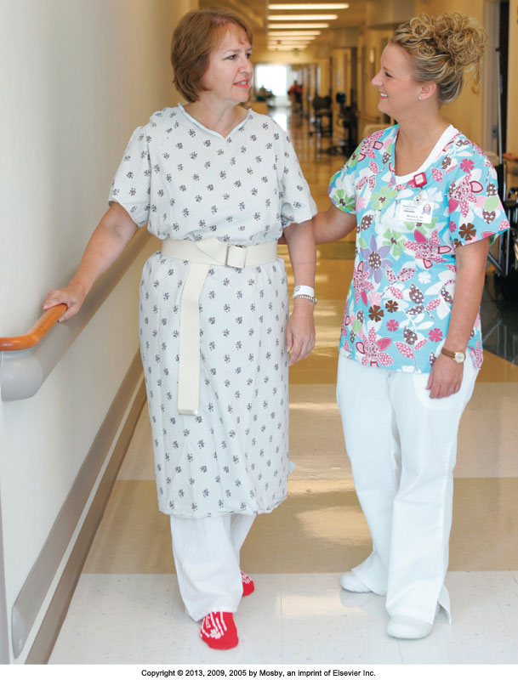
Nursing Process: Implementation
Maintain learning attention and participation.
Build on existing knowledge.
Select teaching approach.
Incorporate teaching with nursing care.

Slide 20
Nursing Process: Implementation (cont’d)
Select appropriate instructional methods:
  Group instruction
  One-on-one discussion
  Preparatory instruction
  Demonstration
  Analogy
  Role playing
  Simulation

Slide 21
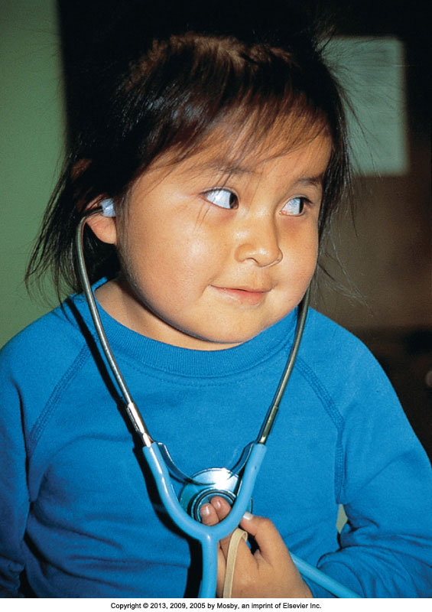
Nursing Process: Implementation (cont’d)
Illiteracy and other disabilities
Cultural diversity
Using different teaching tools
Special needs of children and older adults

Slide 22
Quick Quiz!
2. During a teaching session, the nurse tells a patient with a recent neck injury that damage to the nerves is comparable to a water hose that has been pinched off. During this teaching session, the nurse is using the process of
A. Analogy.
B. Discovery.
C. Role playing.
D. Demonstration.
25 - 22

Slide 23
Nursing Process: Evaluation
See through the patient’s eyes.
  Have the patient’s learning needs been met?
Evaluate a patient’s learning by observing performance of expected learning behaviors under desired conditions.
Discontinue, adjust, or amend the plan.
Patient outcomes:
  Legal responsibility
  Documentation

Slide 24
This work is licensed under a Creative Commons Attribution 4.0 International License.
Except where otherwise noted, this content by Southern Regional Technical College is licensed under the Creative Commons Attribution 4.0 International License. To view a copy of this license, click https://creativecommons.org/licenses/by/4.0/
Healthcare Careers Work!(HCW) is sponsored by a $2.3 million grant from the U.S. Department of Labor, Employment & Training Administration. TAACCCT Grant #TC- 26488-14-60-A-13. Southern Regional Technical College is an equal opportunity employer and will make adaptive equipment available to persons with disabilities upon request.
This workforce product was funded by a grant awarded by the U.S. Department of Labor’s Employment and Training Administration. The product was created by the grantee and does not necessarily reflect the official position of the U.S. Department of Labor. The U.S. Department of Labor makes no guarantees, warranties, or assurances of any kind, express or implied, with respect to such information, including any information on linked sites and including, but not limited to, accuracy of the information or its completeness, timeliness, usefulness, adequacy, continued availability, or ownership.

