Slide 1


Introduction
This workforce solution was funded by a grant awarded by the U.S Department of Labor’s Employment and Training Administration. The solution was created by the grantee and does not necessarily reflect the official position of the U.S Department of Labor. The Department of Labor
makes no guarantees, warranties, or assurances of any kind, express or implied, with respect to such information, including any information on linked sites and including, but not limited to, accuracy of the information or its completeness, timeliness, usefulness, adequacy, continued
availability, or ownership.
.
#ROADTOREADINESS
Why Wait? Explore College & Career Options NOW!
Stephanie Flowers – Success Coach
330.494.6170
sflowers@starkstate.edu
This work is licensed under the Creative Commons 4.0 International License. It is attributed to Ohio TechNet. To view a copy of this license, visit .
This workforce product was funded by a grant awarded by the U.S. Department of Labor’s Employment and Training Administration. The product was created by the grantee and does not necessarily reflect the official position of the U.S. Department of Labor. The U.S. Department of Labor makes no guarantees, warranties, or assurances of any kind, express or implied, with respect to such information, including any information on linked sites and including, but not limited to, accuracy of the information or its completeness, timeliness, usefulness, adequacy, continued availability, or ownership.
This work is licensed under the Creative Commons Attribution 4.0 International License. It is attributed to Ohio TechNet. To view a copy of this license, visit http://creativecommons.org/licenses/by/4.0/.
Notes:
Greetings!
My name is Stephanie Flowers and I am a Success Coach in the Engineering Technologies department at Stark State College. Tonight we are going to talk about some of the exciting and affordable programs we have at Stark State College. I will discuss with you some of the Industrial Programs we have, Jean Barbatos and Dan Schweitzer will discuss opportunities within the Oil and Gas division. We have Danielle here from admissions who can answer any questions you may have about the admissions process, financial aid and any other questions you may have.
Mrs. Anne Fritz, guidance counselor for Litchfield Middle School and Principal Larry Johnson were gracious enough to allow us to come and speak with you. At the end of our presentation, if you are interested in coming to main campus for a tour of our facilities, please sign the sign up sheet outside the auditorium.

Slide 2
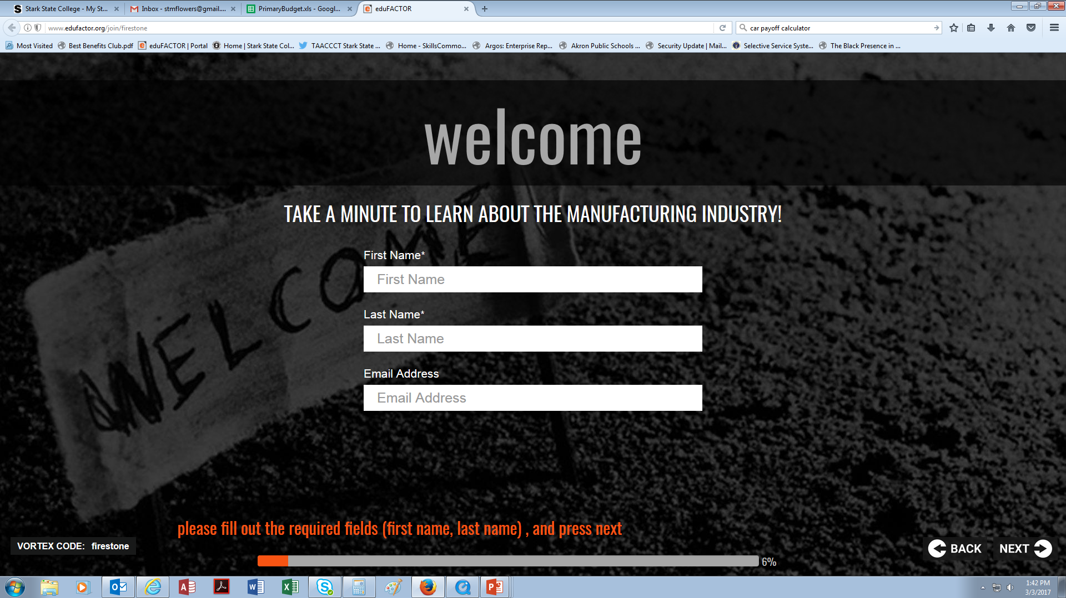
sdsdsd
http://www.edufactor.org/join/firestone -
Notes:
Did everyone bring their cell-phones? Great!
Let’s start our discussion by taking a minute to learn about the manufacturing industry. Go to www.edufactor.org/join/firestone.

Slide 3
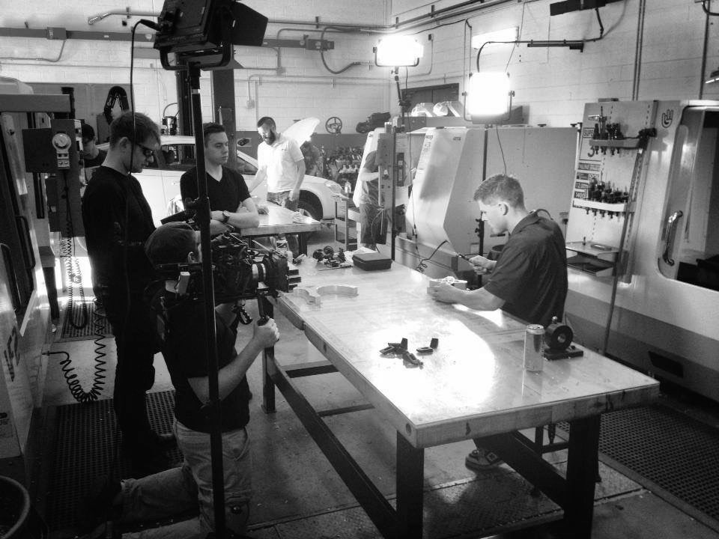

When passions are pursued
Companies are
Started
Careers are
launched
The economy is
strengthened
When you pursue your passion and connect your ideas to your hands powerful things happen…
#ROADTOREADINESS
Notes:
The manufacturing field is in need of career employees in Ohio. Based on data compiled by SPR from Ohio, PA and WV DOL, WFD and ODJFS it is projected that over the next 10 years, there will be an increase in the following areas. This is attributed to both job growth as well as the need to replace an aging workforce.
Machinists 8.34%
Industrial Machinery Mechanics 20.48%
CNC Machine Tool Operators 17.21%
CNC Machine Tool Programmers 25%
Welders 7.37%
Think about what it going on around you, how many of you had the opportunity to attend the car show or follow what’s going on in the automobile industry?
The transportation industry is moving towards shared, autonomous and electric cars….that means manufacturing is becoming more high tech than ever.
But not only do they need individuals that understand how to make and program different products, but also people that can maintain it.
Please understand that the idea of needing a 4yr degree in order to launch a career, make good money and raise a family is a myth.

Slide 4
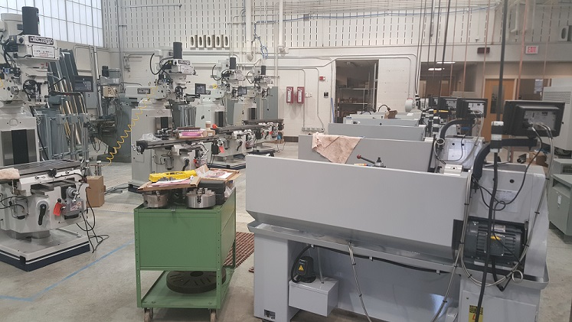
Equipment
ABOUT
Advanced manufacturing at stark:
  $1 million dollar investment from DOL, Timken, Haas
  4- Manual lathes, 4- milling machines
  4-haas cnc machines , 2- 3d printers
#ROADTOREADINESS
Notes:
So what are we really talking about? We are here to talk about and dispel the myths associated with career fields that are in need of self-starters, innovators, individuals with entrepreneurial spirits, people who are not afraid to think outside of the box and can see the bigger picture, people like you!
Through the Trade Adjustment Assistance Community College Career Training Act under the Department of Labor, Stark State College was awarded over $1 million to upgrade its Advanced Training Center.

Slide 5
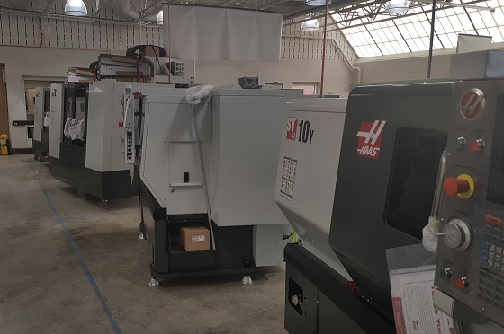
Stark State Lab
ABOUT
Career Pathways:
  cnc 1yr tech certificate
  AAS – Advanced manufacturing
#ROADTOREADINESS
Notes:
The department of Engineering Technologies has over 40 associates and certificates. Many of our programs are stackable and transferable to over 30 colleges and universities towards a bachelors degree. Students are also able to obtain credentialing after taking just one or two courses.
For example, if you look in your folder you will find information about our computer numerical control program. Students working towards the CNC One Year Certificate are able to obtain two additional career enhancement certificates at no additional cost. Students are also able to sit for the NIMS credential testing, which stands for National Institute for Metalworking Skills, which is the equivalent of receiving AWS for Welding or OSHA Certifications. This credential is available at no cost to the student and never expires. There are 4 credentials available.
The CNC 1yr cert is stackable into the Advanced Manufacturing Associate Degree which is also in your folder. You can begin working towards this now if you are in middle school or as a freshmen, sophomore or junior by taking classes through Stark States College Credit Plus Program which is also in your folder. You can begin taking your English, math arts & humanities and/or social & behavioral sciences elective courses for college credit free of charge! For more information speak with your guidance counselor about how you can ear college credit while working towards your high school diploma. The application process is simple and the admission criteria is that you just meet the pre-requisites for the class you wish to take. Again your guidance counselor can help you with that.
Our civil, electrical, mechanical and pre-engineering associates degrees articulate to BS degrees at the University of Akron.

Slide 6
Spend less earn more go farther
We provide affordable, transferable, quality education.
College/University | Annual tuition 30 credits per year | Savings per year
Stark State College* | $ 4,608
Average of Ohio public two-year colleges*² | $ 5,131 | $ 523
Average of public four-year universities in region* | $ 9,700 | $ 5,092
Average of private four-year universities in region* | $ 27,025 | $ 22,417
For-profit career colleges
Brown Mackie (North Canton) | $ 12,123 | $ 7,515
National College | $ 11,550 | $ 6,942
Herzing University (Akron) | $ 12,250 | $ 7,642
#ROADTOREADINESS
SCHOLARSHIPS
Notes:
Please understand that the idea of needing a 4yr degree in order to launch a career, make good money and raise a family is a myth. Companies today want students that have hands on practical experience, and the demand is great. If you follow the news, you hear the stories about manufacturers saying we have jobs but there aren’t any qualified workers, see the article in your folder from NPR.
Think about this, annual tuition at Stark State College is $4608 for 30 credits, that’s taking 15cr. In the fall and spring semester. Most 4yr. Colleges cost twice that amount per year, and that doesn’t include the room and board which is another $9k per year.
Stark State College also has an enormous amount of scholarship dollars to students.
For manufacturing, we have scholarship money available for students that would like to start this summer, which could potentially cover the entire cost of your program at Stark when combined with your Pell Grant, Choose Ohio First and other scholarship dollars.

Slide 7
An Advanced Manufacturing Degree (61 cr) IN 1 Calendar Year After High School?
Middle – High School College Credit Plus (CCP)
  English 3cr., Math 3cr., Arts & Humanities and/or Social & Behavioral Science 6cr.
    $1843.20 savings at Stark or an average of $4960.08 at a 4yr institution not including room and board which would be approximately $5,000 more
Summer
  Two core classes 10cr., Student Success Seminar 1cr.
Fall
  5 core classes 15cr.
  NIMS Credentialing Exam (@ no cost)
Spring
  5 core classes 16cr.
  NIMS Credentialing Exam (@ no cost)
Summer
  2 core classes 7cr.
  GRADUATION
Low Tuition Costs
$7,500 for 49cr.
- $3,500 Pell Grant*
--------------------------
$4,000
- $1,000 CCP Scholarship *
---------------------------
$3,000
- $1,500 Choose Ohio First*
- $1,500 Choose Ohio First*
-----------------------------
$0 – Balance Due
*pending eligibility; other scholarships are also available
Notes:
Lets think hypothetically: If you decided to pursue our advanced manufacturing degree which is 61cr. beginning in Middle or even high school and you completed your English, math and liberal arts electives that would be 12cr. The equivalent of one full-time semester at Stark, a savings of $1,843.20 at Stark or an average of $4,960.08 at a 4yr institution, not including room and board which would be approximately another $5k.
In a year and a half after graduating high school you could potentially earn your associates degree with minimal out-of-pocket expenses. And receive over 4 credentials.

Slide 8


Incredible Jobs
  Incredible
  jobs
SFS INTEC
AMERICAN STANDARD
ALCOA
SGS TOOLS
TRILOGY PLASTICS
TIMKEN STEEL
The average US manufacturing worker earns $77,506 annually. 20% higher than workers in other industries.
#ROADTOREADINESS

Slide 9

Student Success Services
STUDENT SUCCESS
SERVICES
Faculty Adviser
Success Coach
Tutoring
Career Development Services
Military Services
#ROADTOREADINESS

Slide 10

Your Future
“Your Future is created by what
You do
{
Today
}
and
tomorrow”
#ROADTOREADINESS
Notes:
There are contact cards in your folder. If you would like someone from admissions to contact you about any of our programs, please complete the card and turn in to Danielle. Again if you are interested in coming to main campus for a tour please fill out the sign up sheet located in the atrium.

