Slide 1
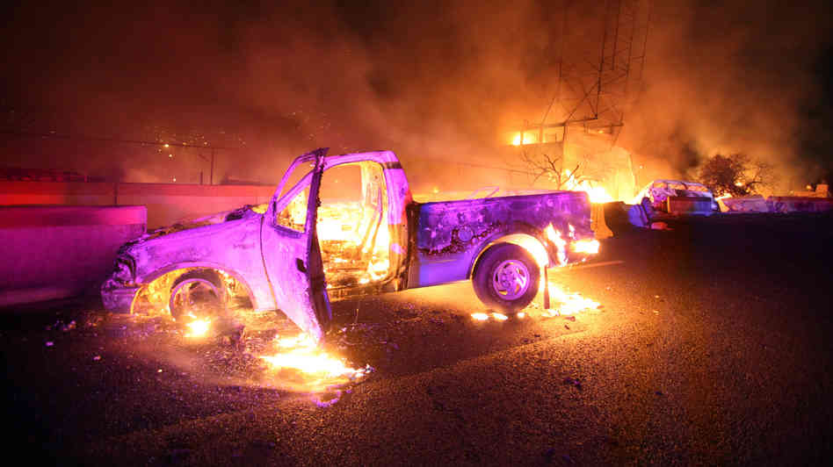
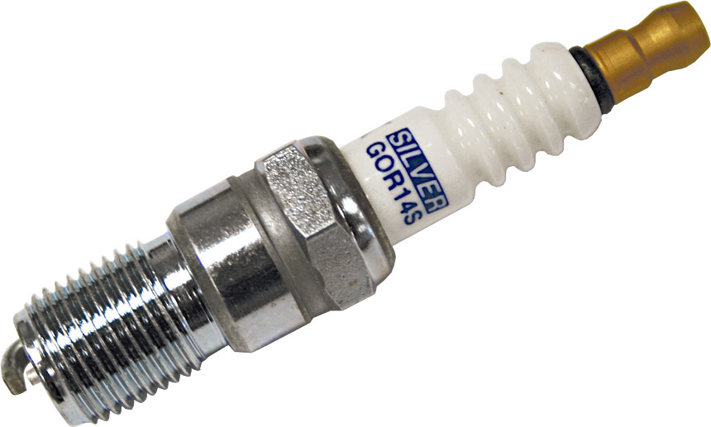
Ignition Systems
Chapter #10

Slide 2
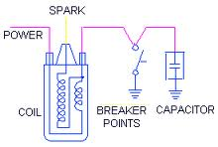
Basic Ignition System Operation
To provide sufficient voltage to discharge a spark between the electrodes of a spark plug.

Slide 3
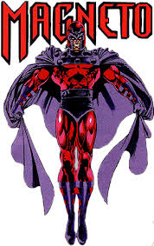
Ignition System Components
Most small engine use a magneto system or variation. Magneto is specific to a points system, but is used universally to describe various ignition systems. You decide what language you want to use… Control module… Ignition module…
  Permanent magnet
  Spark plug
  Sparkplug wire
  Ignition coil
  Switching device

Slide 4
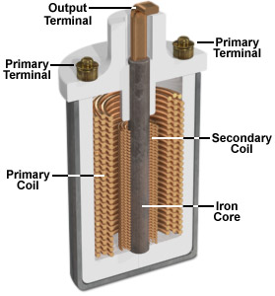
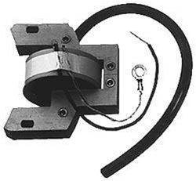
Ignition Coil

Slide 5
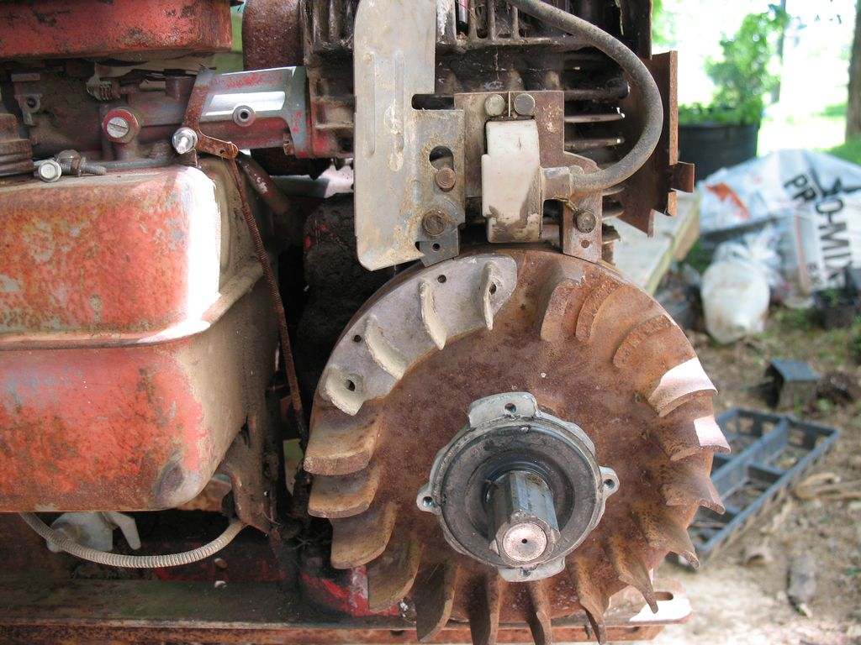

Slide 6
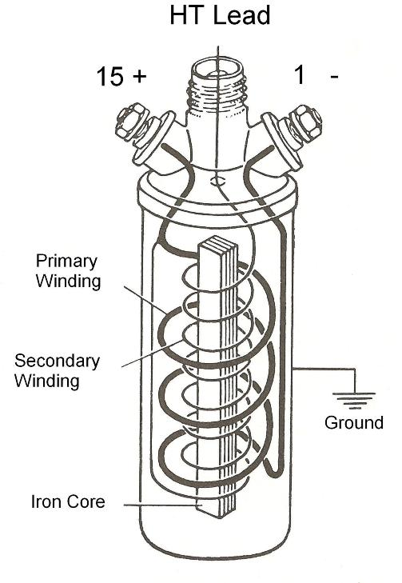

Slide 7
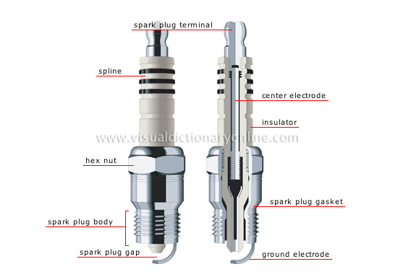
Spark Plugs

Slide 8
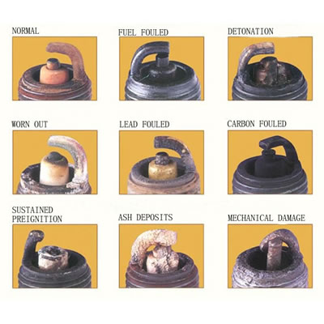
Spark Plugs

Slide 9
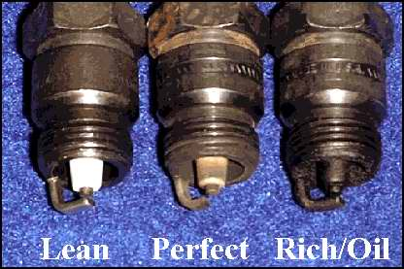

Slide 10
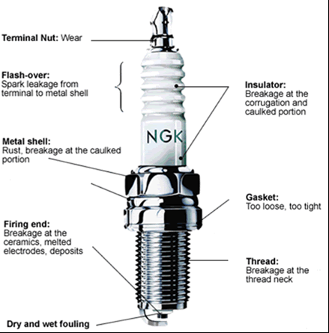

Slide 11
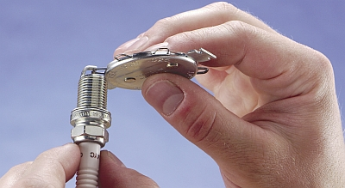
What is the gap?
Look it up… .023-.030 ???

Slide 12
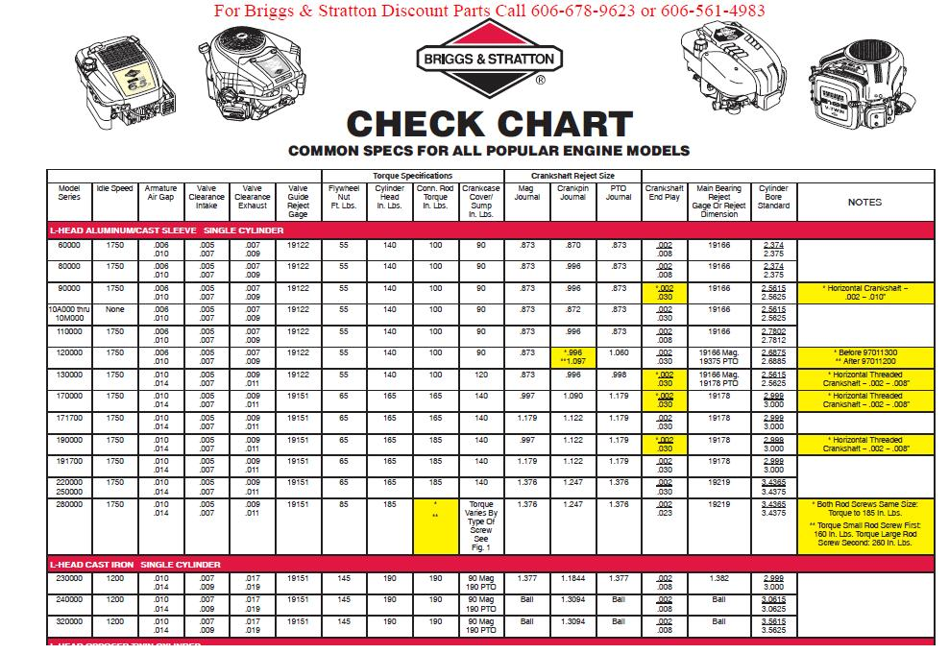

Slide 13
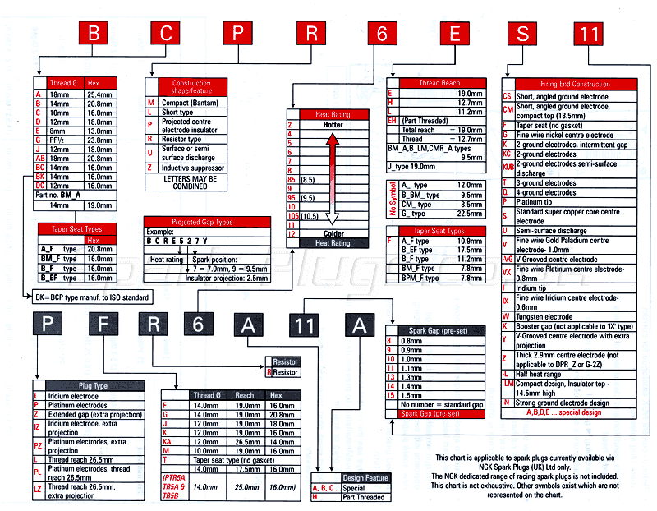
Spark Plug Code Interpretation

Slide 14
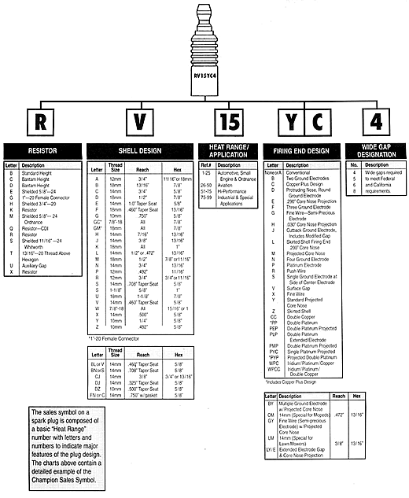

Slide 15
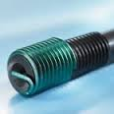
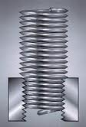
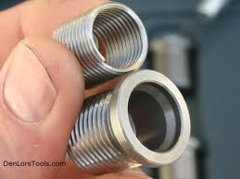
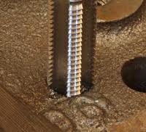
Plugs???
Replace every 100 hrs. or first sign of hard starting.
Torque: Alum. head 210 in/lbs Cast iron head 300 in/lbs
Battered or clogged threads M14 X1.25 metric tap
Heli-coil - Thread insert

Slide 16
Plug Brand?
Briggs uses Champion.
I use NGK or Bosch.
What will you use?

Slide 17
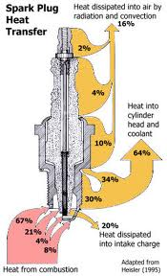
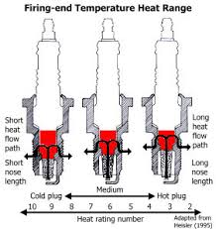
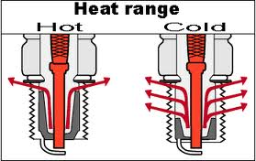
Spark Plug Heat Transfer
Heat range

Slide 18
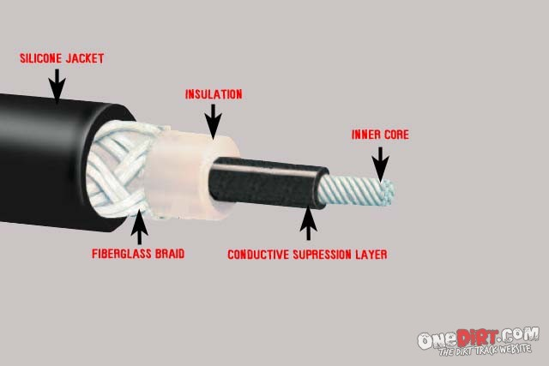
Spark Plug Wire

Slide 19
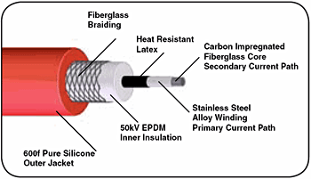

Slide 20
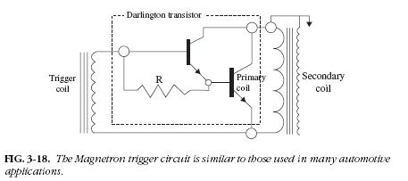
Switching Devices
Trigger collapsing field in primary coil – inducing a high voltage in secondary coil – firing plug – igniting fuel/air mixture – driving piston down on power stroke
Mechanical
Electronic

Slide 21
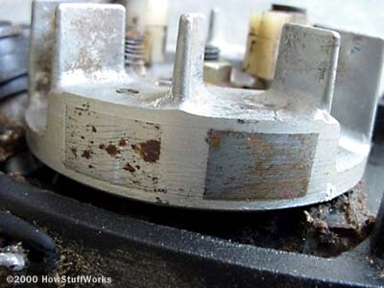
Flywheel - it’s magnetic…

Slide 22
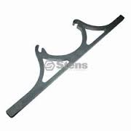
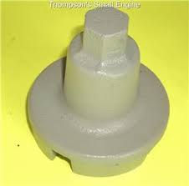
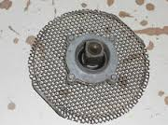
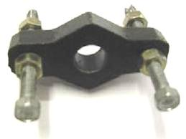
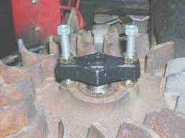
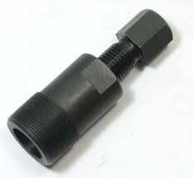
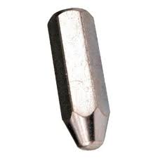
Removal - Flywheel
Starter drive – tool 19163
Puller
Shocker

Slide 23
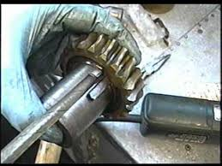
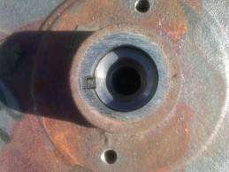
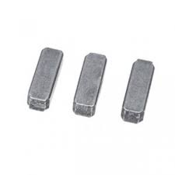
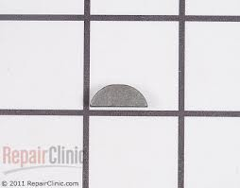
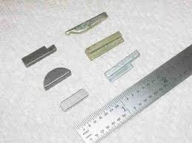
Key and keyway
Briggs uses soft aluminum
Other manufactures use steel
Replace flywheel or hub
if worn.
Magnets seldom wear out.
Should attract screwdriver
5/8”away.
CDI uses weaker magnets.

Slide 24
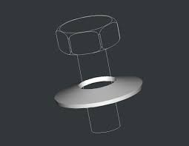
Installing Flywheel
Clean crankshaft
Bellville washer convex side up
30 wt. oil on bolt threads
Torque
  Engines >6 CID – 40 ft/lbs
  6 to 10 CID – 55 to 60 ft/lbs
  11 to 20 CID – 85 to 90 ft/lbs

Slide 25
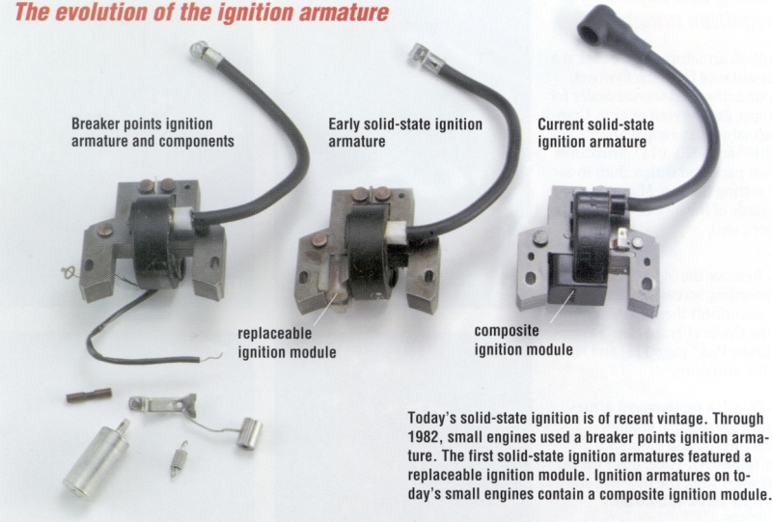

Slide 26
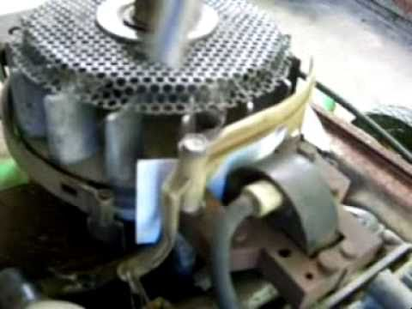

Slide 27
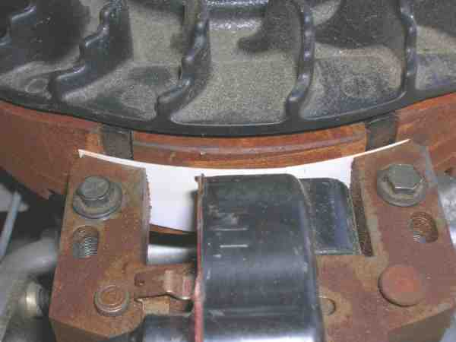

Slide 28
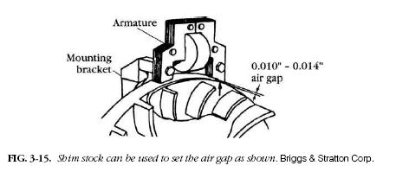
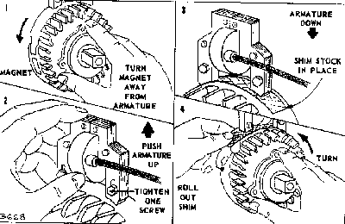
Use a business card

Slide 29
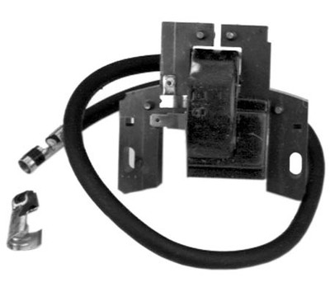
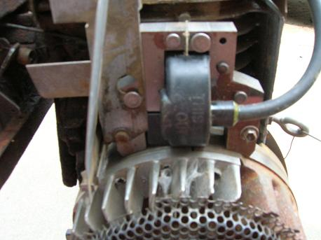
Magneto Ignition Systems

Slide 30
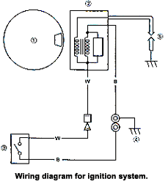
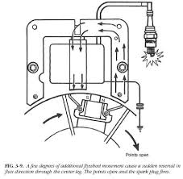

Slide 31
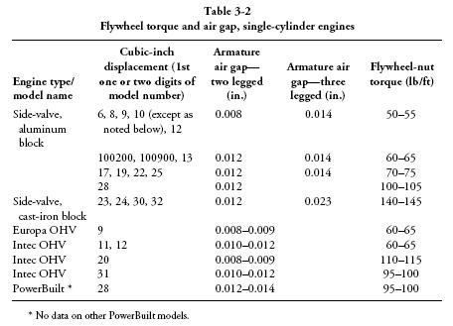

Slide 32

Capacitive Discharge Ignition (CDI)

Slide 33

CDI Ignition…
Do not run with battery disconnected…
Kohler Smart Spark CDI
Do not run with plug wire disconnected.

Slide 34
Flywheel magnets generate 200 VAC in the input coil
The Rectifier converts the AC output to DC storage in the capacitor
The SCR (silicon controlled rectifier) remains non-conductive to block capacitor discharge
About 180 degrees later flywheel magnet sweeps past the trigger coil to generate signal voltage across the resistor – this causes the SCR the conduct
The stored charge on the capacitor discharges through the primary side of the pulse transformer
Current flow in the primary side of the pulse transformer (actually the ignition coil) generates a 25K Volt potential in the secondary windings that goes to ground across the spark-plug electrodes
Caution: Solid-state components are vulnerable to stray and reversed-polarity voltage

Slide 35

Troubleshooting
Replace plug
Replace key is distorted or sheared
Check wiring, dielectric grease on contentions
Ignition interlock
Test unit (special tool) or replace with know good unit

Slide 36

Transistor-Controlled Ignition (TCI)
Magnetron
Plug terminal and engine
ground 3K – 5K Ohms.

Slide 37

Darlington Transistor
Used for amplification…

Slide 38

Mechanical Breaker Point Ignition (MBI)m

Slide 39


Slide 40


Slide 41


Slide 42

Test ign. Circuit
W or W/O plug

Slide 43


Slide 44


MSD
The MSD Enhancer system for the Briggs & Stratton/Tecumseh is designed as a complete system. The system has 12 Volts DC operating voltage, 14,000 (1 Cylinder) rpm range, 100 MJ energy output maximum, 14° – 18° (1 Cylinder) multi spark duration, 1.5 AMPS @ 10,000 RPM current requirements, Primary 450 Volts voltage output, and 30,000+ VOLTS with MSD Coil secondary voltage. The following schematic shows the MSD Briggs & Stratton/Tecumseh Ignition System Wiring Diagram.

Slide 45

Battery Ignition Systems
Textbook pages 208-209
  Figure 10-24, 10-25, & 10-26

Slide 46


The Lead-Acid Battery
6 cells, each cell 2.105V
Discharge rate 3-20% month
500-800 cycles

Slide 47
Batteries Cont.
Explosion – Hydrogen
Recycling
Baking soda or ammonia
Sulfating and DE sulfating
Types of Batteries
State of Charge | Specific Gravity | Voltage
 |  | 12V | 6V
100% | 1.265 | 12.7 | 6.3
75% | 1.225 | 12.4 | 6.2
50% | 1.190 | 12.2 | 6.1
25% | 1.155 | 12.0 | 6.0
Discharged | 1.120 | 11.9 | 6.0

Slide 49

Electrical System Simplified

Slide 50


Slide 51


Slide 52


Slide 53


Slide 54


Slide 55


