Slide 1
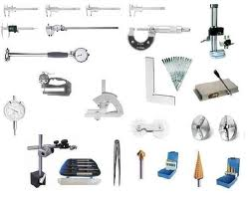

Tools and Measuring Instruments
Chapter #2

Slide 2






Hand Tools
Tool programs
Quality
Specialty

Slide 3
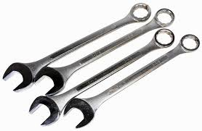
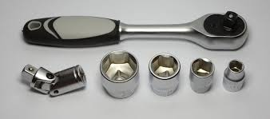

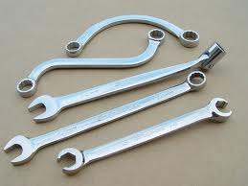
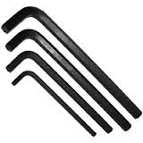
Wrenches
Open end
Box end
Adjustable
Tubing – fuel/brake line
Socket
Allen
Torx

Slide 4
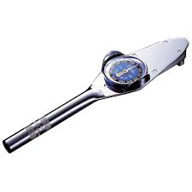
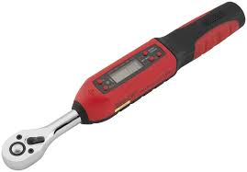
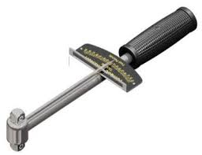
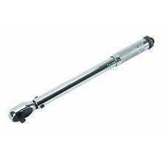
Torque wrenches
Beam
Click
Dial
Torque to yield
+ Degree
Foot/inch pounds

Slide 5
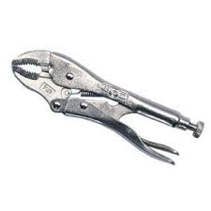
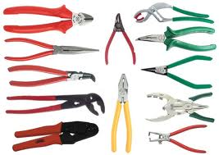
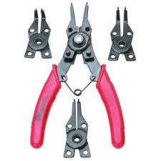
Pliers
Gripping, pulling, cutting
Vise-grips
Strippers
Retaining Ring
  Inside
  outside

Slide 6
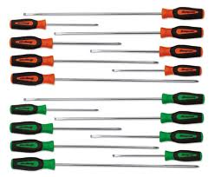
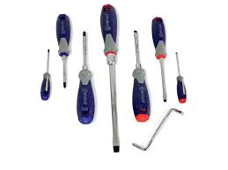
Screwdrivers
Slotted
Phillips
Offset

Slide 7
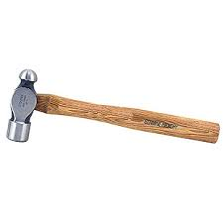
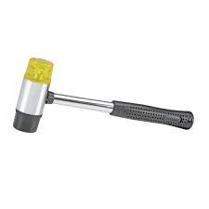


Hammers/punches
Ball peen
Rubber mallet
Plastic mallet
Center punch
Pin punch

Slide 8
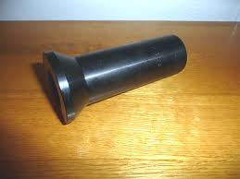

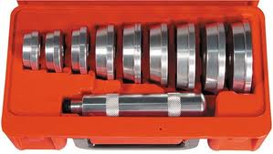
Seal Drivers

Slide 9

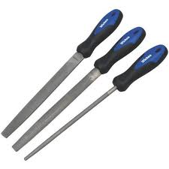
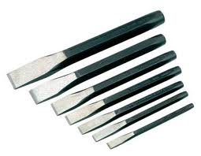
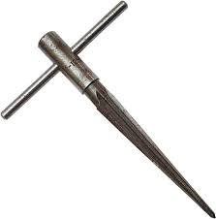
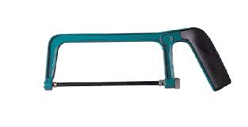
Assorted
Hacksaw
Reamers
Files
Chisels
Picks/probes/pickup

Slide 10
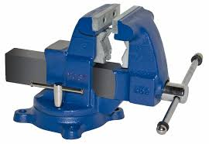
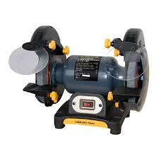
Vise/Bench Grinder

Slide 11
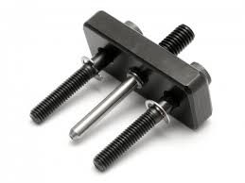
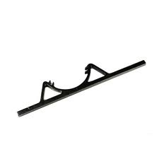
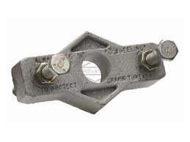
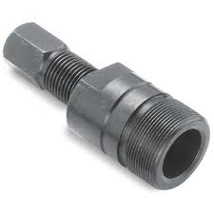

Pullers/Holders
Flywheel puller and holder
Starter clutch wrench

Slide 12
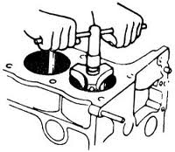
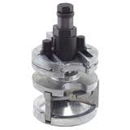
Ridge Reamer
Useful?

Slide 13

Ring Spreader
Useful?

Slide 14
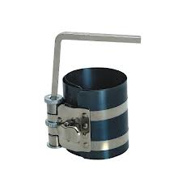
Ring compressor
Must have!
  Sized for small pistons
  Get a decent one

Slide 15


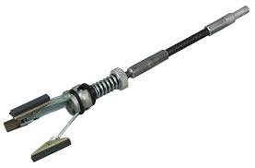
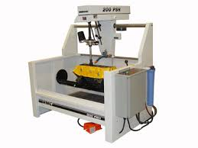
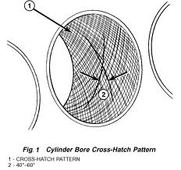

Cylinder Hone

Slide 16
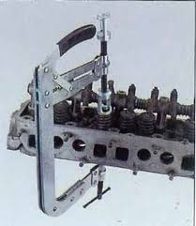
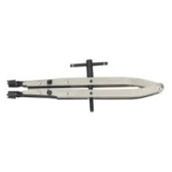
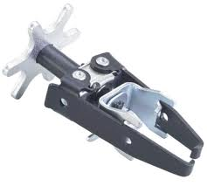
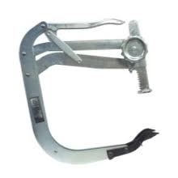
Valve Spring Compressor

Slide 17


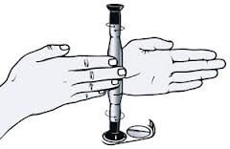

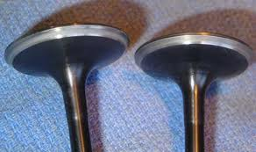
Lapping stick

Slide 18
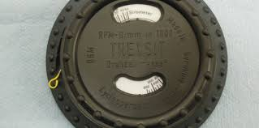
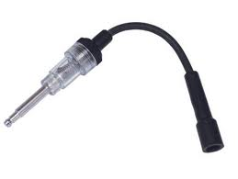
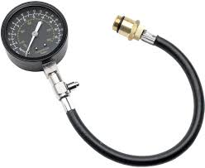
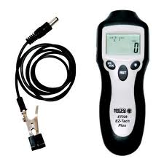
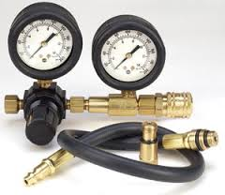
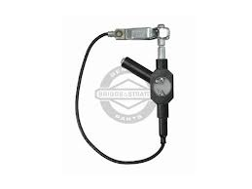
Engine Test Instruments
Tachometer
Spark Tester - a must…
Compression Tester
Leak Down Tester

Slide 19
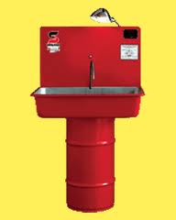

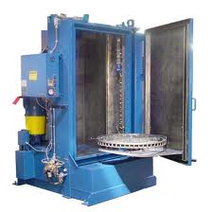
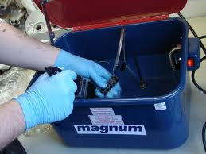
Cleaning Equipment
Parts washer/Fluid
  A must have item

Slide 20
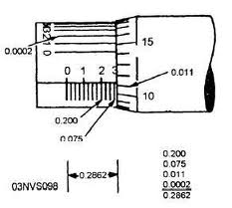

Measuring Instruments
Micrometers

Slide 21



Measuring Instruments
Vernier Caliper

Slide 22


Measuring Instruments
Dial Indictor

Slide 23



Measuring Instrument
Telescoping Gauge

Slide 24




Measuring Instrument
Small Hole Gauge

Slide 25



Measuring instrument
Thickness Gauge or Feeler Gauge

Slide 26



Measuring Instrument
Combination Square
  Measuring valve height
  Straight edge

Slide 27




Screw Gauge
How about an assortment of hardware???

Slide 28

Gateway Community College, 2014
This work is licensed under the Creative Commons Attribution 4.0 International License. To view a copy of this license, visit http://creativecommons.org/licenses/by/4.0/.
This workforce solution was funded by a grant awarded by the U.S. Department of Labor’s Employment and Training Administration. The solution was created by the grantee and does not necessarily reflect the official position of the U.S. Department of Labor. The Department of Labor makes no guarantees, warranties, or assurances of any kind, express or implied, with respect to such information, including any information on linked sites and including, but not limited to, accuracy of the information or its completeness, timeliness, usefulness, adequacy, continued availability, or ownership.

