Slide 1
Cranial Nerves

Slide 2
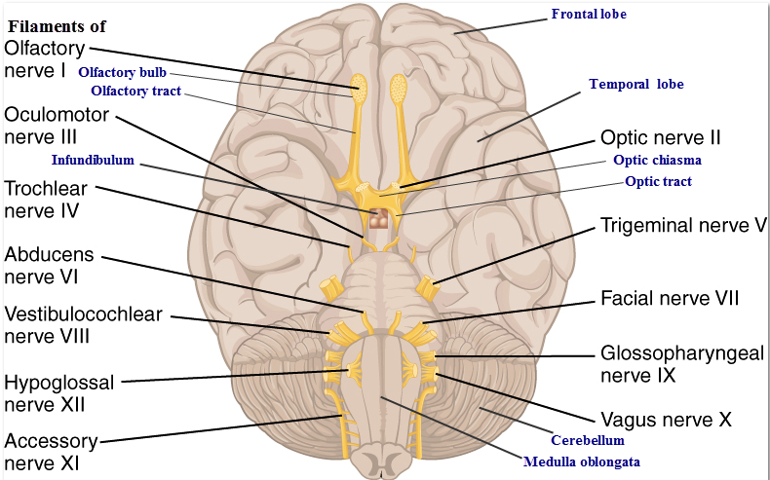
Labeled Cranial Nerves
Photo credit: Labeled Cranial Nerves modified from 1320_The Cranial Nerves by OpenStax CNX via Wikimedia Commons / CC BY-NC-SA

Slide 3
Cranial Nerves List
Olfactory (S) IX. Glossopharyngeal
Optic (S) X. Vagus (B)
Oculomotor (M) XI. Accessory (M)
Trochlear (M) XII. Hypoglossal (M)
Trigeminal (B)
Abducens (M)
Facial (B)
Vestibulocochlear (S)

Slide 4
Mnemonics
Oh Oh Oh To Take A Family Vacation. Go Vegas After Hours
Some Say Marry Money But My Brother Says Big Brains Matter More

Slide 5
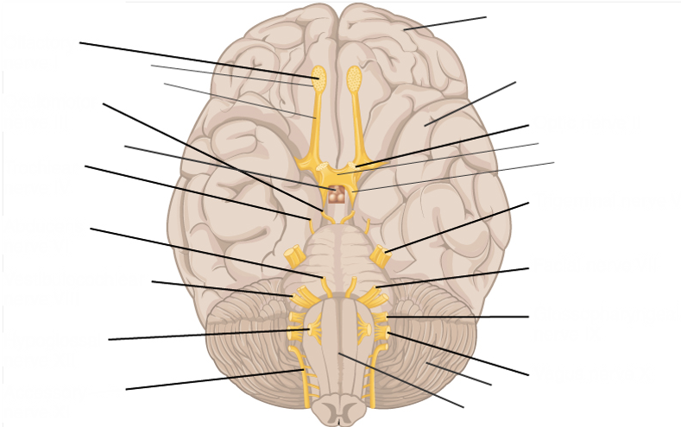
Cranial Nerves Labeling Exercise
Photo credit: Cranial Nerves Labeling Exercise modified from 1320_The Cranial Nerves by OpenStax CNX via Wikimedia Commons / CC BY-NC-SA

Slide 6
Department of Labor Disclaimer
This workforce solution was funded by a grant awarded by the U.S. Department of Labor's Employment and Training Administration. The product was created by the grantee and does not necessarily reflect the official position of the U.S. Department of Labor. The U.S. Department of Labor makes no guarantees, warranties, or assurances of any kind, express or implied, with respect to such information, including any information on linked sites, and including, but not limited to, accuracy of the information or its completeness, timeliness, usefulness, adequacy, continued availability or ownership.
“Cranial Nerves” by BOOST Consortium, Robeson Community College is licensed under the Creative Commons Attribution 4.0 International License. To view a copy of this license, visit Creative Commons 4.0 License

