Slide 1

Basic Computer Skills for the Workplace
Prepared by Mayerlin Caridad

Slide 2
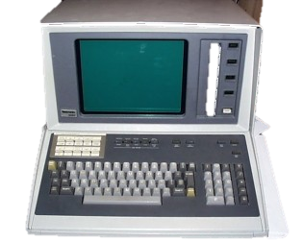
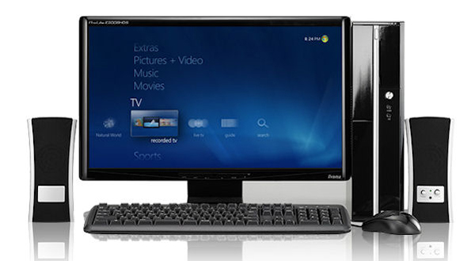
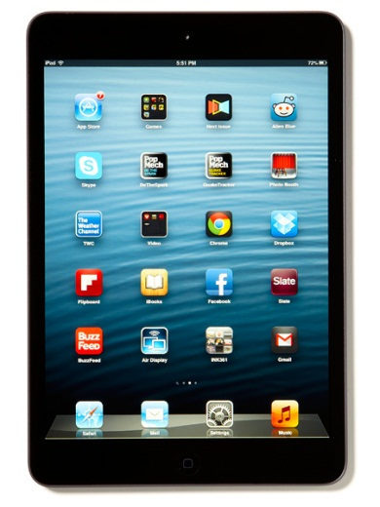
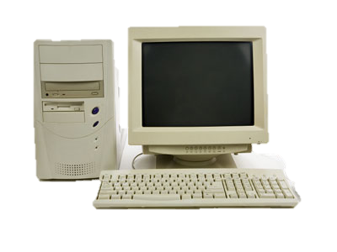
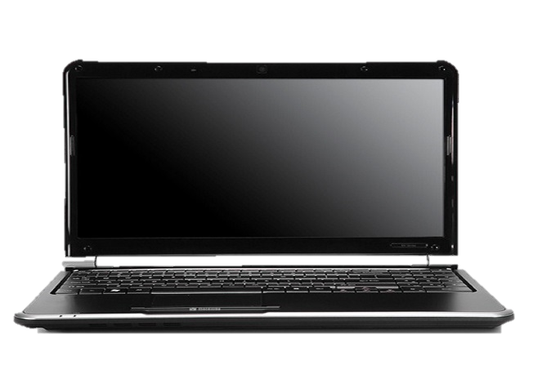
Types of computers

Slide 3
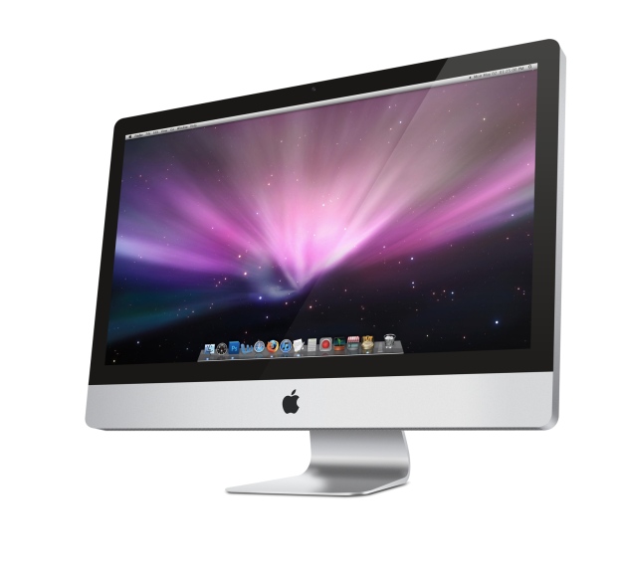
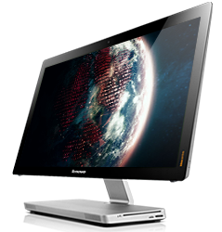
Types of computers
Windows/PC
Mac/Apple
VS.
Windows
Manufacturers that make personal computers: (many) Toshiba, Asus, Acer, HP, Dell, Gateway, Samsung, Lenovo and Sony.
Mac OS
Only one manufacturer makes Apple computers- Apple
Image taken from bing.com
Image taken from lenovo.com

Slide 4
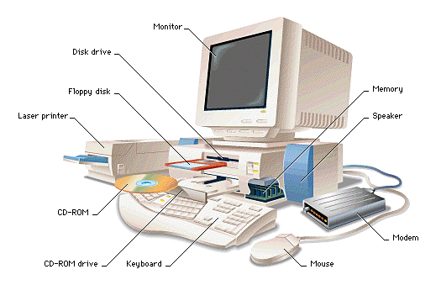
Computer parts

Slide 5
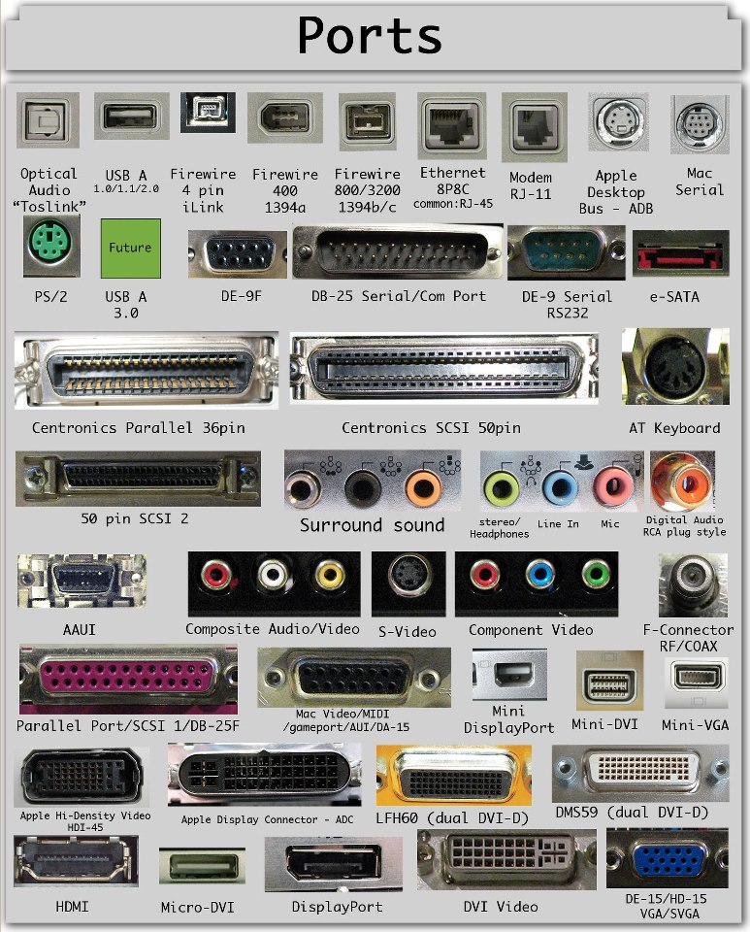
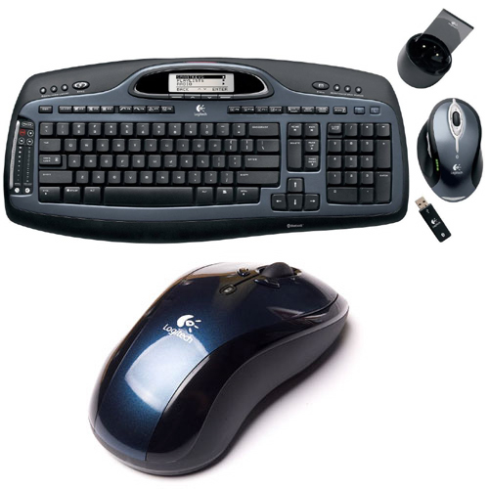
Computer ports and peripherals
Ports
Peripherals
Image taken from removeandreplace.com

Slide 6
Overview of Microsoft Office Applications
Access- database
Outlook- e mail, calendars
PowerPoint- presentations
Excel- spreadsheets; organize, store, manipulate data
Publisher- Forms, templates, greeting cards
Word- What do YOU use Word for?

Slide 7
What is the Operating System (OS)
“It is the most important program on a computer. Every general-purpose computer must have an operating system to run programs… Operating system perform basic tasks, such as recognizing input from the keyboard, sending output to the display screen, keeping track of files and directories on the disk, and controlling peripheral devices such as disk drives and printers.” –webopedia.com
Some examples of popular modern OS are Windows, Linux, Mac OS X, and Unix.

Slide 8
Features of operating system
Desktop- what you see on the screen when you first start your computer
Windows explorer- File manager application and navigation tool. It serves as interface for accessing the filing system.
Taskbar- fixed strip along the bottom of screen showing icons for each running application, pinned applications and notification area
Search- find folders or files by using search techniques

Slide 9
E-mail Basics
Why have an email address?
Samples of inappropriate addresses for business purposes
        johnandmary@ymail.com
        haveablessedday@gmail.com
What are more professional options?
        Any ideas?
gmail.com, yahoo.com, live.com, hotmail.com, ccri.edu, uri.edu
Let’s get you an email address

Slide 10
Department of Labor Disclaimer
This product was funded by a grant awarded by the U.S. Department of Labor’s Employment and Training Administration. The product was created by the grantee and does not necessarily reflect the official position of the U.S. Department of Labor. The Department of Labor makes no guarantees, warranties, or assurances of any kind, express or implied, with respect to such information, including any information on linked sites and including, but not limited to, accuracy of the information or its completeness, timeliness, usefulness, adequacy, continued availability, or ownership.

