Slide 1

Marketing to Leverage PLA to Enroll More Adult Students

Slide 2


Where most colleges market

Slide 3
The Hidden Higher Education Market
Many more adults than high school grads
Source for High School Graduates: National Center for Education Statistics. 2012-2013 school year. https://nces.ed.gov/programs/projections/projections2021/tables.asp
Source for Adults with some college and no degree: Lumina Foundation. http://strongernation.luminafoundation.org/report/

Slide 4

Can We Make the Shift?
To enroll more adult students
To give more people access to education

Slide 5
How Does This Relate to PLA?
87%
of Americans think students should be able to receive college credit for knowledge and skills acquired outside the classroom
75%
would be more likely to enroll in higher ed if they could receive credit for what they already know
Lumina Gallup Poll: America’s Call for Higher Education Redesign – Feb 2013.

Slide 6
Think (and Talk) Like a Marketer

Slide 7
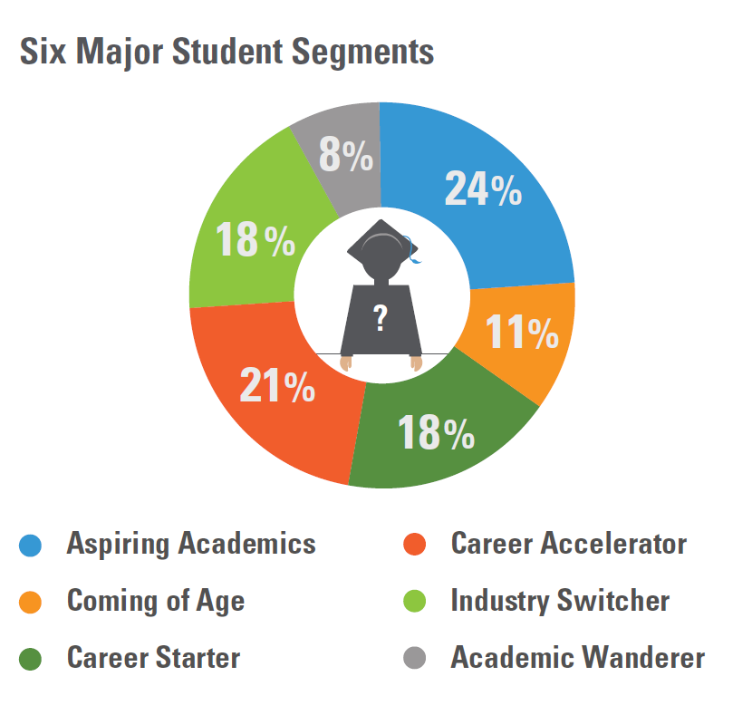
Thinking About Personas
Source: The Parthenon Group, “The Differentiated University

Slide 8
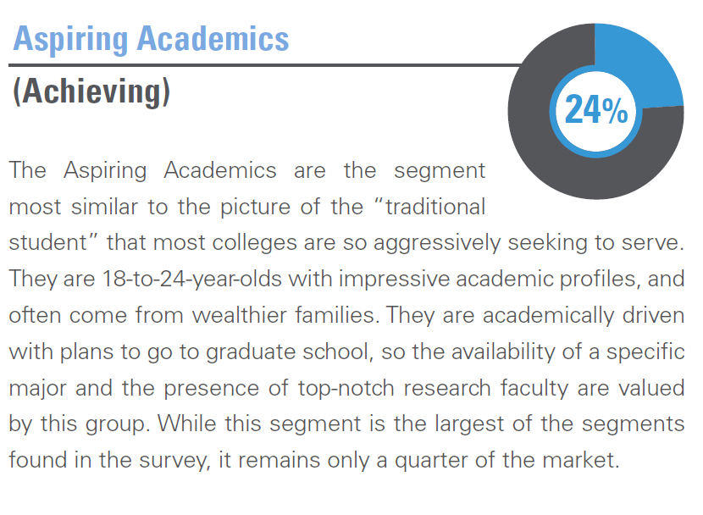
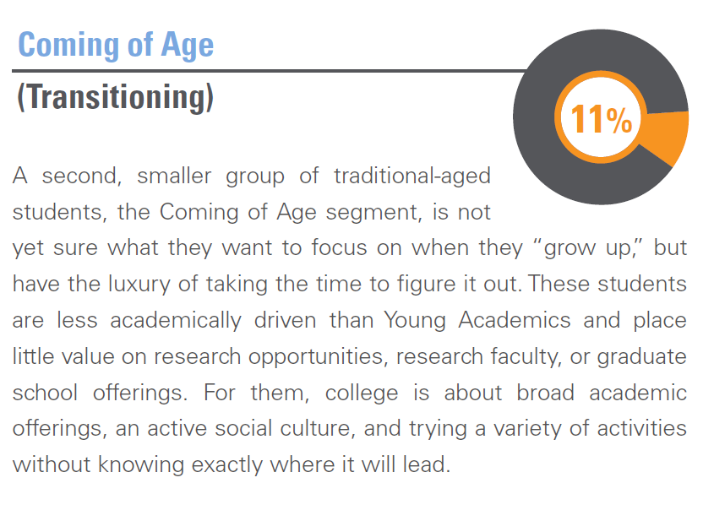
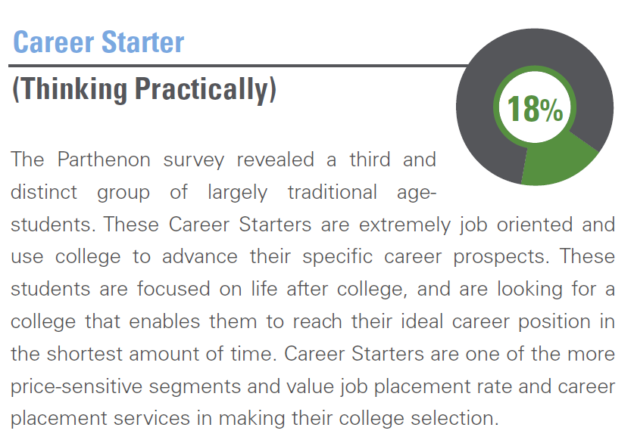
Thinking About Personas
Personas most colleges are targeting.
Source: The Parthenon Group, “The Differentiated University

Slide 9
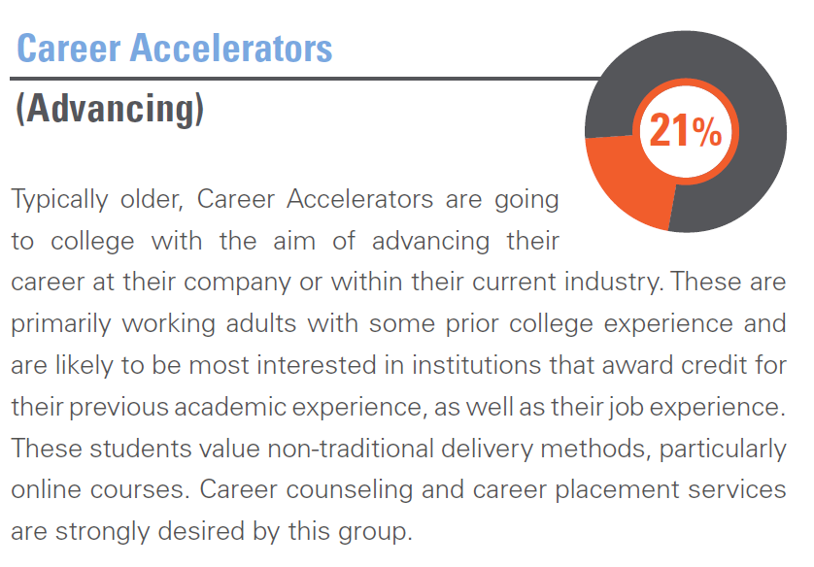
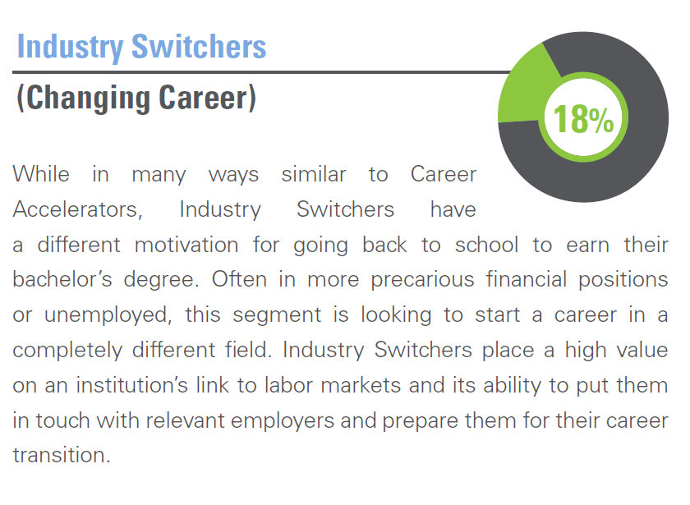
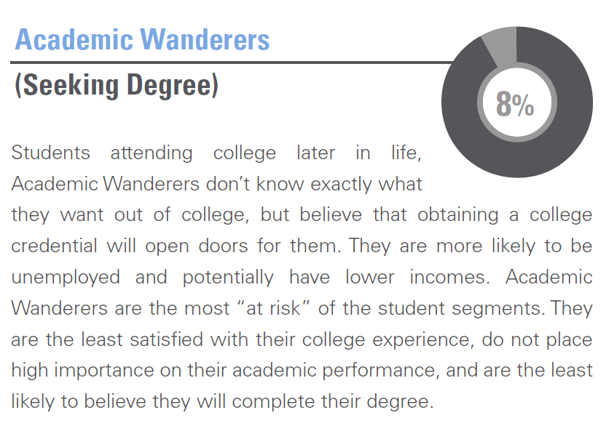
Thinking About Personas
Personas for most adult learners.
Source: The Parthenon Group, “The Differentiated University

Slide 10

You Know a Someone Who Needs a Degree
1 in 5 American adults has some college credits, but no degree
Describe an adult learner you know. What is this learner’s background? Family situation? Work experience?

Slide 11
Who Do You Want to Target?
In marketing, there are endless ways to spend money. To use resources wisely, marketers must “target” certain markets.
Where are your best prospects?
  Some college no degree
  In certain local industries
  Distance from college

Slide 12
Finding Your Target Market
Variables:
Age – 25-34, 35-44
Degree attainment, high school degree, some college, no degree (“low-hanging fruit” because have college experience, may not have long to go before degree or credential attainment, Prior Learning Assessment likely to be the most benefit to this group)

Slide 13
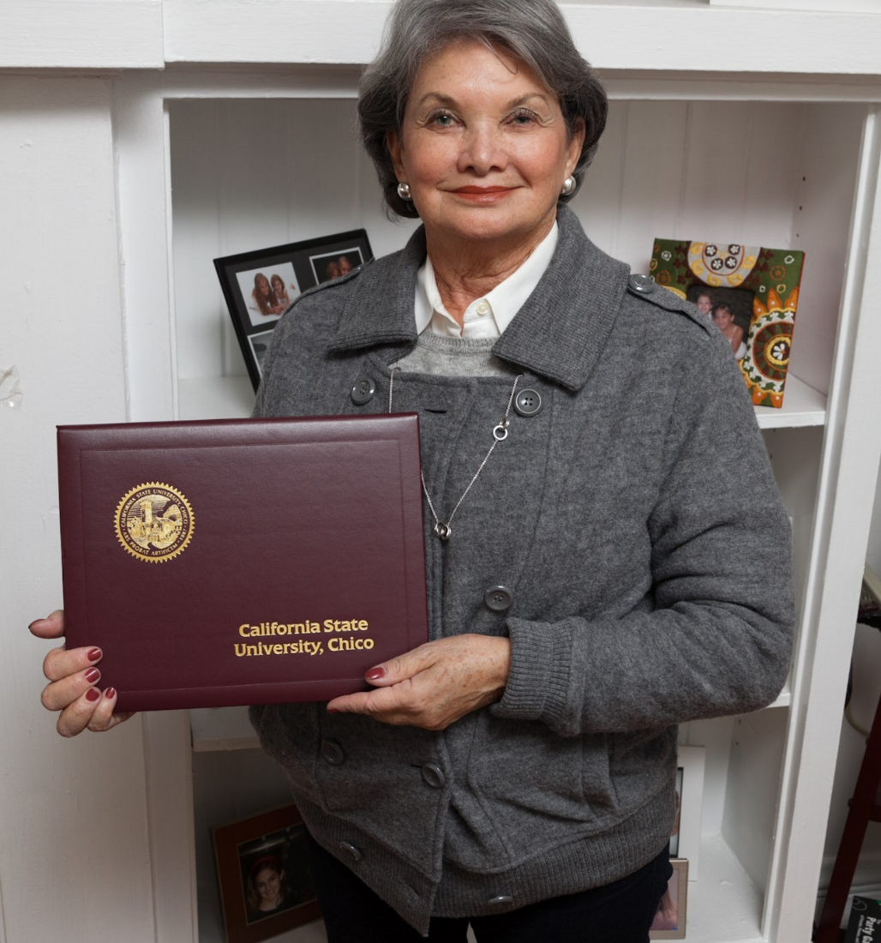
Your Current Student Population
Have you analyzed your current student population?
  How many are over 25 years old?
  What percentage is that of the total population?
  How many are enrolled in online or blended classes?
  Consider race, ethnicity and gender breakdowns
YOU MIGHT BE SURPRISED!

Slide 14
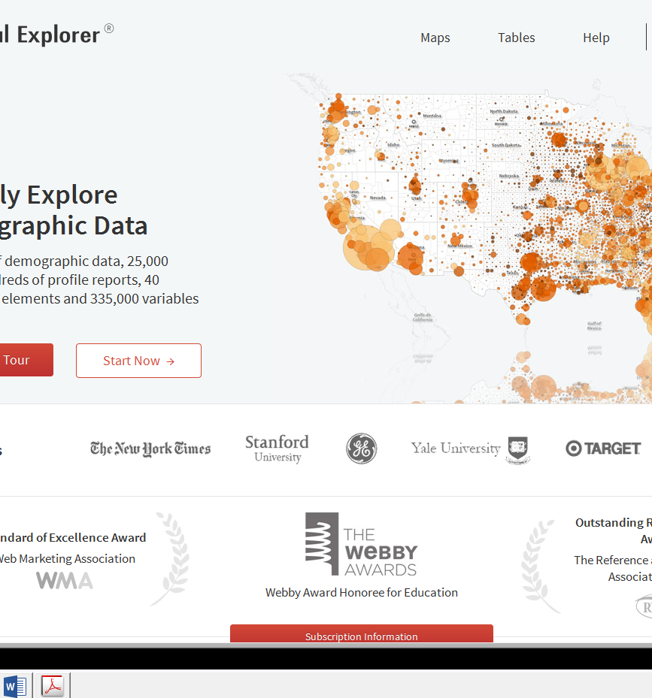
How to Reach the Target Audience
We’re not in high schools anymore…
Using Social Explorer
Notes:
Industries that are appropriate for portfolio assessment:
Business and Management
Information Systems/Technology
Human Resources
Finance/Accounting
Criminal Justice/Legal
Hospitality/Event Management
Healthcare Administration

Slide 15
TARGET: ADULTS
Comparing density of population with some college against population with bachelor’s degrees

Slide 16
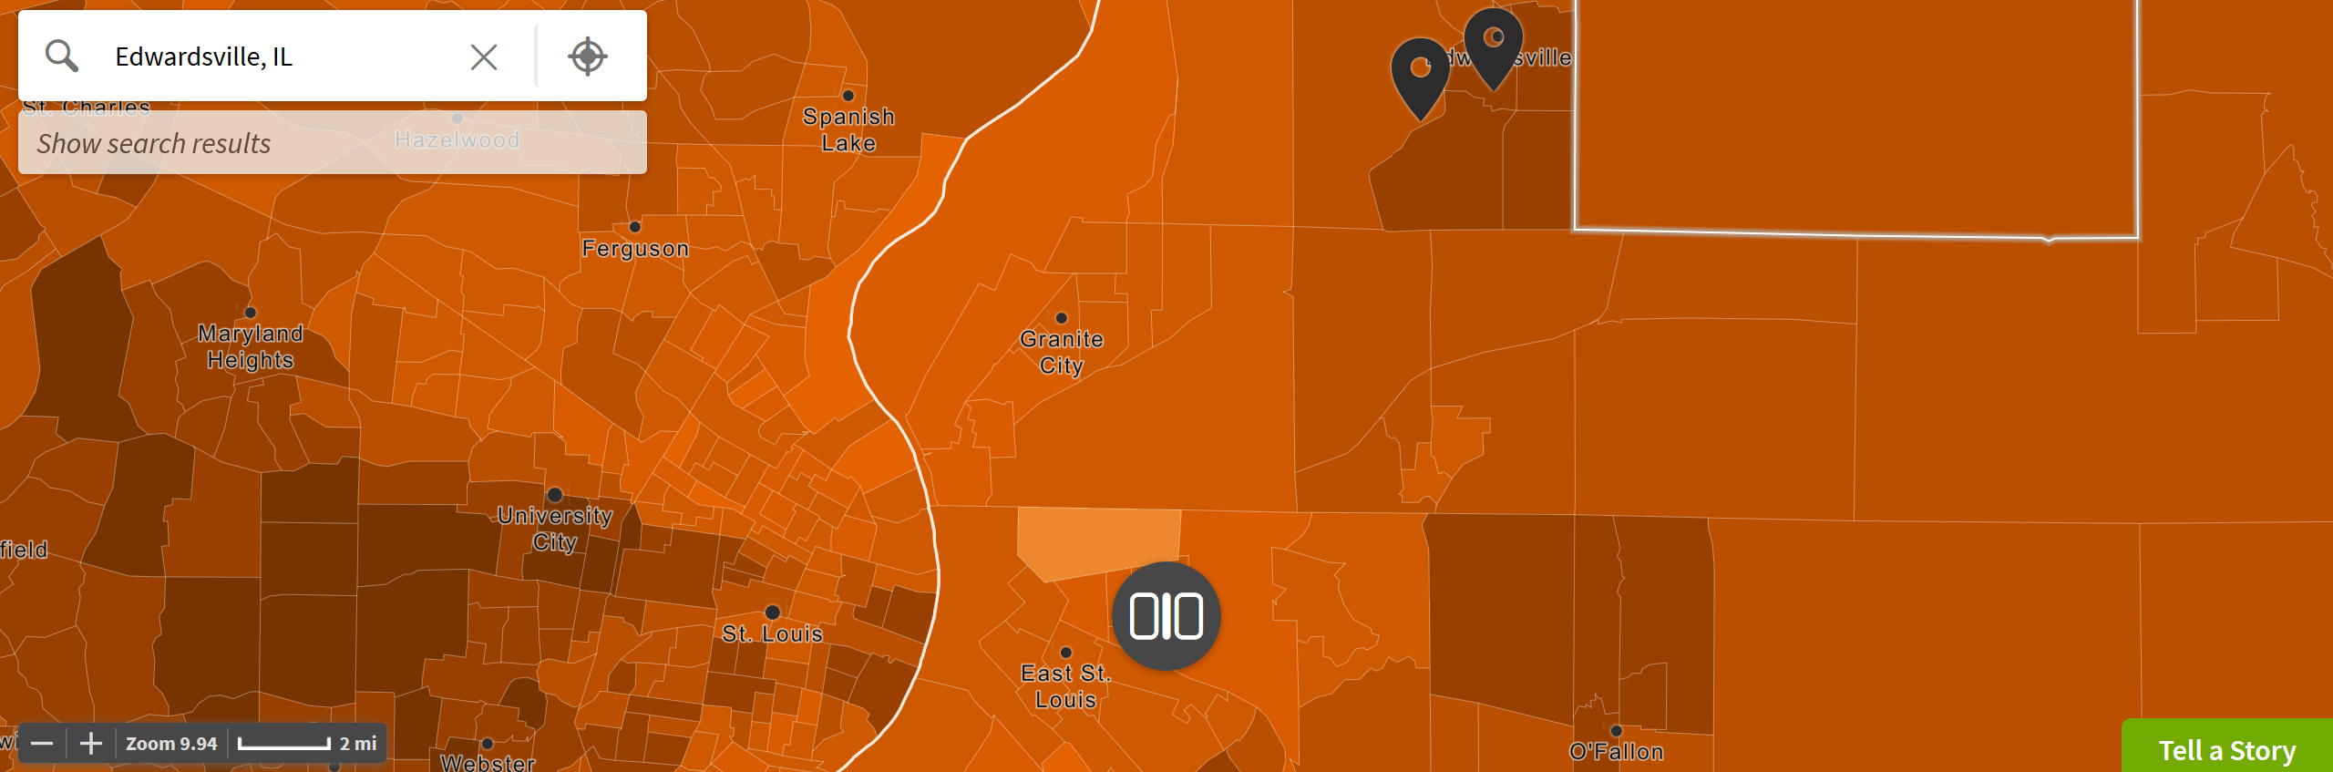
Some College

Slide 17
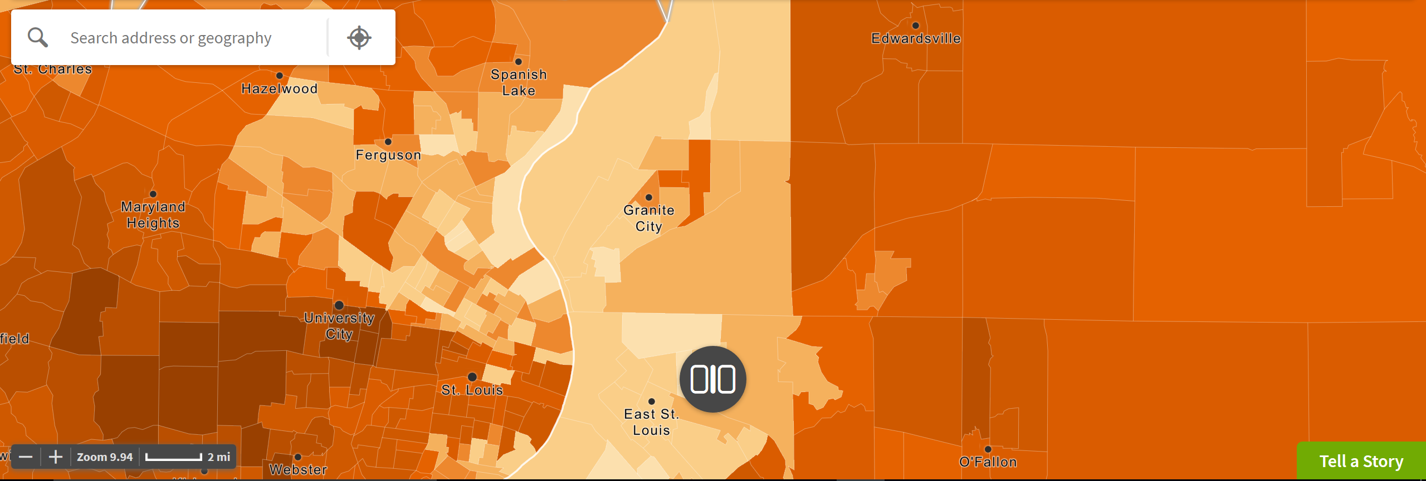
Bachelor’s Degree

Slide 18
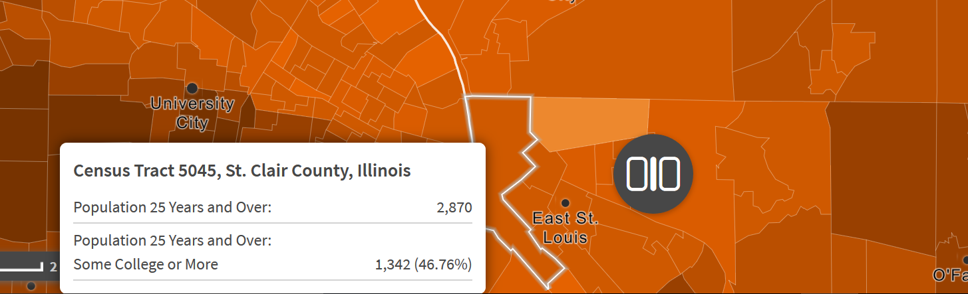
One Census Tract: Some College

Slide 19
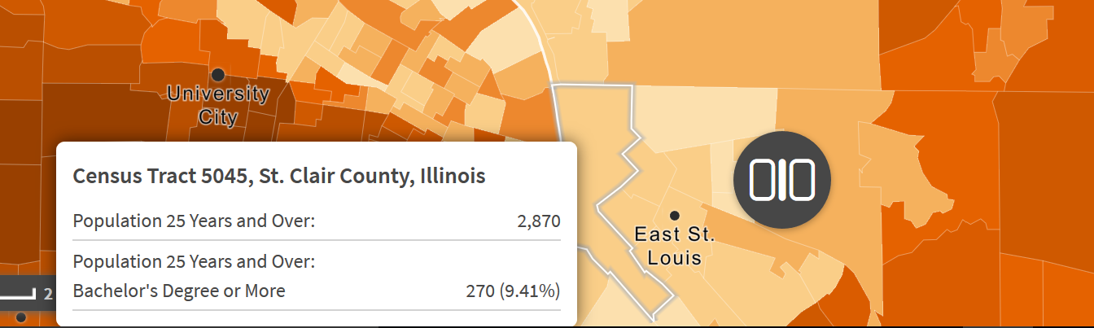
One Census Tract: Bachelor’s Degree

Slide 20
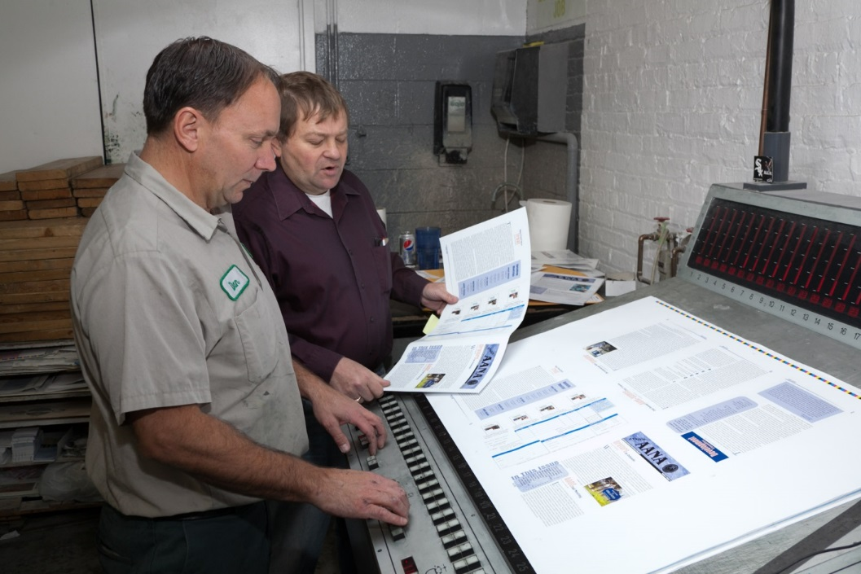
Targeting Employers
Building Illinois' Bioeconomy Consortium Employers:
Do they have frontline employees that need training to move to higher levels?
How could this fit into a marketing strategy?

Slide 21

Tough Choices
This is it.
This is what matters.
The experience of a product.
How it makes someone feel.
But what about PC gamers? Isn’t that a huge market?
Ad answers:
If you are busy making everything,
How can you perfect anything?
If you are not sure about your choice, test, test, test!

Slide 22

Targeting the Market
How Do We Choose Who to Target?
  College Mission
  Location
  Employers
Exercise: Choosing your target markets

Slide 23
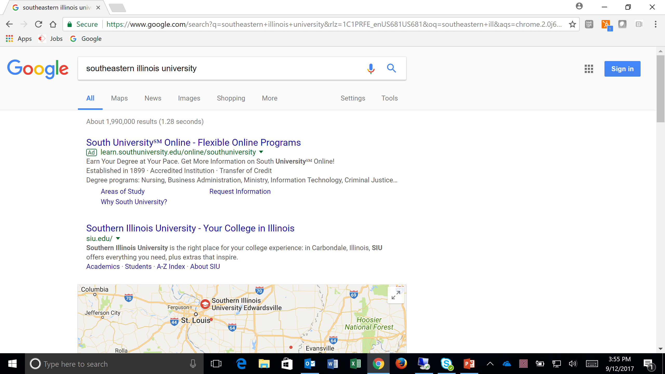
If You Don’t, They Will
Based on location AND online

Slide 24
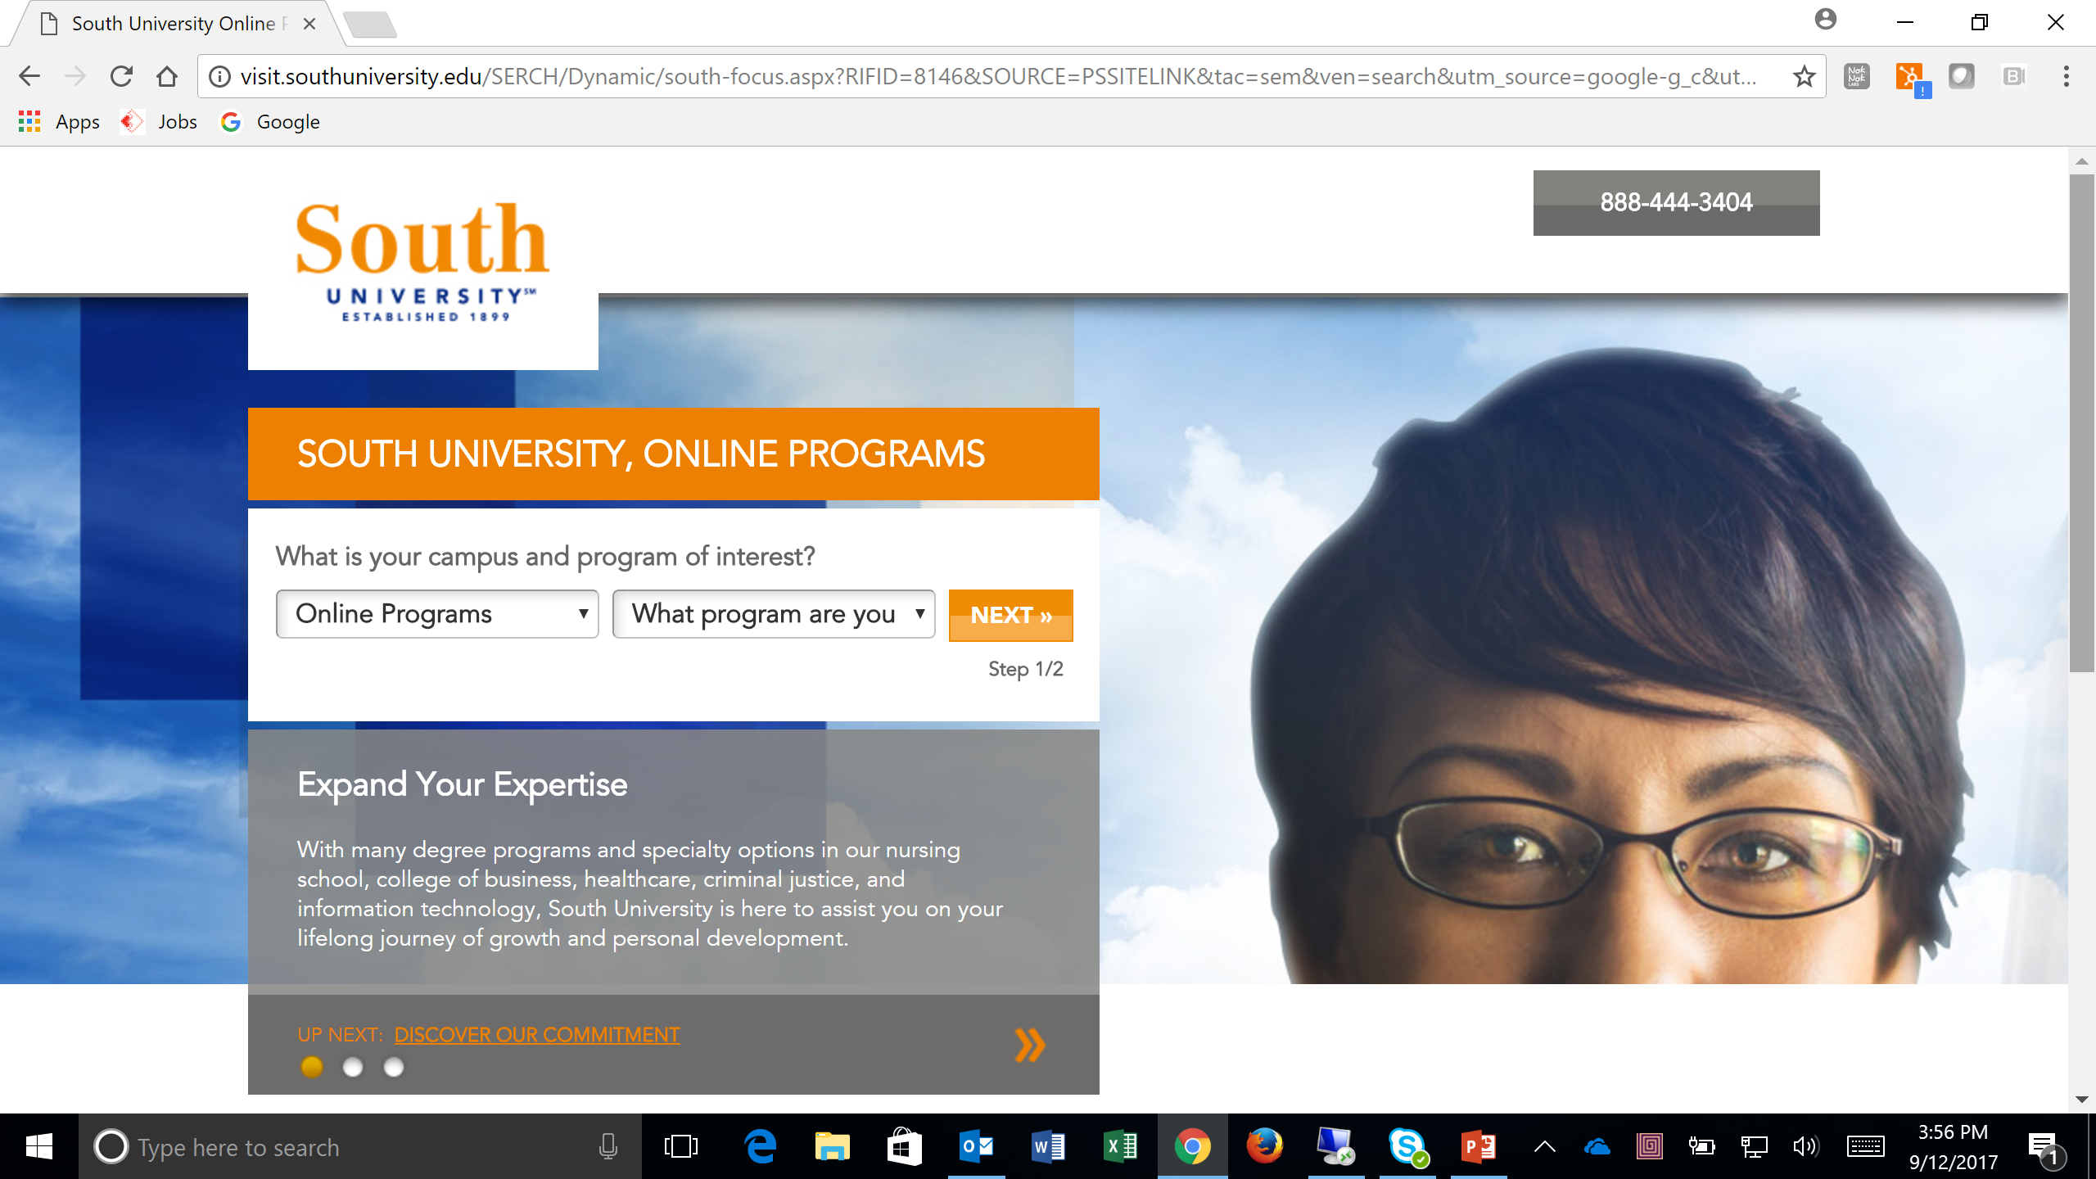
What Are Your Competitors Doing?

Slide 25
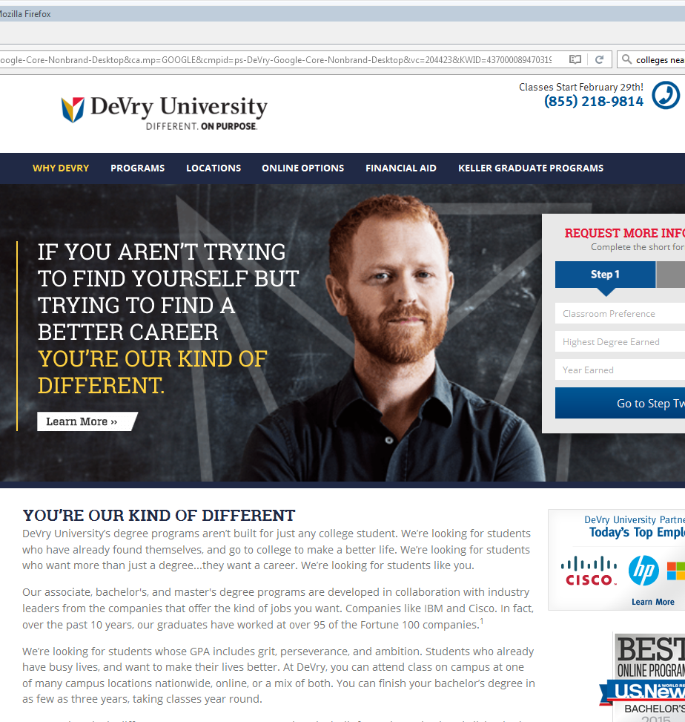
What Are Your Competitors Doing?
What are competitors saying to adults to enroll them?
Do they use adult learner messaging to attract them?
What communication vehicles are they using?

Slide 26
So How Do You Market to Adults?
They are not “coming of age” and often not “aspiring academics”
They are mostly “career accelerators” and “industry switchers”
Notes:
Don’t use “Aspiring Academics” and “Coming of Age” persona language when that isn’t your target audience
Promoting “social culture” like sports and recreational activities is not likely to resonate with the adult audience
Even promoting “top-notch research faculty” may not resonate with this group unless you can connect it to jobs
What appeals to “Career Accelerators”, “Industry Switchers” and “Academic Wanderers”?
Highlight PLA
Highlight degree attainment
Highlight link to employers and jobs

Slide 27
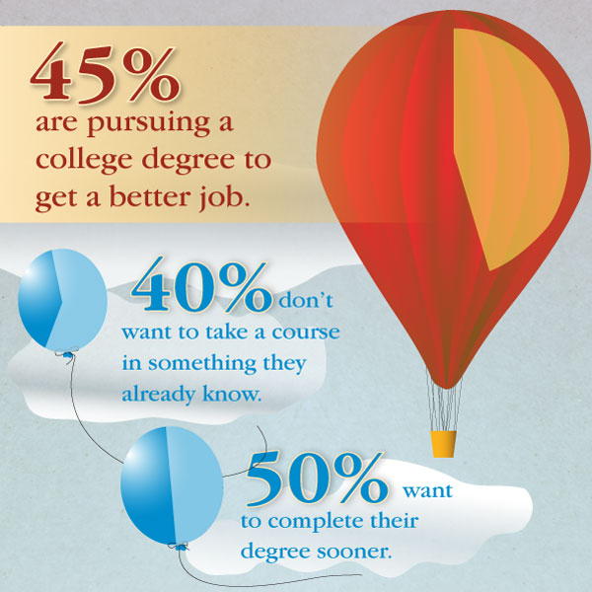
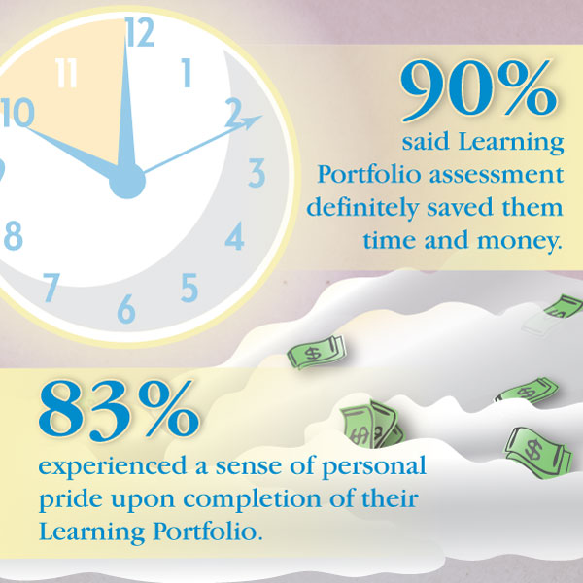
What Do They Care About?

Slide 28
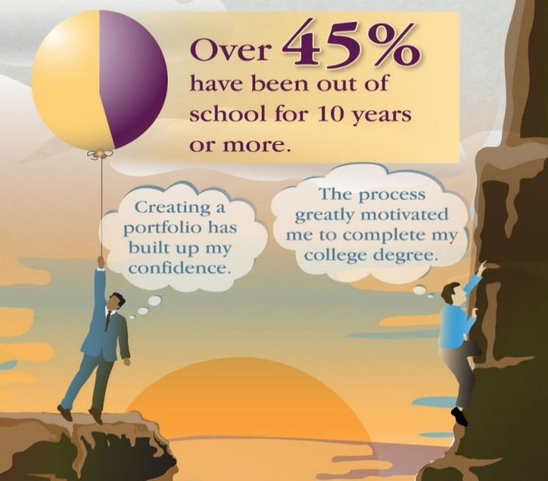
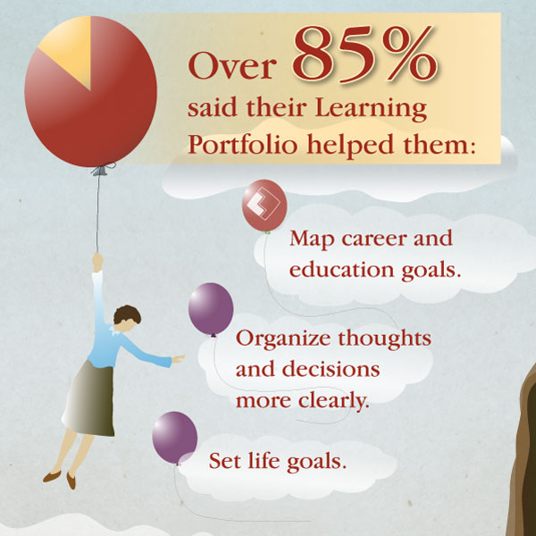
What Are Their Challenges?

Slide 29

Establishing a Niche
What do we do better than them?
What do we have that they don’t?
Now put that in the context of what adults are looking for.
Exercise: Crafting marketing messages

Slide 30
Communication Vehicles
Veteran or Service Member
Direct Mail
Radio/Television/Newspaper Ads
Entertainment Venues
Social Media
Email
Keyword Search and Online Display Ads
Publicity & Media Outreach
Website
Search Engine Optimization and Links

Slide 31

Advertising & Tracking
Google analytics to track results
Google AdWords, Social Media and Search Engine Optimization to drive traffic
Direct mail, inserts and advertising can direct to unique urls
Landing pages for ads

Slide 32
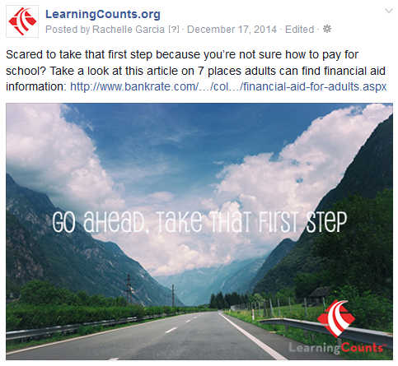
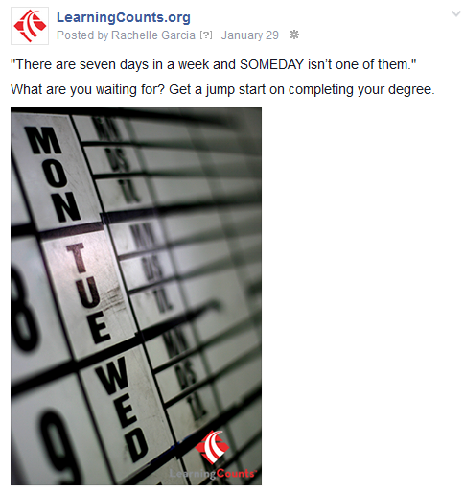

Social Media
Use Social Media to help build awareness around credit for prior learning

Slide 33
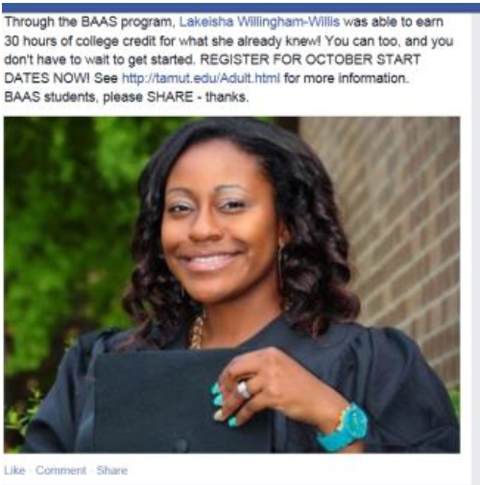
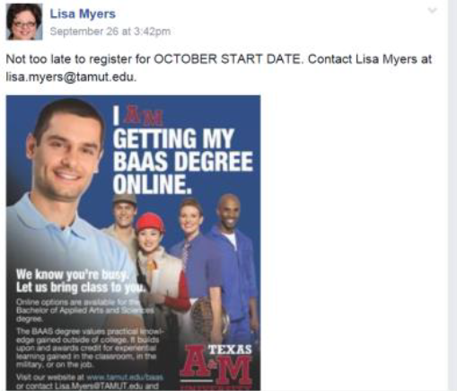
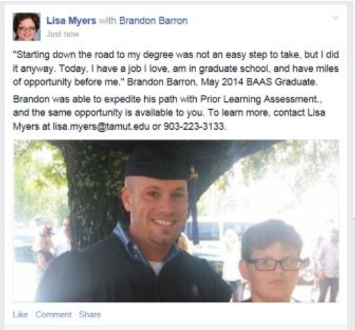
Social Media
Facebook Post Ideas:
Let them know about PLA information sessions.
Share education news stories from online, local, and national media
Show photos of successful PLA students

Slide 34
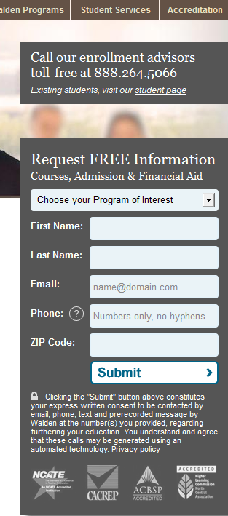
Capturing Leads
Others capture leads right on the home page or landing pages.
Also provide a toll-free number
Discussion: How do you capture leads?

Slide 35

Newspaper
Community Newspapers – higher readership
Targeted to the areas you want to reach
Repeat ads
Messages target to adults
Discussion: What are you doing now?

Slide 36

Direct Mail
Another option is a direct mail campaign targeted to certain zip codes
Cover areas you want to reach
Campaign can be targeted to smaller number, depending on budget
Messages targeted to adults
Discussion: What are you doing now?

Slide 37

Email
The list, the list, the list
Can you purchase something?
Can you separate out adults on your list? Messages targeted to adults
Discussion: What are you doing now?

Slide 38

Let’s Talk List!
Consider:
  Targeting over 25
  Lists of inactive students
  Internal staff
  Timing? One semester in, but still a ways to go
  Employer partners

Slide 39

Radio
Target by age group
Consider reach
Consider online radio
Messages targeted to adults
Discussion: What are you doing now?

Slide 40
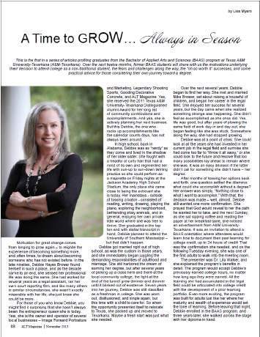
Public Relations
Develop relationship with a local editor
Community publications often crave “local boy/girl does good” stories. You are one of the few reputable sources able to provide those

Slide 41

Public Relations
Announce your PLA program to the media
Time the release with peak enrollment periods

Slide 42


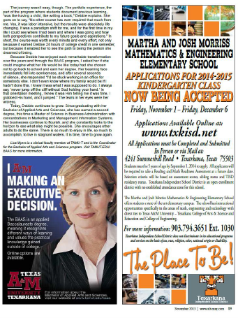
What Have You Seen Lately?
Share some recent promotions from your college that could have been more adult-friendly
Think of some that could have incorporated a PLA message

Slide 43

Where Are You Already Marketing?
Can adults be incorporated into your existing marketing plan?
  Change your messaging
  Add PLA to your messaging

Slide 44
A PLA Example from Ivy Tech

Slide 45
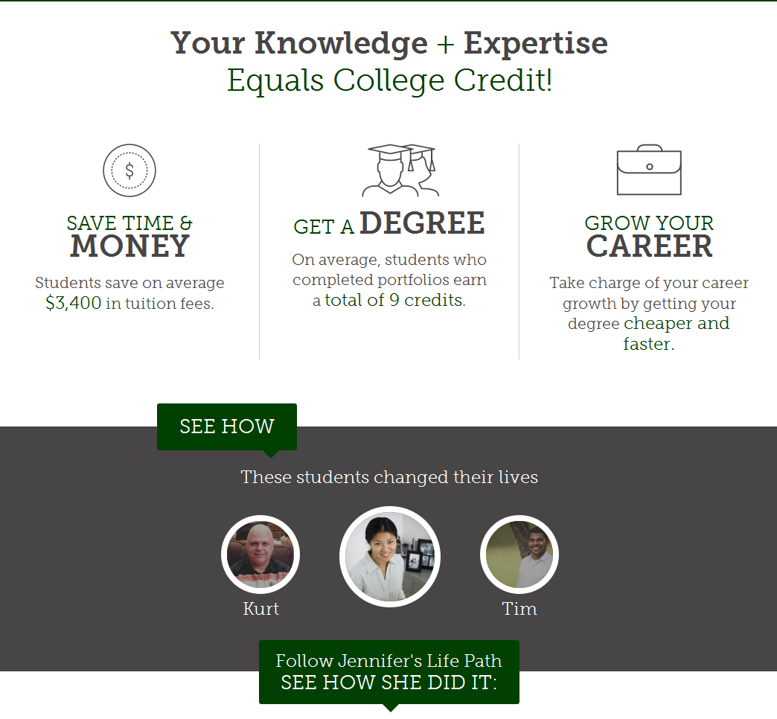
Ivy Tech’s PLA Landing Page
For advertising campaigns

Slide 46

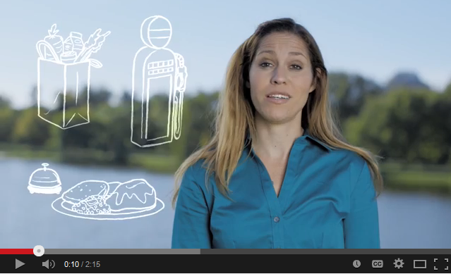
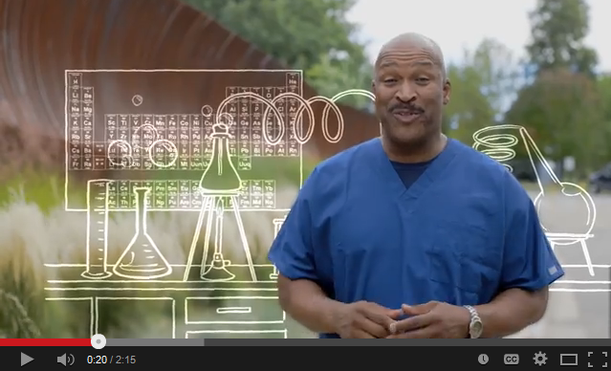
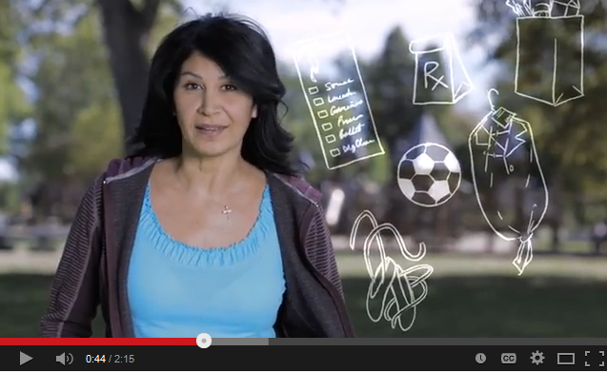
Link to CAEL’s Video
Video highlights the benefits of PLA and gives examples.
Available to all campuses
Includes PLA Video

Slide 47
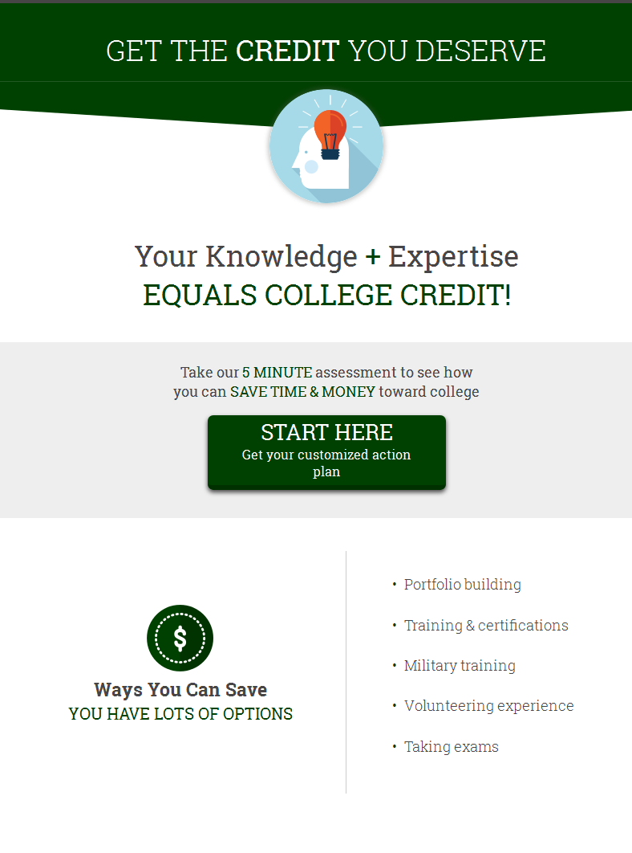
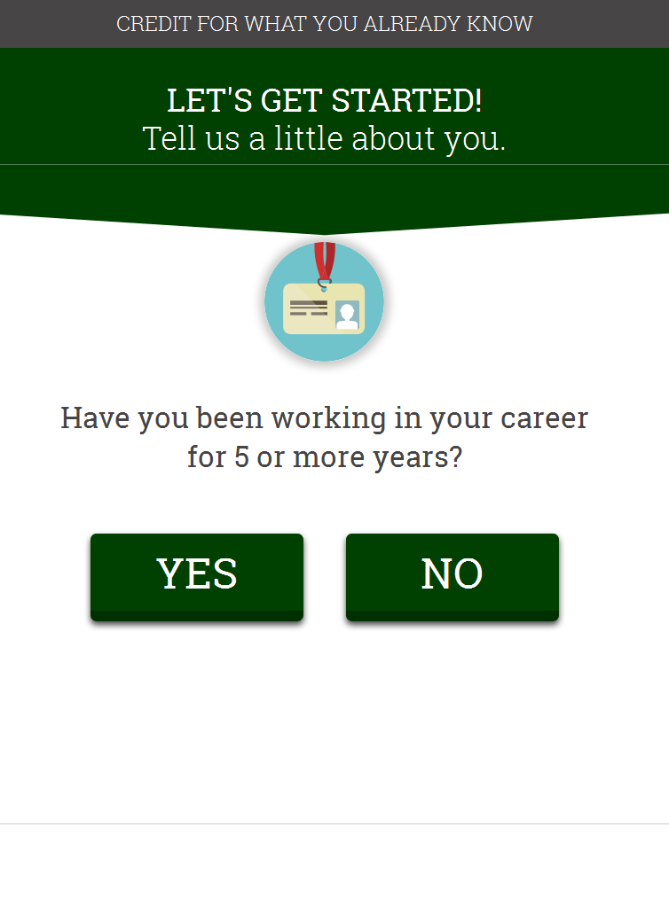

Ivy Tech Credit Predictor
Used for lead generation – prior to enrollment.
Alternative link in ad campaigns

Slide 48
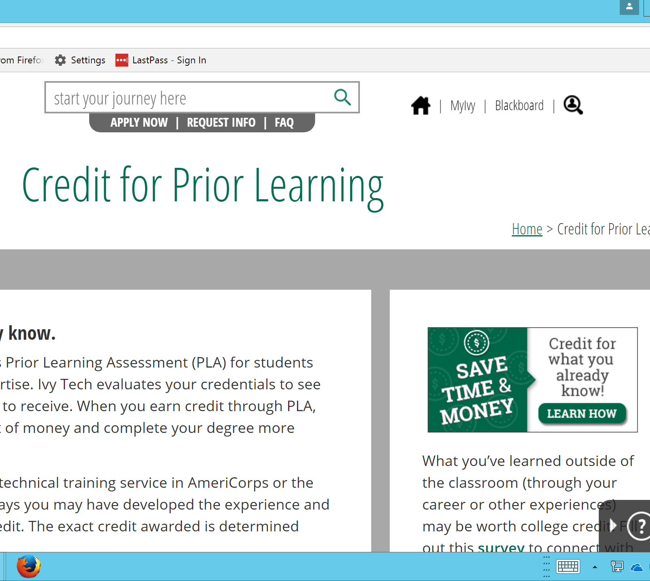

Button Links from Website
Capture leads and route interested students properly
Admission and enrollment direct students here too

Slide 49
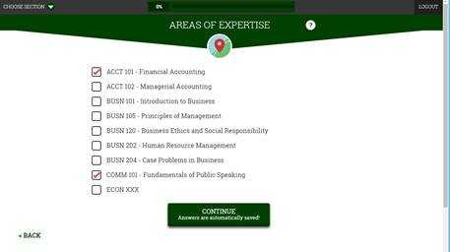
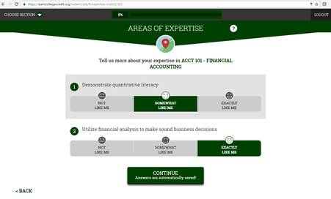
Ivy Tech PLA Accelerator
To streamline PLA advising

Slide 50

Budget Considerations
Keys to keeping costs low:
Leverage what you are already doing
  What campaigns are in play now? Can they be tweaked to include messages on that highlight PLA?
Target the audience well
  What’s the right mix between adult prospects and traditional-aged prospects?
  Where are you marketing now? Is your target audience for PLA there?

Slide 51

Decision Point
Which communication vehicles will you use to reach adult learners in your selected target audience?
How will you change your communication vehicles to reach them?
  Website
  Online advertising, SEO and social media
  Newspaper
  Direct mail
  Email
  Radio
  Public relations
Exercise: Communication Vehicles and Purpose

Slide 52
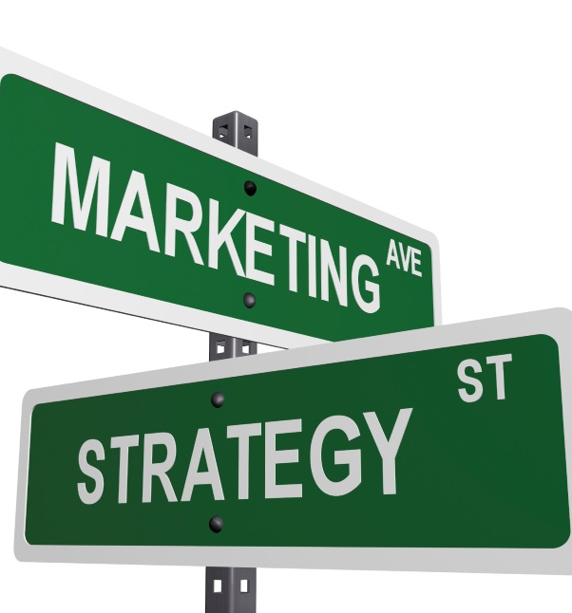
Summary
There is a huge market. Find the adults!
Change your messages and imagery. Mention PLA!
Use lots of communication vehicles.

