Slide 1
Clinical Lab Dilutions
MLT 241 Intro to Clinical Chemistry
SLO IX. Calculate mathematical manipulations and problems for basic math, the metric system, and dilutions

Slide 2
Major reasons for using dilutions
Dilution of specimens
  Specimen has larger amount of a substance than what can be measured accurately
  Interfering substance in the specimen that may possibility be diluted enough to be insignificant
Making a working solution from a stock solution
  Preparation of a weaker solution from a stronger solution

Slide 3
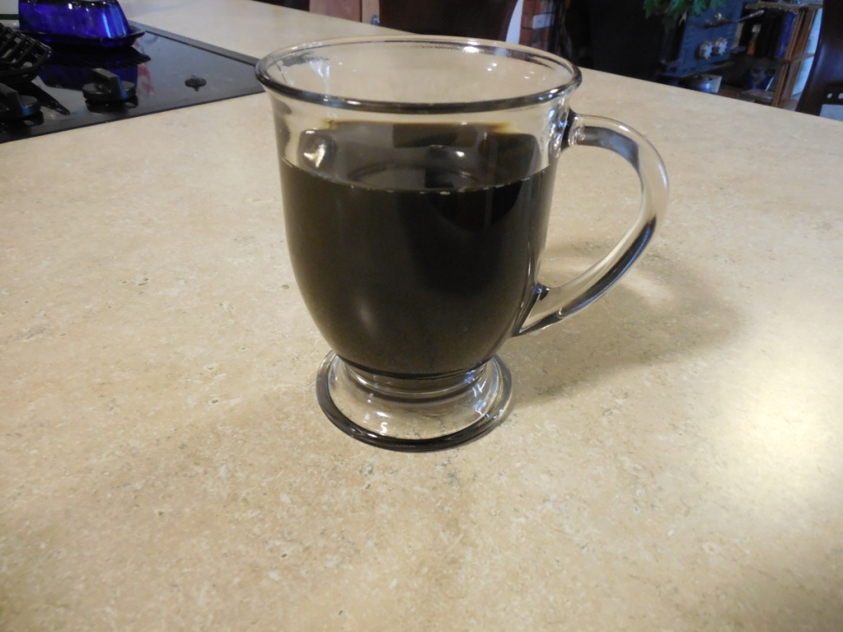
Morning Coffee for instance
Sometimes my morning coffee is just too strong for me.

Slide 4
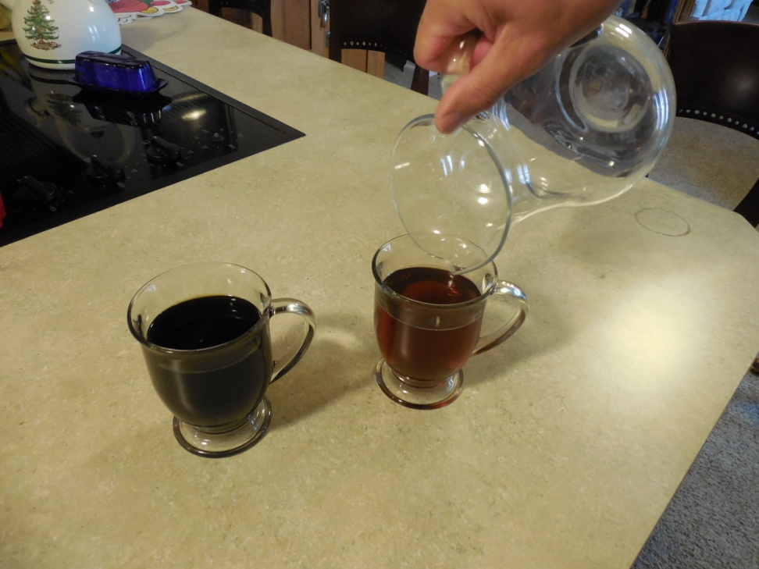
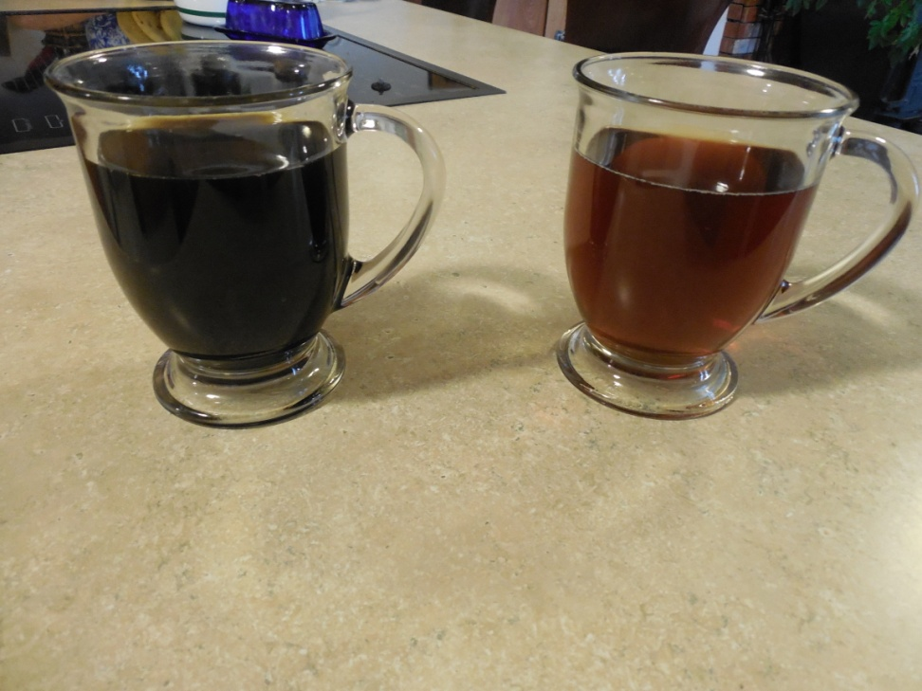
I can dilute it with more water. I still have the coffee but by increasing the volume I can make the coffee weaker. You can see that the coffee is more dilute with your own eyesight

Slide 5
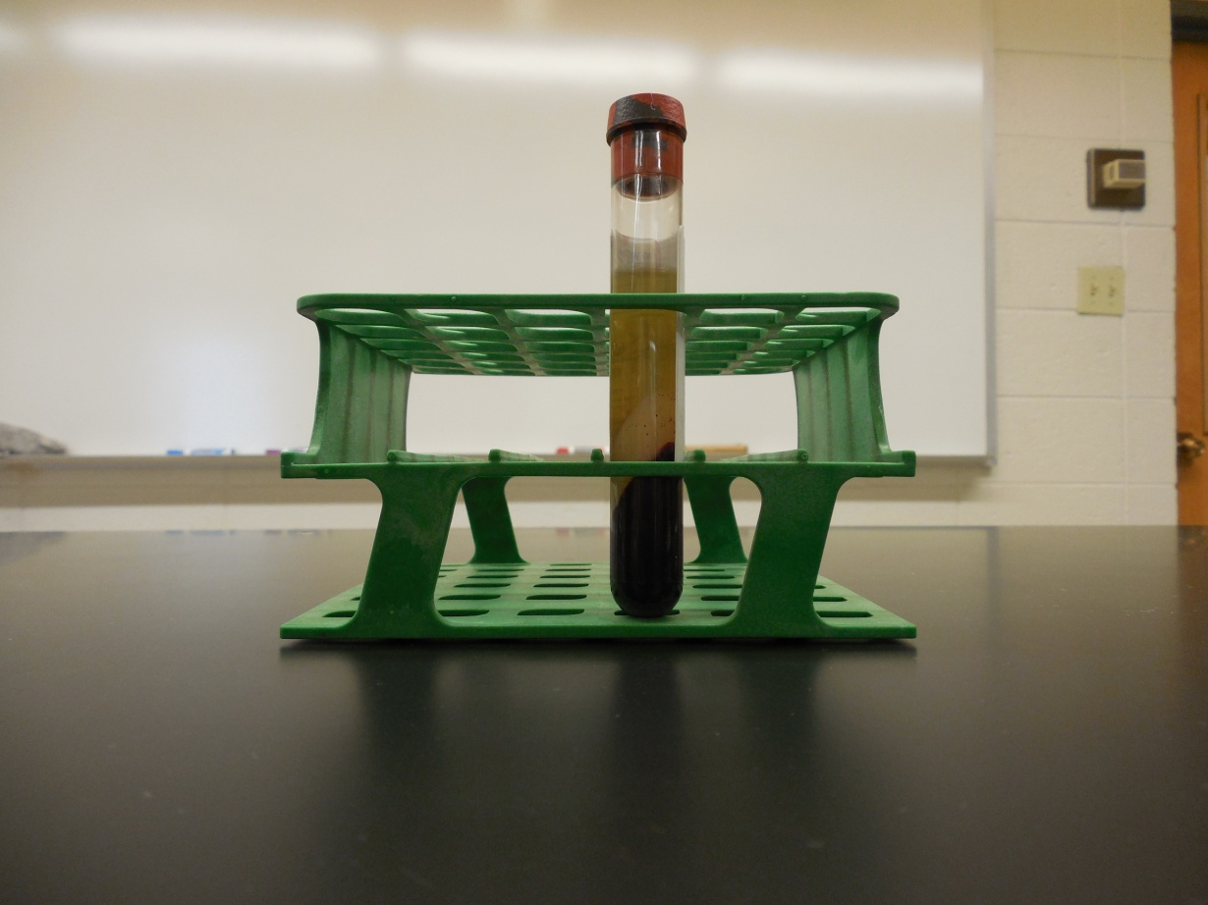
Lab report:
GLUCOSE: >700 mg/dl
That is what we are doing when we dilute a specimen that needs to be tested for a certain analyte but is too “concentrated” for our instruments to measure it with accuracy.

Slide 6
Dilution of a specimen
So we have an unknown amount of an analyte – lets use glucose for example. We want to measure a diluted sample of this and calculate how much of the analyte is in the original.
A simple dilution uses this formula
Sample volume
Sample volume +diluent volume
So a 1:2 dilution has 1 part sample and 1 part diluent
A 1: 10 dilution has 1 part sample and 9 parts diluent

Slide 7
Error Alert!
DON’T make an error by forgetting the fact that the denominator or the formula includes both the volume of the sample and the volume of the diluent!!!

Slide 8
Lets try diluting it in half.
From a previous slide we have a sample with a glucose of >700 mg/dl. We have to get the concentration less than that for the instrument to read it accurately.
1 to 2 dilution – sometimes written 1:2 or say “1 part in a total of 2 parts”
The dilution factor in this case is 2.
1 ml water and 1 ml serum is now the specimen you will analyze
2 mls total
1 ml serum
1 ml water
You take 1 part serum and 1 part of diluent into a tube and mix
Run this on the analyzer
Multiply the result of this by the factor or 2 in this case

Slide 9
The report you got from the instrument is the diluted sample so you must MULTIPLY the result you got by the dilution factor- this time by 2.
Analyzer’s Initial Report would read:
Patient Name: George J. Smith
ID number: 12252014
DOB 12/24/1949
Glucose: 415 mg/dL HIGH
YOU MUST CALCULATE final result
415 x 2 = 830 mg/dL
Final Report
OJC MLT Laboratory Report
Patient Name: George J. Smith
ID number: 12252014
DOB: 12/24/1949
Glucose: 830 mg/dL Critical HIGH

Slide 10
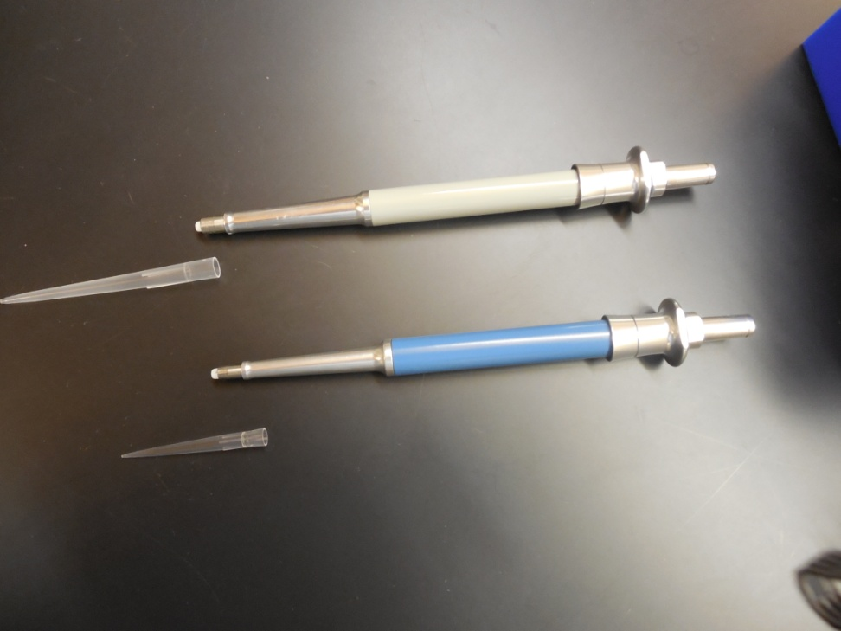
Larger dilution
You need to dilute a sample by 1:10
(1 part in a total of 10 parts)
This time you use 1 part serum and 9 parts water or diluent.
For example:
  100 ul serum
  900 ul water
  Dilution factor = 10

Slide 11
Uric Acid initial report unreadable
Uric Acid final report 140 mg/dL
Put 100 ul of serum and 900 ul of water into a tube and mix
Run the dilution on the analyzer
Take the result and multiply it by 10
Uric Acid reads 14 mg/dL x 10 = Final result 140 mg/dL
Report the final result

Slide 12
Calculation Help
1:5 dilution and we want to end up with 1000 ul of fluid
1/5 = x/1000
5x = 1000
x = 200
To make our dilution we would use 200ul of serum and 1000-200 ul, or 800 ul of water.
200 ul + 800 ul would be a 1 in a total of 5 dilution.
Let’s say that you have decided that you need a 1:5 dilution. The instrument we are going to run this test on needs at least 1 ml(1000ul) of fluid to run the test so how shall we make this dilution. We could use 1 ml of serum and 4 mls of water but we would have 5 mls of fluid and would be using a large amount of our serum. What if we decided to just use 200 ul of our serum

Slide 13
Can only use a specific amount of serum
1:4 dilution needed
¼ = 100ul serum/x amt water
¼ = 100/x
400 ul= x
So we would take 100ul of serum and add it to (400-100ul) or 300ul and you would have a 1:4 dilution
We are short on serum. We need to make a 1:4 dilution. We only have a little over 0.5 ml (500 ul) and we may want to repeat this test al least once. Let’s make our dilution using only 100 ul of the serum.

Slide 14
Diluting for standards
What if we start with a known amount and want to have some other concentration?

Slide 15
The other reason that we often do dilutions is because we need a range of different concentrations of an analyte so we can test the accuracy of our instrument.
Glucose Standard
660 mg/dL
Purchased product
Glucose concentration 330 mg/dL
Made from a 1 to 2 dilution of the standard
Glucose concentration 165 mg/dL
Made from a 1 to 4 dilution of the standard
Glucose concentration
66 mg/dL
Made from a 1 to 10 dilution of the standard
Glucose concentration
33 mg/dL
Made from a 1 to 20 dilution of the standard
Standards are often purchased at the highest concentration an instrument can measure . Then the standard can be diluted, the dilutions calculated and a curve can be made with the data to calculate what an unknown concentration would be. (more on that later)
This is an example of a glucose standard that was purchased at a known concentation – 660 mg/dl. The tech then made several dilutions and then calculated the concentration of each of those dilutions.

Slide 16
Division of the dilution factor
In the case of each dilution used in the previous slide, the tech divided the initial concentration by the dilution factor.

Slide 17
Standard is divided by dilution factor
Standard
660 mg/dL
660 mg/dL / 10
Standard = 66 mg/dL
1: 2 dilution of standard
660 mg/dL / 2
Standard 330 mg/dL
1:4 dilution of the standard
660 mg/dL / 4
Standard = 165 mg/dL
1: 10 dilution of the standard
1:20 dilution of the standard
660 mg/dL / 20
Standard = 33 mg/dL

Slide 18
Additional Practice
A 1:20 dilution needs to be made. How many parts of the serum and how many parts of the diluent will be used?
For your 1:20 dilution, the instrument needs at least 1000 ul total volume. How much serum and how much diluent would you need to do this.
You added 100 ul of serum to 400 ul of water, mixed the sample and ran it for a creatinine. The diluted sample read creatinine: 1.2 mg/dL what is the dilution factor and what is the final result of the creatinine?

Slide 19
Let’s look at these additional practice problems in our next class period
A 250 ug/mL standard is diluted 1:5, 1:10 and 1:25. What is the final concentration of each of the dilutions?
If the 1 to 10 dilution is taken and diluted again by 1:10. What would the final concentration be?

Slide 20
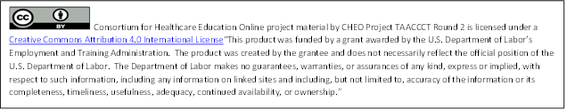
Graphics and Text by Catherine Bollacker, MT(ASCP)
Otero Junior College
MLT Program
La Junta, Colorado

